Slide 1
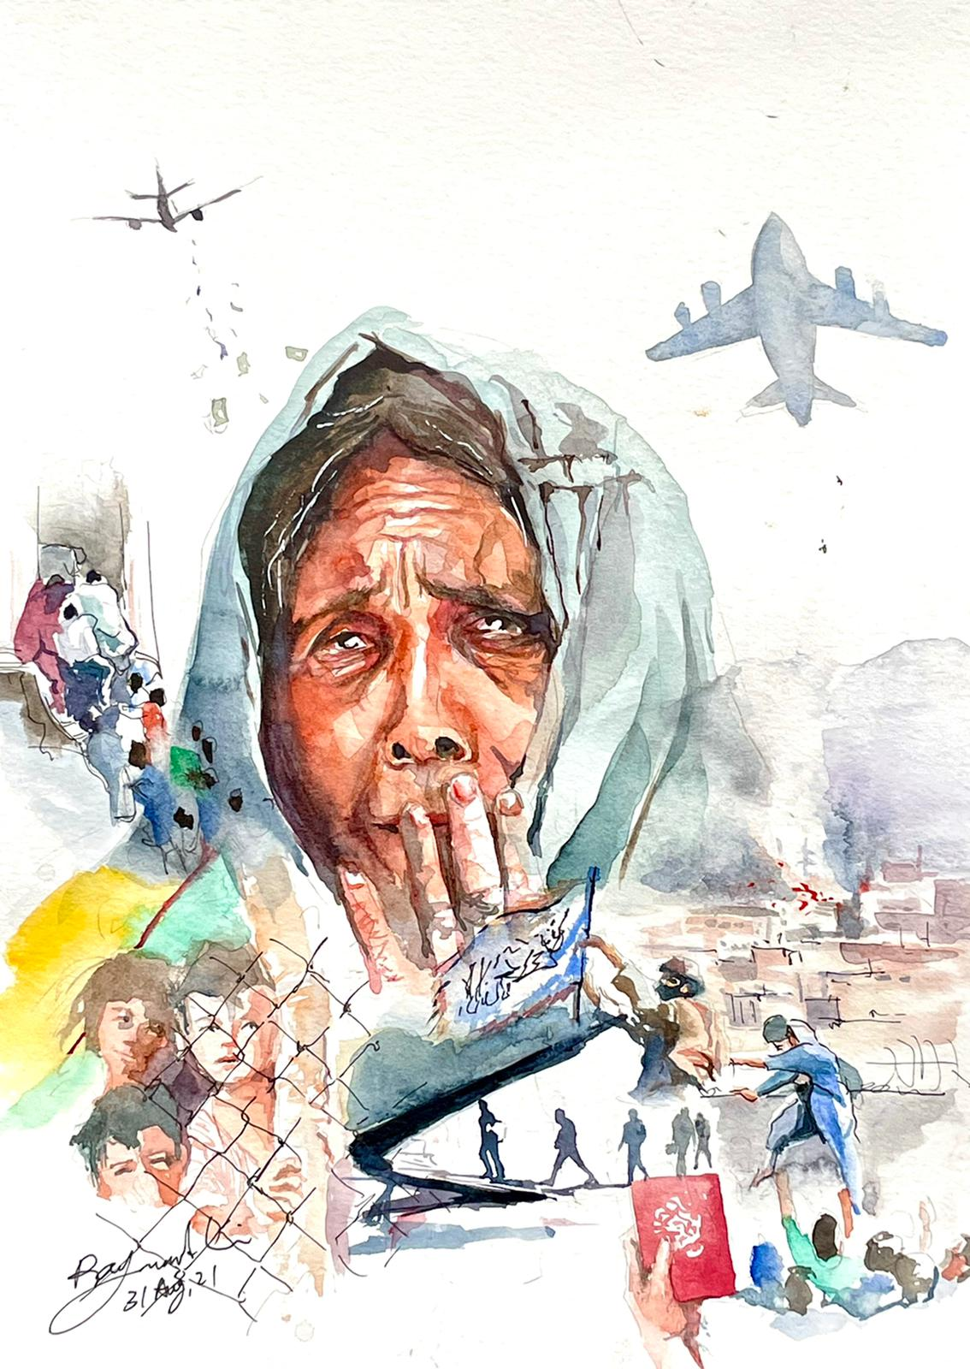
Afghanistan Presentation
21 July 2022

Slide 2
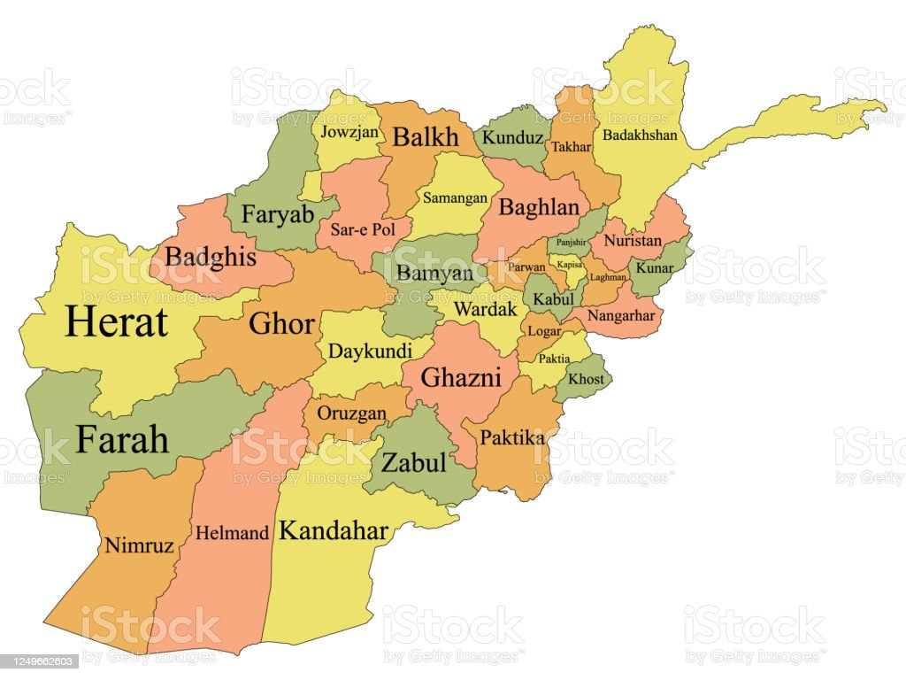
Afghanistan Demography
Afghanistan Population is 40,802,033 (https://www.worldometers.info/world-population/afghanistan-population/)
The nation has suffered 40 years of conflict, natural disasters, chronic poverty and food insecurity.
More than 3.5 million Internally Displaced People (IDPs) live in Afghanistan (as per IOM)
634,800 people were displaced in 2021 alone.
2.6 million registered Afghan refugees in the world, of whom 2.2 million are in Iran and Pakistan alone.
Minority Communities – Pashai, Tajik, Haazara

Slide 3
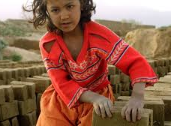
Poverty Statistics
97% of the population may plunge into poverty by mid-2022 (UNDP)
49.4% of the population live below national poverty line in 2020 (ADB)
The proportion of employed population below $1.90 purchasing power parity a day is 35.4% in 2021 (ADB)
28 million people are identified as acutely food insecure.

Slide 4
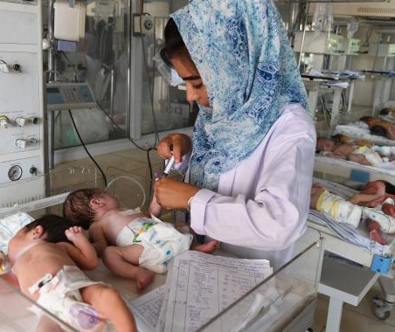
Health Statistics
The country has one of the highest infant mortality rates in the world. As per Statistica, 106.75 is the Infant Mortality Rate (IMR) in 2021.
Maternal Mortality Rate (MMR) is 638 per 100,000 live births. This is preventable.
UNICEF warned that up to 1 million children were at risk of death from malnutrition (January 18, 2022)
https://www.statista.com/statistics/264714/countries-with-the-highest-infant-mortality-rate/
https://www.unicef.org/afghanistan/health

Slide 5
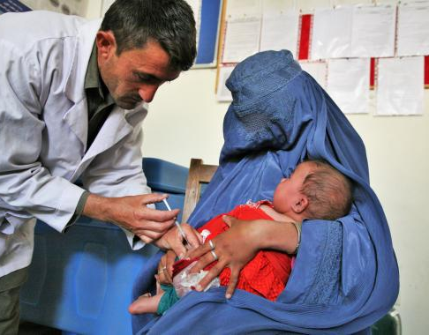
Health Statistics
As per Human Development Index (HDI), Afghanistan is the 21st least developed country in the world.
It is one of the only three remaining countries that has not eradicated Polio.
Life expectancy at birth stands around 64 years (2019).
It has the second lowest health worker density in the Eastern Mediterranean Region (EMR), with a ratio of 4.6 medical doctors, nurses and midwives per 10,000 people, considerably below the threshold for critical shortage of 23 health care professionals per 10,000.
"Global strategy on human resources for health: Workforce 2030". World health Organization. Archived from the original on March 3, 2016. Retrieved 2021-03-10.

Slide 6
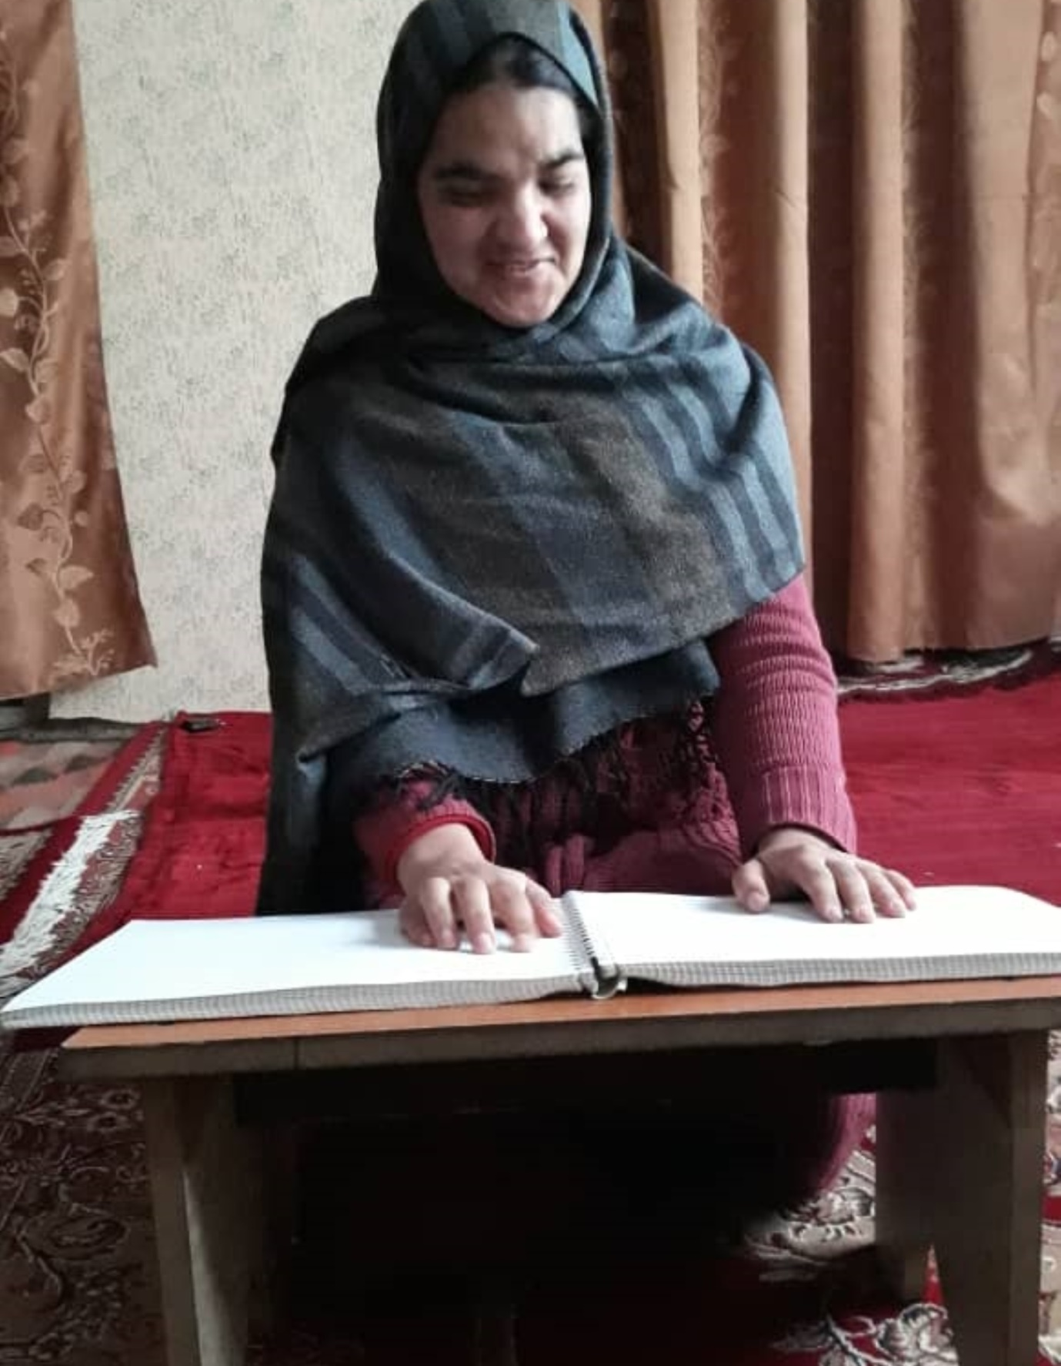
Disabilities
2.7% of population had severe disabilities (2005) or 4.7% if less severe disabilities considered.
One in 5 households has a person with a disability (Francois-Trani, 2003) includes an adult or child with a serious physical, sensory, intellectual, or psychosocial disability.
Reasons for disability
  War, landmines, many due to inadequate healthcare, accidents, malnutrition, and preventable diseases (Francois-Trani, 2003), traditional, close relative inter-marriages,
War veterans accepted and esteemed in social structures; other congenital disabilities are viewed with shame; especially women and children. Considered a source of embarrassment and shame for families leading to PwD marginalisation and deep discrimination.
https://sites.psu.edu/rhs100fa18001/2018/10/04/disability-in-afghanistan-part-1/
https://www.hrw.org/report/2020/04/28/disability-not-weakness/discrimination-and-barriers-facing-women-and-girls

Slide 7
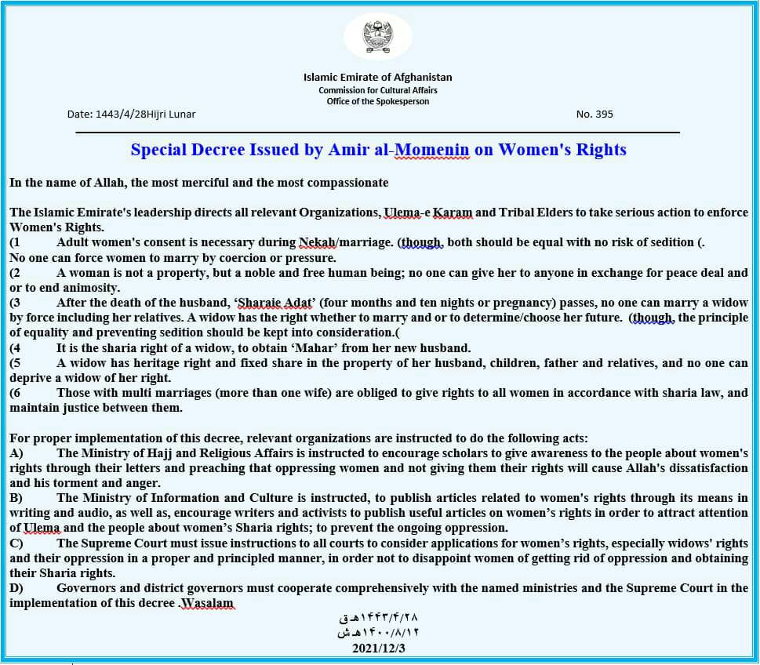
Women situation
Decrees passed on December 3, 2021
  Women cannot be forced to marry against her will. She is not a property. Right to marry after husband’s death, widow has heritage right to husband’s property, father and relative.
Ministry for the Prevention of Vice and Promotion of Virtue guidelines states that women travelling more than 72 km (45 miles) must travel with a Maharam (male relative).
NGO Female staff can work but has to be accompanied by Maharam.

Slide 8
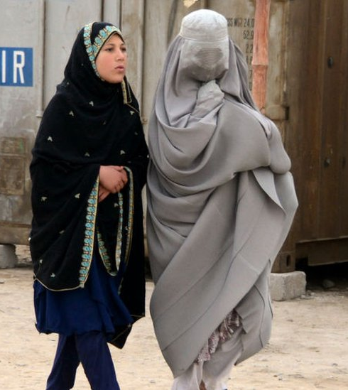
Women situation
Women have to wear Burqa covering even face (but not fully enforced)
Demand is to have separate Office for women and men (some places specifically min. 100 mts distance).
Encourage women staff to be appointed to deal with women issues.
Women are not allowed to travel without Maharam even for short distances; and in flights.
Contrast can be seen in Kabul
More than 200 female judges remain in Afghanistan. They are hiding, according to the International Association of Women Judges.

Slide 9
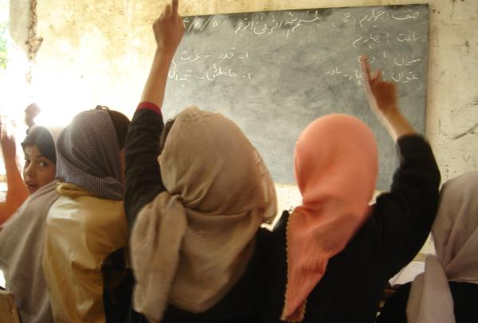
Girl Child situation
Girl child can study upto Grade 6 and not above that.
However, in Kabul, Private Universities have classes for girl students.
Assumptions
  There is a conflict between the groups to allow the girl child to continue to study.
  New regime does not have infrastructure and teachers to teach girls and boys separately.

Slide 10
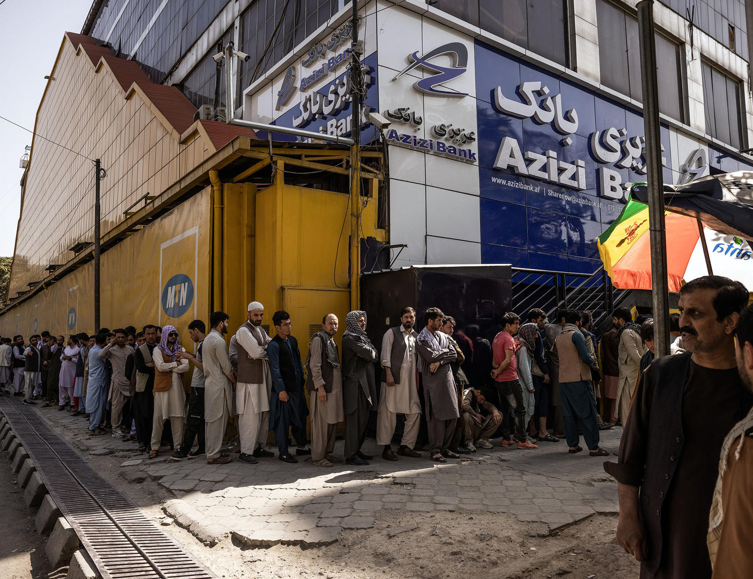
Banking systems
Afghanistan International Bank (AIB) is fully functional.
They have frozen many organization accounts for various reasons. They are not opening any new accounts unless supported by UN organization.
Azizi bank is receiving money but can only release 25% of the total money you transferred in a week. Cannot be trusted.
Money exchangers and hawala system is used. They charge 3 – 9% commission.

Slide 11
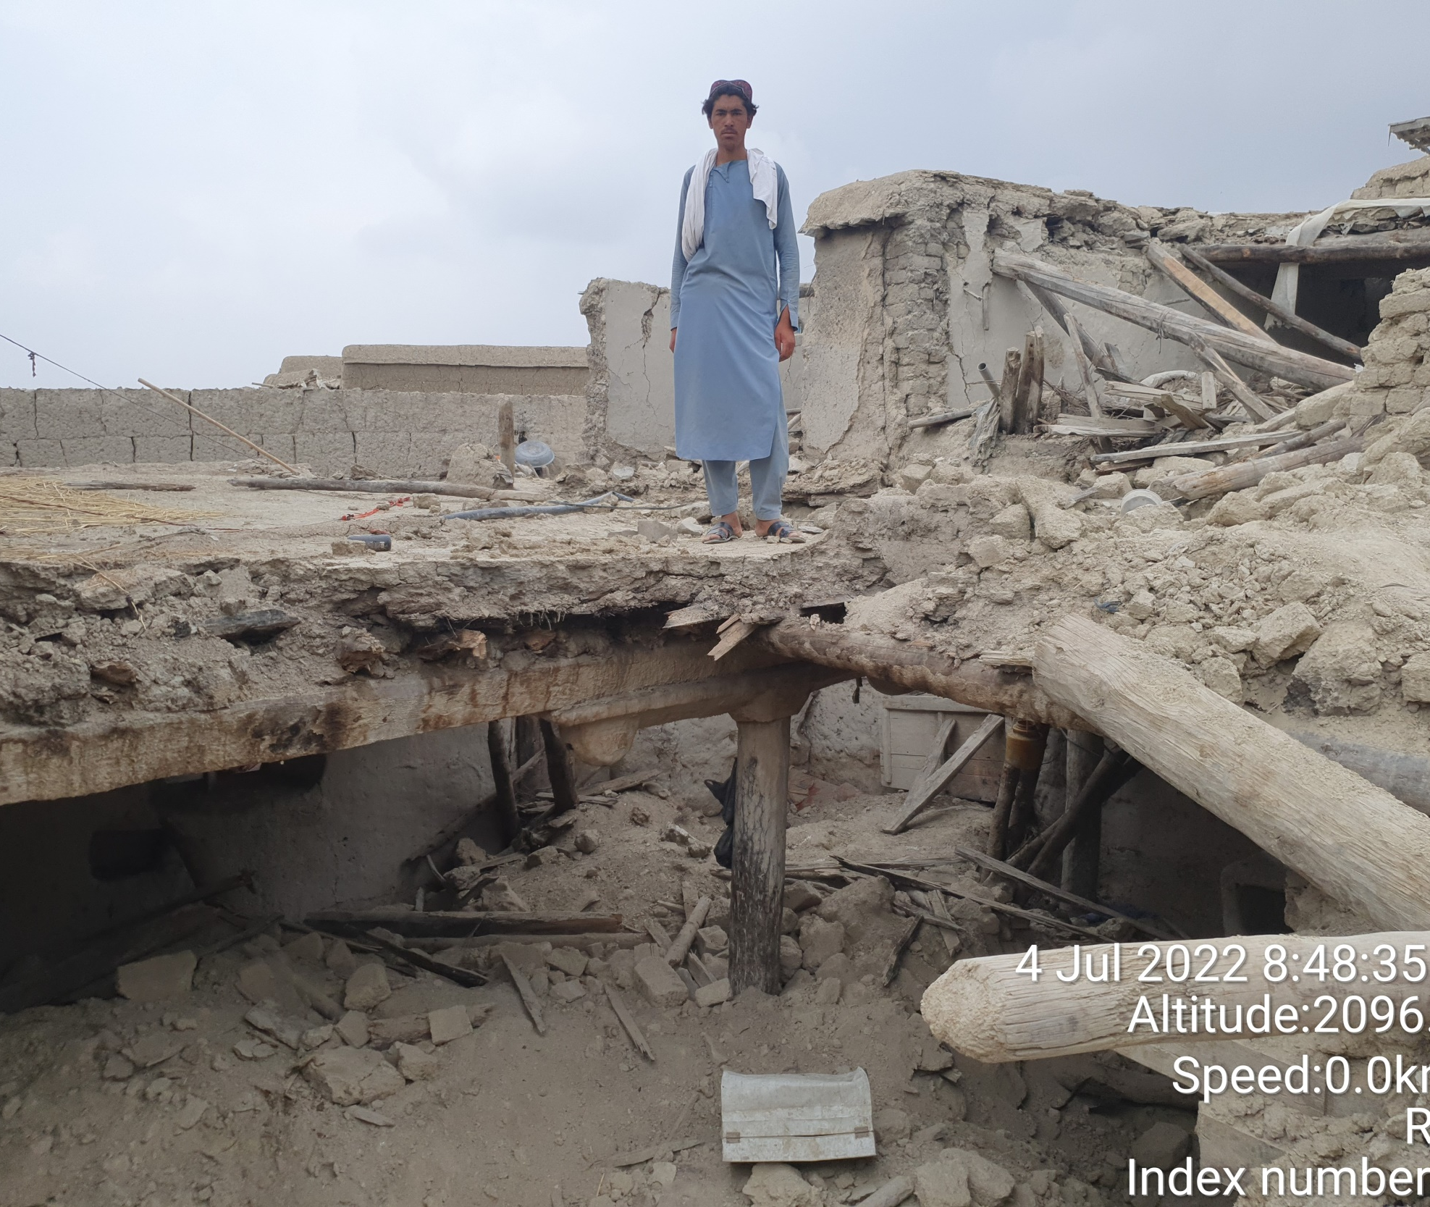
Specific Prayer points
Pray for the families affected by the earthquake in Khost and Paktika provinces.
Winter will set in with snow and temperature dipping to -7°C
Our office is occupied by the forces. We want it to be released.
Safety and security of staff members.

Slide 12


Pray for
Security of all staff
That the girl children will be allowed to continue their education.
Women will be allowed to work and given status
Disabled children to have fullness in life.
Us to be witness to Christ through our work and through word.
Pregnant and lactating Mother and infants to have healthier life
Organizations will do their work effectively and efficiently to bring down poverty ratio.
Conflicts will cease and peace established.
Earthquake affected people will be rehabilitated
Sanctions removed and economic conditions improve.
Banks will be able to function normally.
Crime against locals and NGOs contained.
More Expats to return

Slide 13
Jesus prophesied, "A time is coming when anyone who kills you will think he is offering service to God”
(John 16:2).

Slide 14
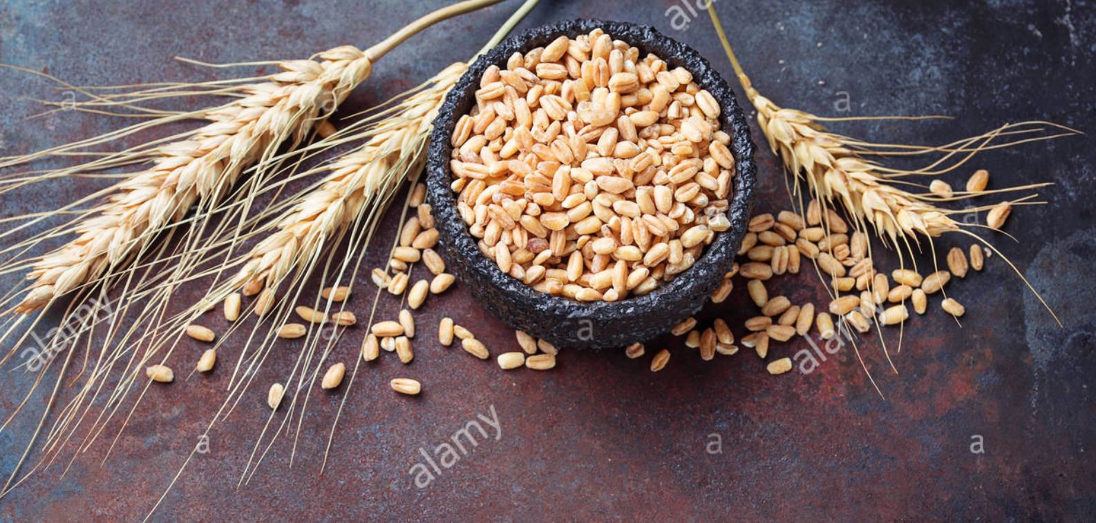
Physical Principle - Spiritual Principle
Very truly I tell you, unless a kernel of wheat falls to the ground and dies, it remains only a single seed. But if it dies, it produces many seeds.
John 12:24

Slide 15
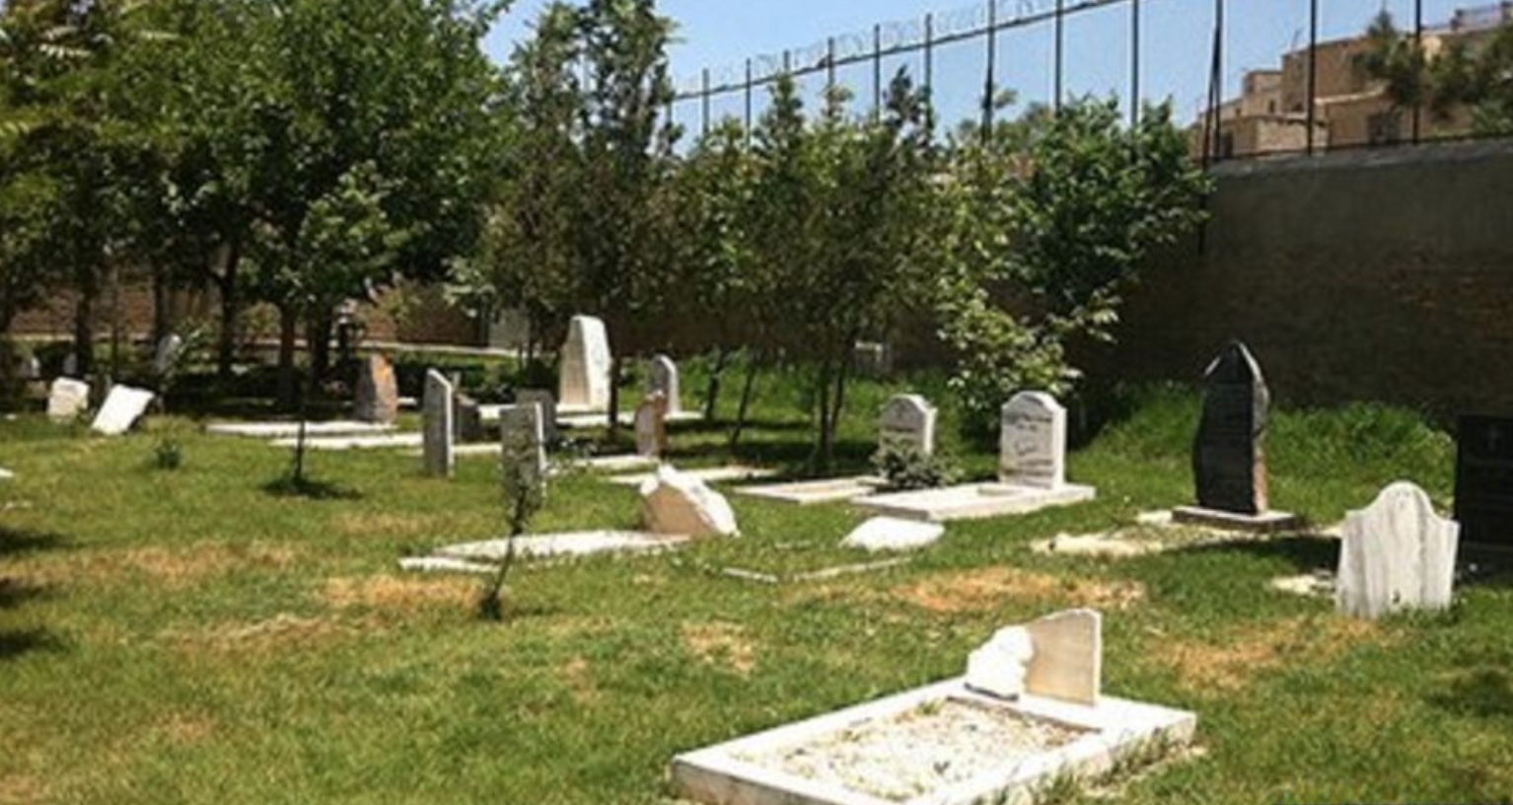
The Blood of the martyrs is the seed of the church
The only Christian graveyard in Afghanistan

