Slide 1
South Asia Prayer Council

Slide 2
Thoughts
The early Church was married to poverty, prisons and persecution. Now we’re trying to marry the Church to prosperity, personality and popularity. Leornard Ravenhill
The Church is not meant to call men and women out of the world into a safe religious enclave but to call them out in order to send them back as agents of God’s kingship. Leslie Newbigin
Christians love evangelism as long as someone else is doing it Ed Stetzer

Slide 3
Summarising the core messages
Brother Onassis
Culminating prayer to gospel strategy and making disciples
Church is not a building but we are a Church
Pastor Michael D
Waiting and hastening for the coming of the Lord
Dr Jason Hubbard
Convergence of prayer and mission; Prayer and Evangelism
Notes:
The word Christians are used only 3 times, Word disciple is used more than 250 times.
The word Church is used 114 times

Slide 4
Summarising the core messages
Brian
Prayer and mission is connected, Who you pray for you care for, love is going to move you to share the gospel
Prayer is not the end game, prayer is the fuel to energise the mission
Evangelism is contagious
Notes:
The word Christians are used only 3 times, Word disciple is used more than 250 times.
The word Church is used 114 times

Slide 5
Summarising the core messages
Dean Briggs
Are we doing his mission or are we fulfilling our mission and calling it as Christ Mission?
Is the Church organising, prioritizing…?
1degree off 400 miles away
Rev D Mohan
Develop and raise Prayer Partners.
Release your lay people only they will do a Real Ministry

Slide 6
Summarising the core messages
Werner
Problem of the Church: Silent Christianity,
Quoting Reinhard Bonke You pray for 100 years nothing will happen unless you go and share gospel
Chadwick
Gospel tailor-made in each context
House Churches/cell group to strengthen

Slide 7
Poreuomai
Christ Mission is all about sending.
Jesus’ prayer in John 17:18
“As you sent me into the world, I also have sent them into the world.”
After resurrection in John 20:21, “… As the father has send me, I also send you.
The Greek word ‘Poreuomai’ (going) occurs 154 times in the New Testament conveys the meaning of travelling or journeying

Slide 8
Jesus 1-12-72 model
Luke 8:1
Luke 9:1
Luke 10:1

Slide 9
The 4 c’s
1. Great Commission (Mat 28-19-20)
2. Great Commandment (Mark 12:30-31; Luke 10:29, 36).
3. Great Compassion (Mat 25:35-41)
4 Great Collaboration (1 Corinthians 3:9; 2 Cor 6:1)

Slide 10
Biblical Terminologies
Children of one father: 1 John 3:1
One body: 1 Corinthians 12:14
One Church: Colossians 1:18
Partnership Philippians 1:5
Co-workers: 1 Corinthians 3:9
Networkers: Luke 5:7
Unity: 1 Corinthians 1:10

Slide 11
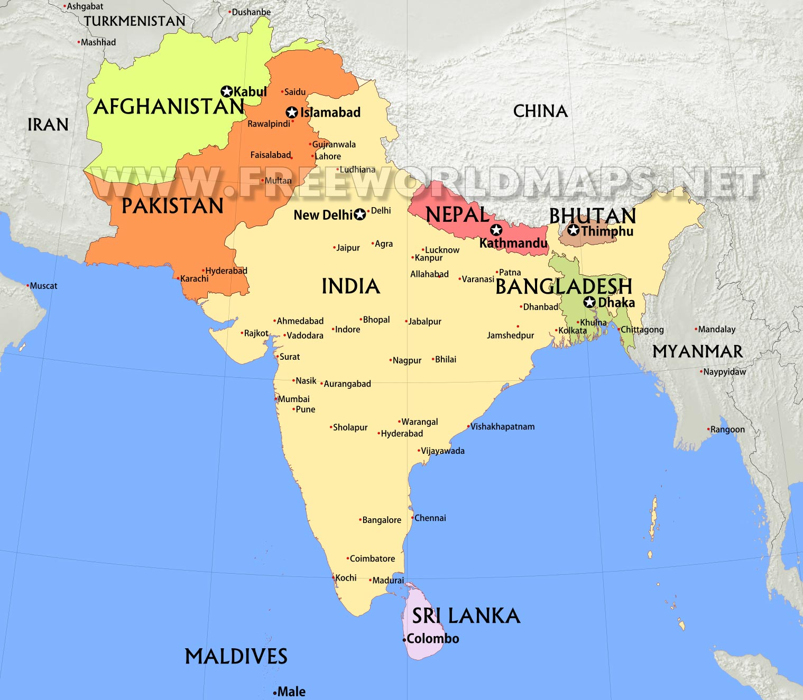
South Asia Map

Slide 12
Beware of the infiltrators
Performance without participation
Attachment without commitment
Addition without reproduction
Birth without growth
Institutionalization
Notes:
I am doing well and My Ministry enterprise runs successfully
I am blessed and favoured
I have enough of my own priorities
My denominational framework is different

Slide 13
Church & Mission infiltrators contd…
Functioning in Silos
Disunity
Culminating to an enterprise
Religious & denominational identity
Mistaken priorities
Notes:
Kevin Campbell
I am doing well and My Ministry enterprise runs successfully
I am blessed and favoured
I have enough of my own priorities
My denominational framework is different

Slide 14
Bridging the Gaps
A Commitment to Biblical Ecclesiology
A commitment to fervent Prayer
A commitment to intentional evangelism
A Commitment to Persevering Disciple-making
A commitment to strategic moves

Slide 15
Desired Prayer Outcomes
1. Therefore I exhort first of all that supplications, prayers, intercessions, and giving of thanks be made for all men
1 Timothy 2:1 CSB
Raise Prayer Intercessors (individual and corporate level) for your city and South Asia Nation
Raise Prayer Movements in your Church
Raise City and Zone wise Prayer

Slide 16
Desired Evangelistic Outcome
“who desires all men to be saved and to come to the knowledge of the truth.” 1 Timothy 2:4
Church evangelistic initiatives

Slide 17
Caution
The church built through consumer strategies will have a culture that becomes transactional rather than conventional Dan White Jr
The Mission is to make disciples of Jesus. Don’t settle for just well-behaved pagans or self righteous pharisees.
The world is not waiting for a new definition of Christianity, it’s waiting for a new demonstration of Christianity. Leonard Ravenhill
If you are at point and want to go to point B, learn what it takes to be at point B while you are at Point A

Slide 18
Way Forward
Define the Strategy (The Blueprint)
Define the Roadmap
Define the Milestones
Monitor the results
Celebrate God’s faithfulness

Slide 19
Challenging your strategy
Move from activity schedule to Spiritual awakening
Challenge the congregation with the purpose for their existence
Clarify Church Mission.
Strengthen the net for a bigger catch (John 21:11)
Notes:
To know him and to have fellowship with him (John 17:3; 1 Cor 1:7)
To be his Witness Acts 1:8; (Matt 5:16; Rom 1:8)
Be a carrier of the gospel (Cor 15:3, John 17:18; Matt 28:19-20
Clarify Church mission: Move from institution to a movement

Slide 20
THE BIG STRATEGY
Mobilize each member to pray & share with their Non-Christian friends
Mobilize Prayers & develop prayer partners
Promote Lifestyle Evangelism

Slide 21
Thank you
Cell +91 7977721853
My Christian Blog:
www.liferedefined4god.blogspot.com
On Twitter
@abundanceShefa

