Slide 1
Bhutan
The Land of the Thunder Dragon

Slide 2
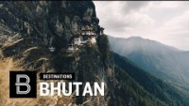

Slide 3
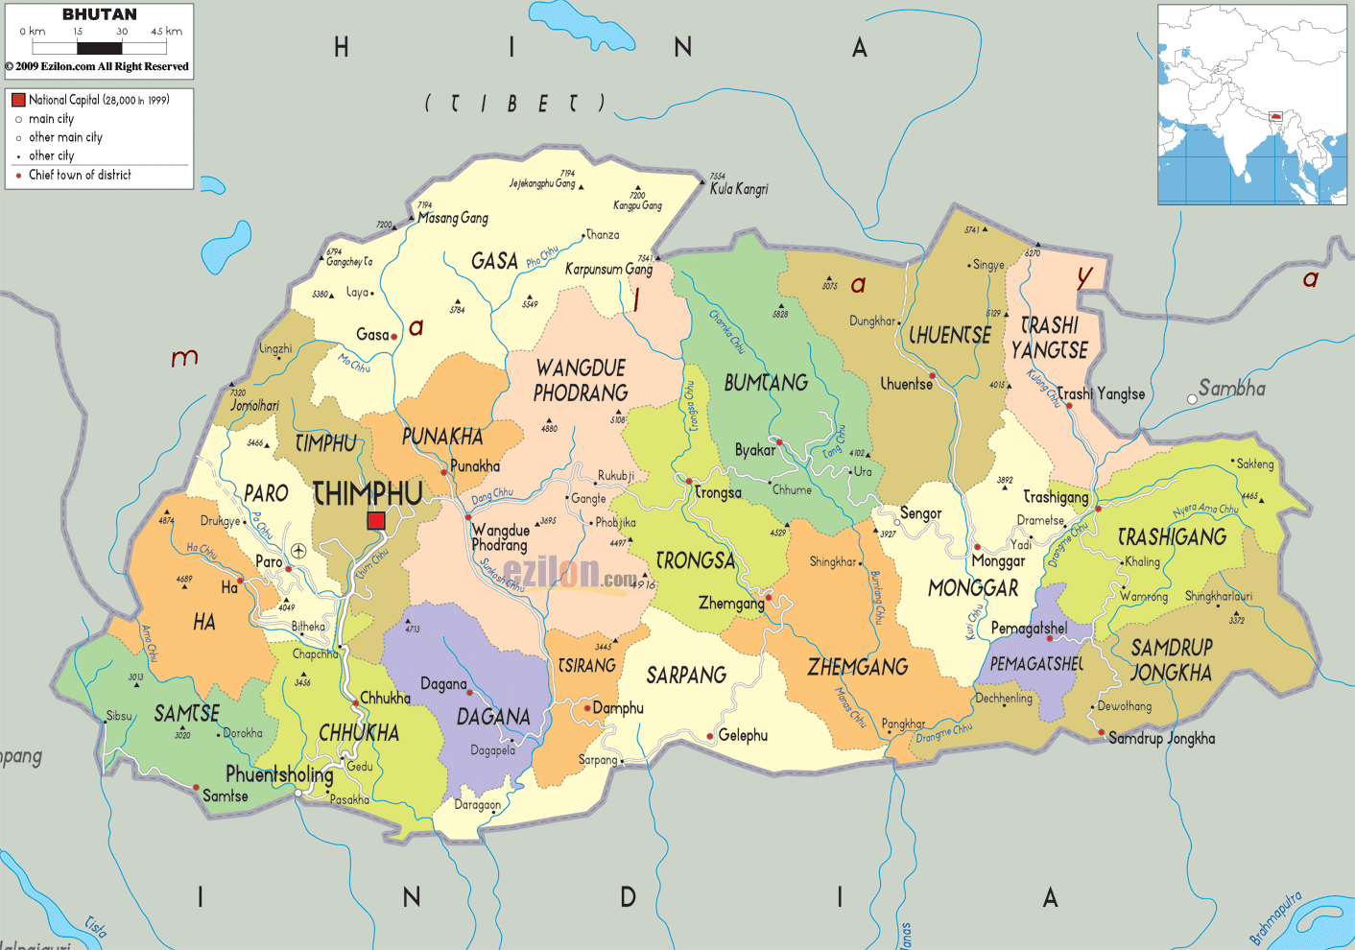
1.
TRANSITION HEADLINE
Bhutan Map
Let’s start with the first set of slides

Slide 4
Reality of Christianity in Bhutan
Bhutanese Buddhist – It is illegal for them to follow Christ.
Those who choose to accept the Gospel face loss of Nationality.
Fear to be identified as Christians in Bhutan

Slide 5
Churches in Bhutan
Thimpu – There are about 50 house churches.
In Phuentsholing, Samsee, Ghelephu, Samdrupjonkhar, Paro, chruches are sparse.

Slide 7
Strongholds in Bhutan
Beliefs in superstitions.
Fear of demonic forces.
Sorcery & witchcraft.
Alcoholism & substance abuse.
Teenage pregnancy.
Domestic Violence.
Divorce.
Mental Health – depression, suicides.

Slide 8
Challenges & Prayer points
Need for Spirit-led leaders in lead the congregation.
Bhutan is closed to the Gospel.
Fear of persecution.
Lack of trained leaders.
Pray for burden for the lost.
Pray for move of the Holy Spirit.

Slide 9
How can we tackle these issues?
Establishing a strong and continuous prayer network.
Unity among Christian denominations in the country.
Good Harvest Force – educated, committed leaders to take on the great commission.
Vision for the gospel to reach Bhutan to be birthed among the native people.
Churches to network in order to spread the gospel.

Slide 10
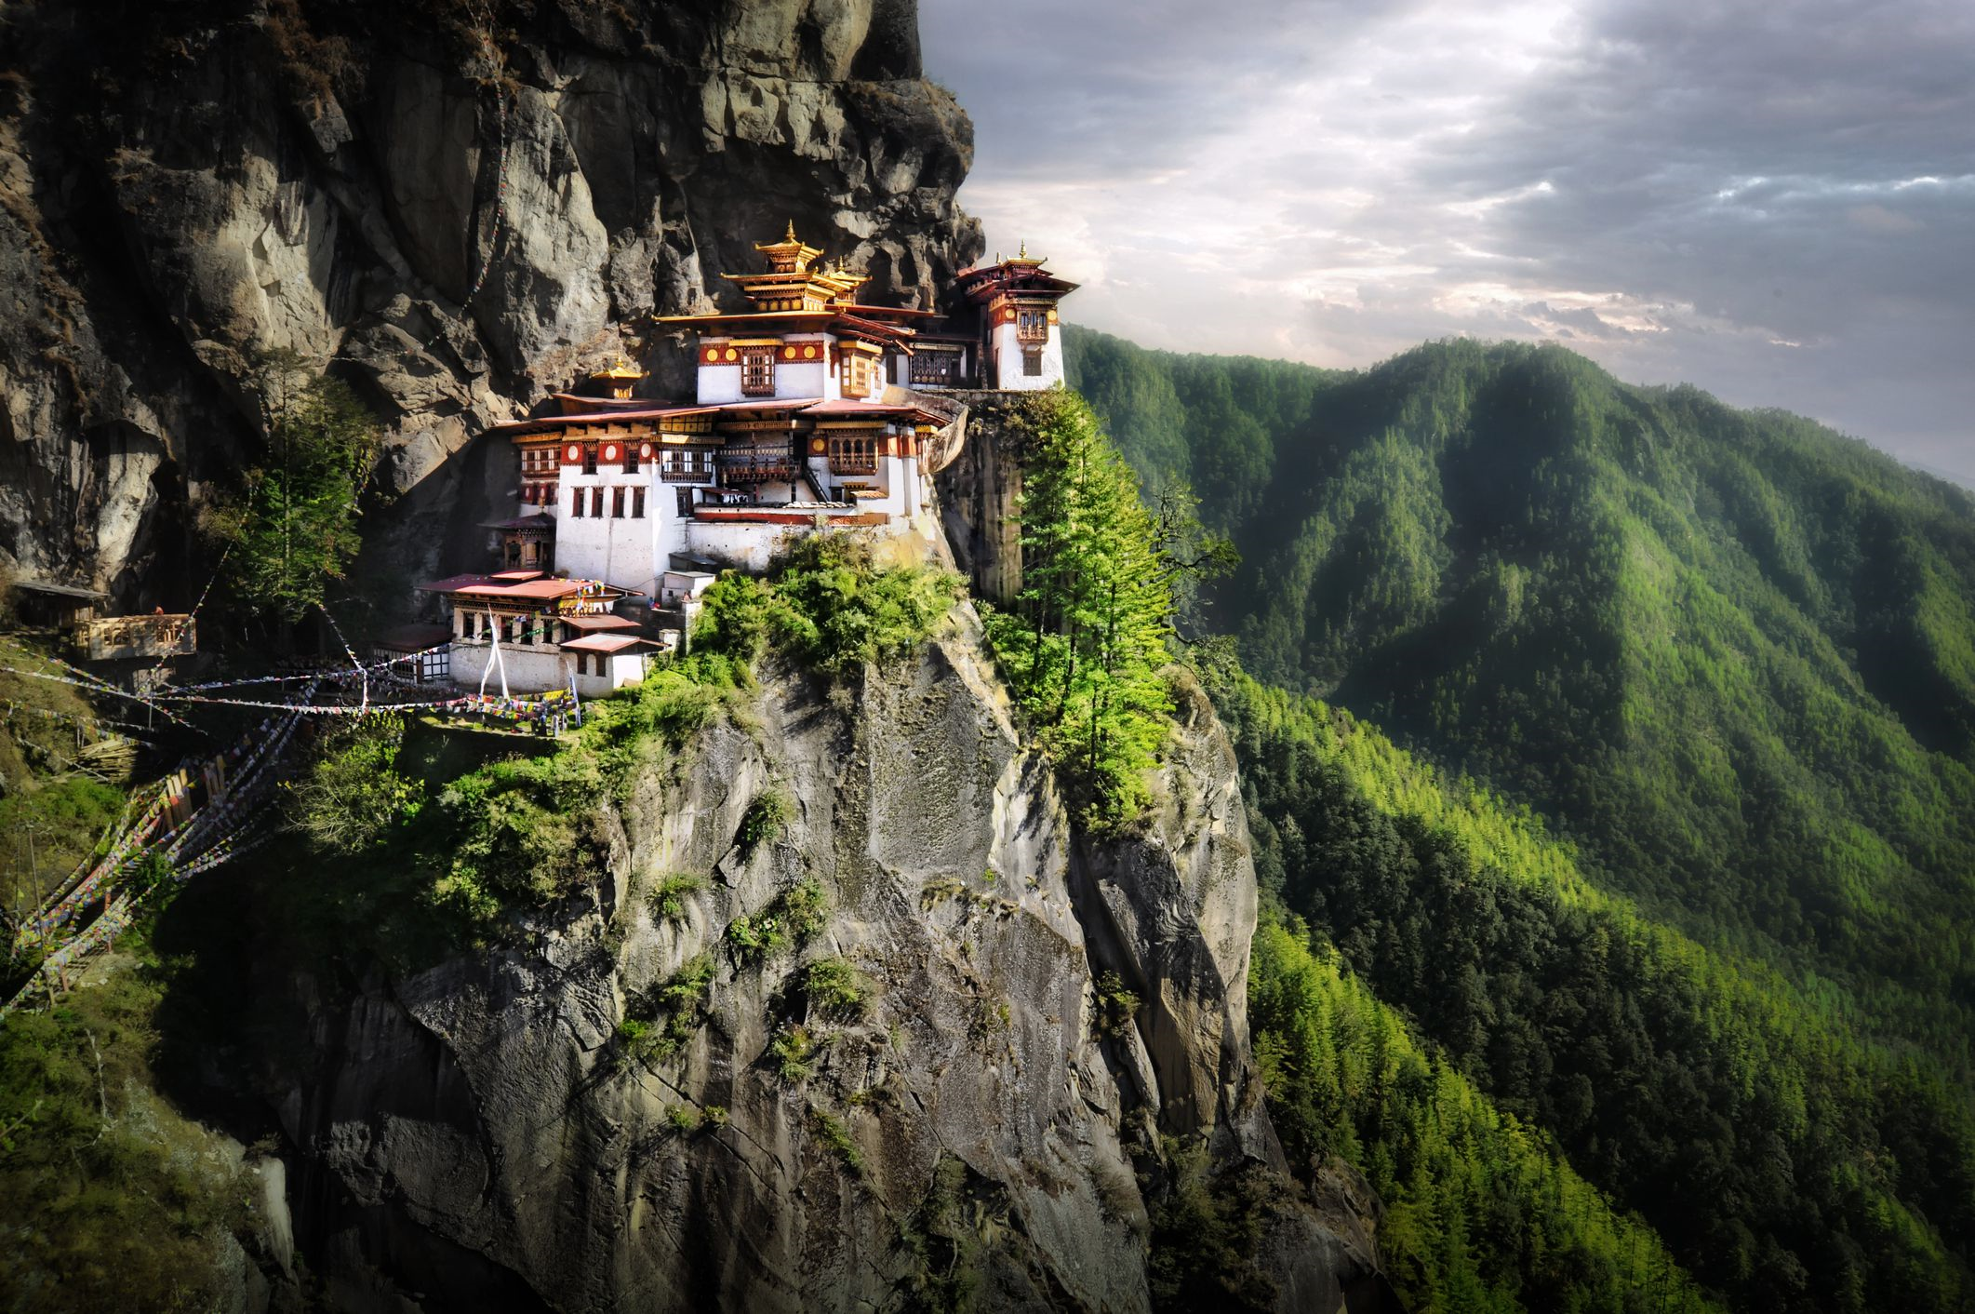
Let’s start with the first set of slides
PRAY FOR THE NATION OF BHUTAN

