Slide 1

1 TIMOTHY 2:1-6 (NIV)
“I urge, then, first of all, that petitions, prayers, intercession and thanksgiving be made for
all people, for kings and all those in authority, that we may live peaceful and quiet lives in all godliness and holiness. This is good, and pleases God our Savior, who wants all people
to be saved and to come to a knowledge of the truth. For there is one God and one mediator between God and mankind, the man Christ Jesus, who gave himself as a ransom for
all people…”

Slide 2
1 Timothy 2:1-6 > ALL PEOPLE
1. Pray for ALL PEOPLE
2. God wants ALL PEOPLE to be saved
3. Jesus gave His life as a ransom for ALL PEOPLE

Slide 3

ALL PEOPLE is used 3x in 1 Timothy 2:1-6
Greek “Anthropos”
= Every Human Being

Slide 4
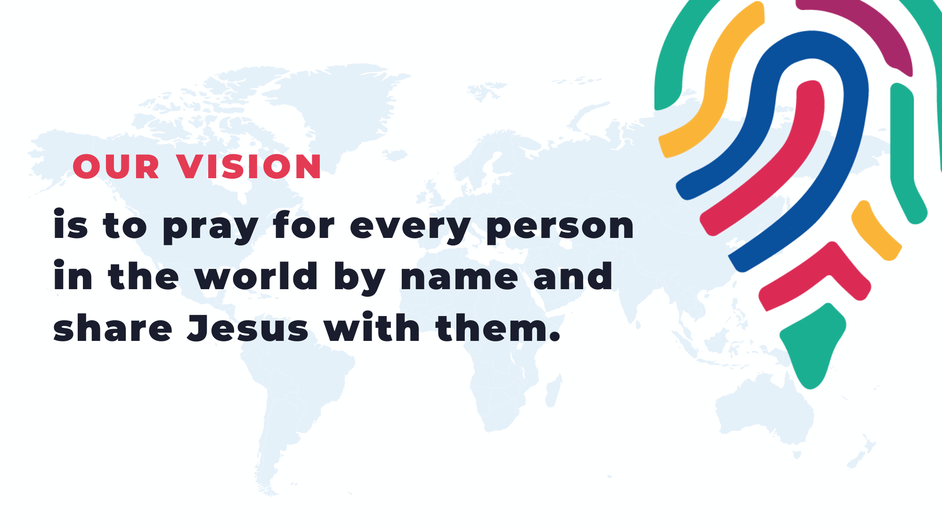

Slide 5
1 John 2:2 (NIV)
“He is the atoning sacrifice for our sins, and not only for ours but also for the sins of the whole world.”

Slide 6
2 Peter 3:9 (ESV)
“The Lord is not slow to fulfill his promise as some count slowness, but is patient toward you, not wishing that any should perish, but that all should reach repentance.”

Slide 7

Everybody can reach somebody and together we can reach the world
Who’s your somebody?

Slide 8

“There are no ordinary people. You have never talked to a mere mortal.”
—C.S. Lewis

Slide 9


Slide 10
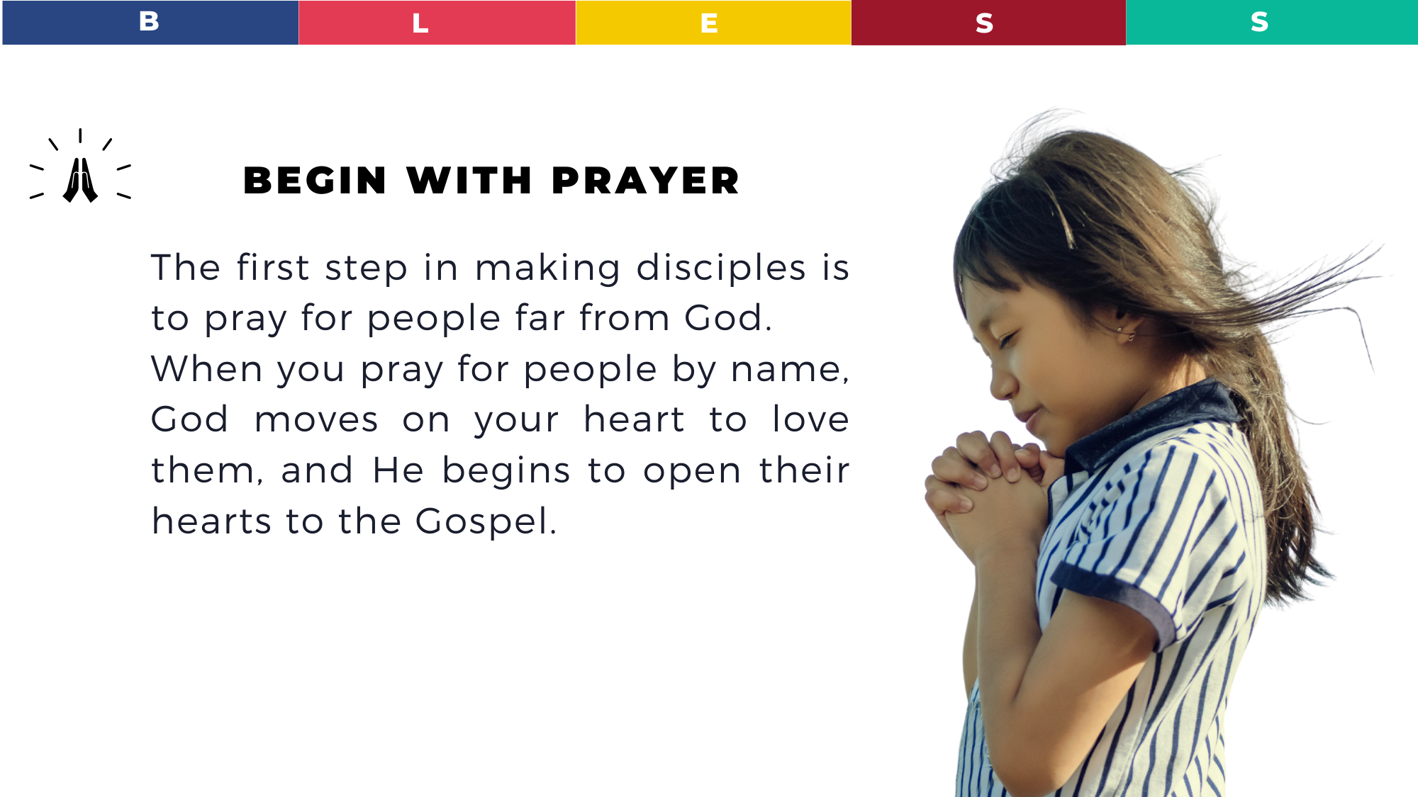

Slide 11
Talk to Jesus about your friends before your talk to your friends about Jesus.

Slide 12
“When you get to heaven, you will realize that everyone there was a result of someone’s prayer.”
—Dick Eastman

Slide 13
Isaiah 43:1 (NLT)
“Do not be afraid, for I have ransomed you. I have called you by name; you are mine.”

Slide 14
Luke 10:20 (NIV)
“Do not rejoice that the spirits submit to you, but rejoice that your names are written in heaven.”

Slide 15
John 10:3 (NIV)
“He calls his own sheep
by name and leads them out.”

Slide 16
Revelation 21:26-27 (NIV)
And into [New Jerusalem] will be brought the glory and honor of the nations. But nothing unclean will ever enter it … but only those whose names are written in the Lamb’s Book of Life.

Slide 17
8 billion names for the 1 Name
We want to pray for 8 billion people by name so they will know the one name, the only name, that can save them—the name of Jesus.

Slide 18
<<ACTION POINT>>
Will you pray for 5 people by name?

Slide 19
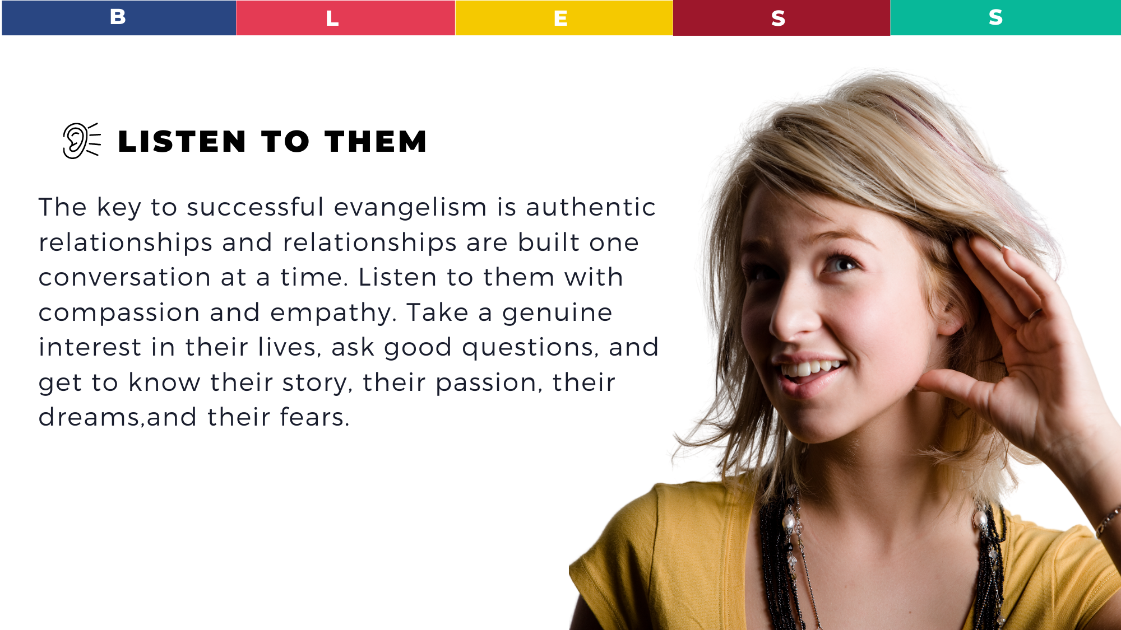

Slide 20
The key to successful evangelism is authentic relationships and relationships are built one conversation at a time.

Slide 21
Many people in the Bible got saved because of one conversation.
Acts 8 – Philip and Ethiopian eunuch
Acts 10 – Peter and Cornelius
Acts 16 – Paul and Lydia
John 4 – Jesus and the woman at the well

Slide 22
<<ACTION POINT>>
Who are you going to have
a conversation with this week?
Listen with empathy to their story, their hurts, fears, and doubts.

Slide 23


Slide 24
“Jesus spent his time eating and drinking—a lot of his time. He was a party animal. His mission strategy was a long meal, stretching into the evening. He did evangelism and discipleship round a table with some grilled fish, a loaf of bread, and a pitcher of wine.”
—Tim Chester

Slide 25
“In Luke’s Gospel Jesus is either going to a meal, at a meal, or coming from a meal.”
—Robert Karris

Slide 26
You always have more influence with friends than you do with strangers.

Slide 27
<<ACTION POINT>>
You eat about 21 meals a week.
Can you share at least 1 meal every week with someone far from God?

Slide 28
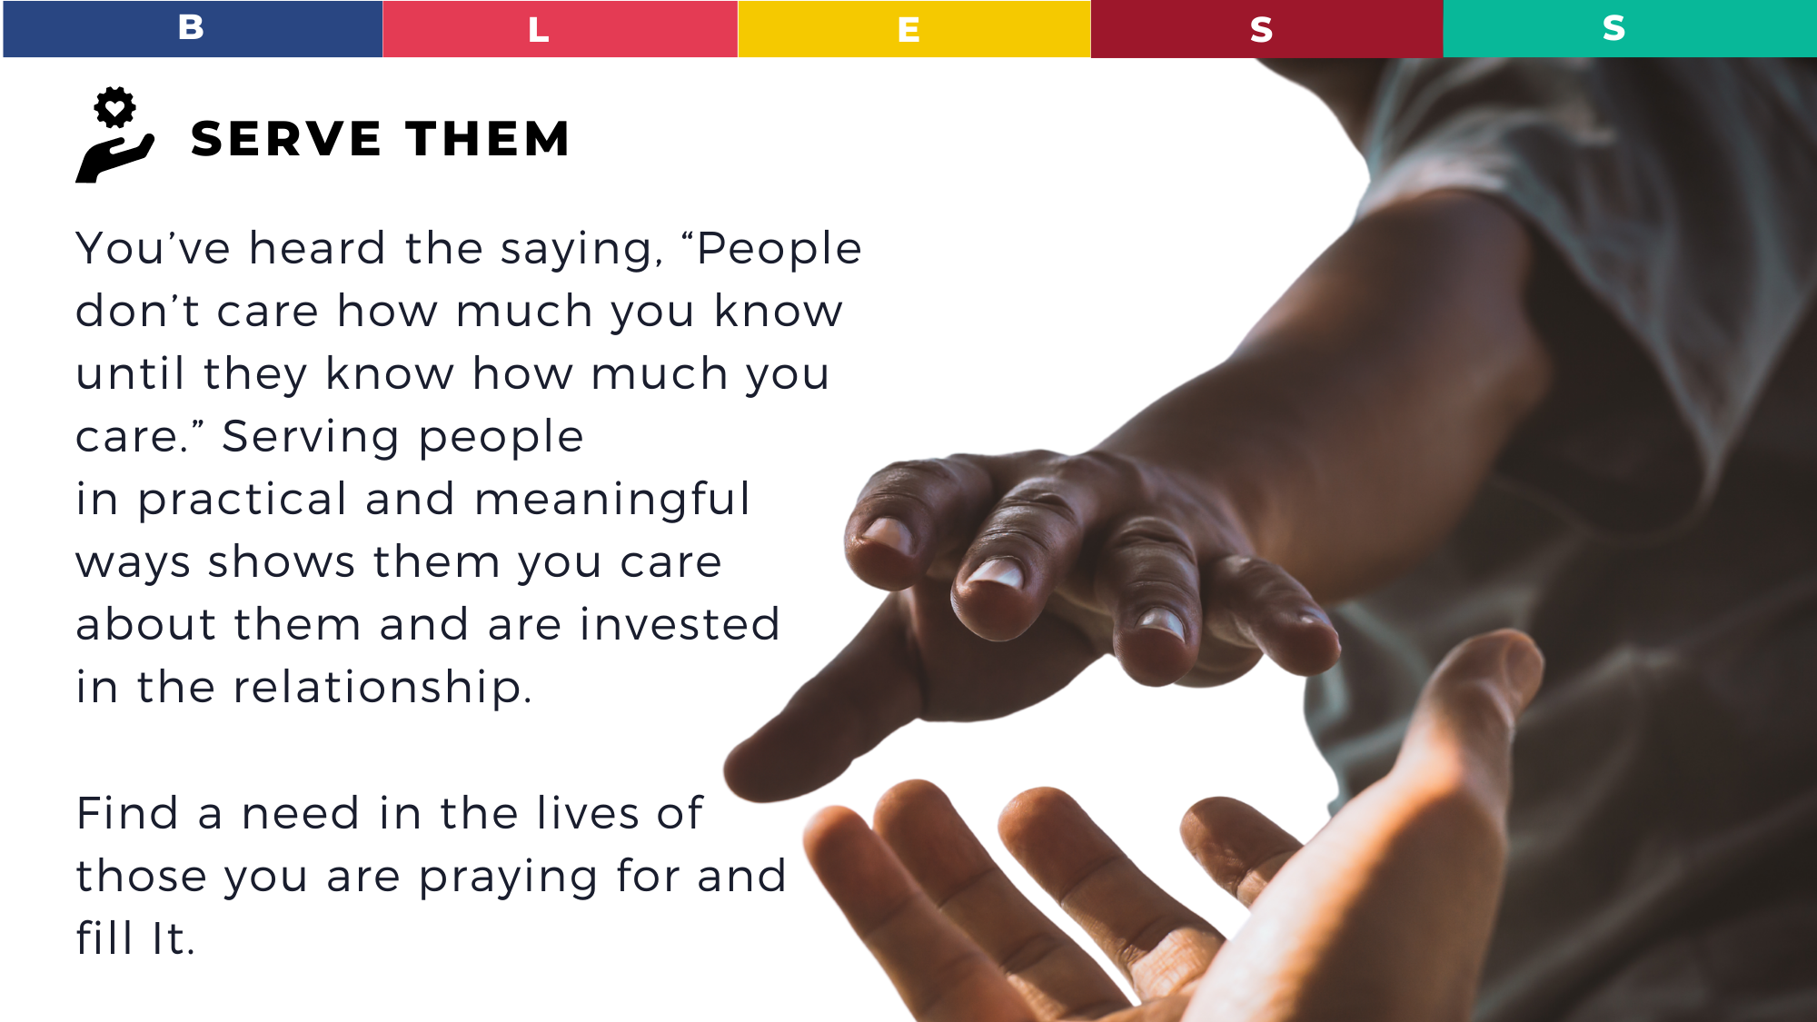

Slide 29
People don’t care how much
you know until they know
how much you care.

Slide 30
Matthew 5:16 (NIV)
“In the same way, let your light shine before men, that they may see your good deeds and praise your Father in heaven.”

Slide 31
Matthew 20:28 (NIV)
“Just as the Son of Man did not come to be served, but to serve, and to give his life as a ransom
for many.”

Slide 32
<<ACTION POINT>>
Who can you serve this week and demonstrate God’s love to them?

Slide 33


Slide 34
Ask the Holy Spirit to give you opportunities to share Jesus
with them.

Slide 35
1 Peter 3:15 (NIV)
“But in your hearts revere Christ as Lord. Always be prepared to give an answer to everyone who asks you to give the reason for the hope that you have. But do this with gentleness and respect.”

Slide 36
Evangelism was designed to be overflow of our relationship with Jesus.
The more we fall in love with Jesus, the more we will tell others about Him.

Slide 37
Revelation 2:4 (Berean)
“But I have this against you: You have abandoned your first love.”

Slide 38
Psalm 27:4 (NIV)
“One thing I ask from the LORD, this only do I seek: that I may dwell in the house of the LORD all the days of my life, to gaze on the beauty of the LORD and to seek him in his temple.”

Slide 39
Acts 4:20 (NIV)
“As for us, we cannot help speaking about what we
have seen and heard.”

Slide 40
How to pray for unbelievers
1. Father, draw them to your Son Jesus (John 6:44)
2. Father, remove their spiritual blindness so they will believe
the Gospel (2 Cor. 4:4; Acts 16:14)
3. Father, give them the gift of repentance to turn from their sins
(John 16:8; 2 Tim. 2:25-26)
4. Father, give me opportunities and boldness to share the Gospel with them (Col. 4:3-4; Acts 4:29-31)
5. Father, please save them and their whole family (Acts 16:31)

Slide 41
BLESS Strategy
Begin with prayer
Listen to them
Eat with them
Serve them
Share Jesus

Slide 42
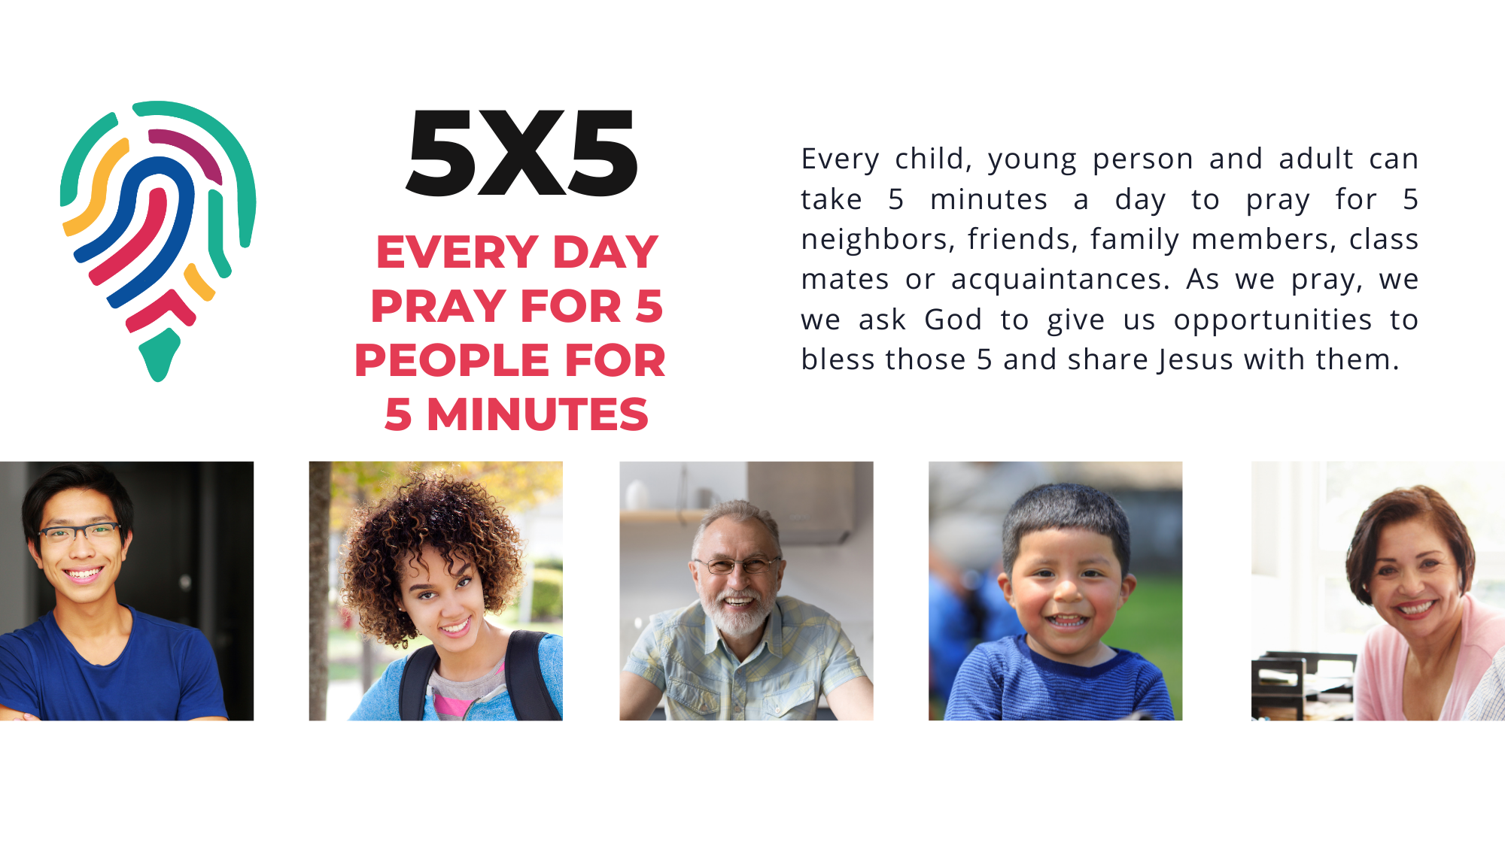

Slide 43
Will you pray for
5 people by name and
share Jesus with them?

Slide 44


