Slide 1
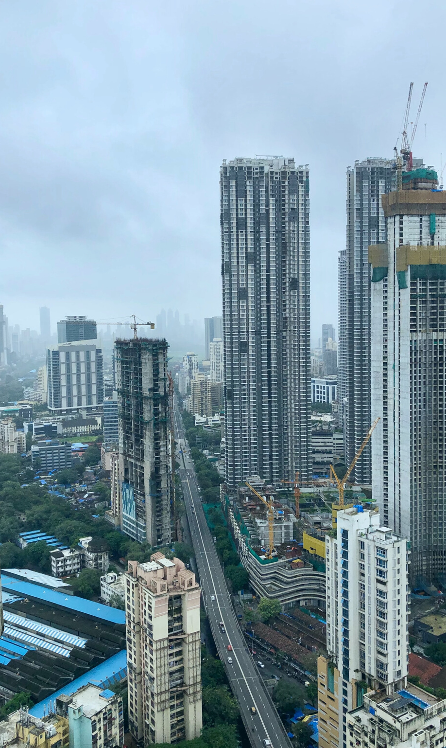
Our cities
need the Gospel.
Influx & Influence

Slide 2
Cities determine the destiny of nations, and their influence on the everyday affairs of individuals is incalculable. Beyond question, the new chapter in world and mission history is entitled 'Cities' and the church of tomorrow will be largely an urban church.
Cities must be regarded as the modern frontiers of Christian missions. If we fail to win the cities, we shall have failed indeed. -Roger Greenway

Slide 3
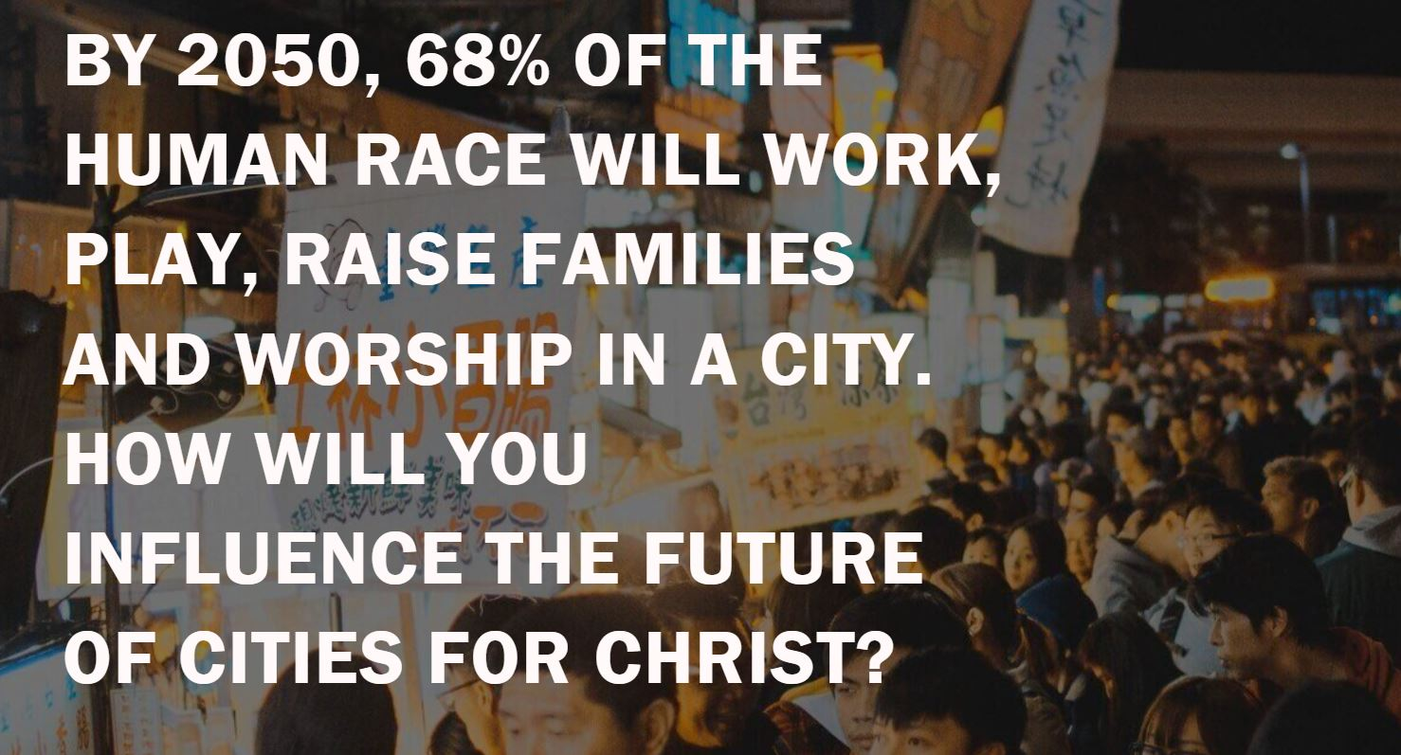

Slide 4
“By 2050, 60% population of the country will live in cities as India’s rate of urbanization is dramatic”
- Minister of State: Rao Inderjit Singh

Slide 5
“Planting new churches is the most effective evangelistic methodology known under heaven.”
– Peter Wagner

Slide 6




About City Initiatives
City Initiatives is dedicated to catalysing gospel movements in every major urban centre in India.
We partner with like-minded individuals, churches, and networks in India who imbibe shared missional DNA and shared vision for city transformation and gospel proclamation in India.

Slide 7
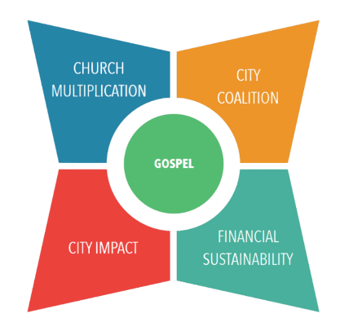
Our 4 focus areas

Slide 8
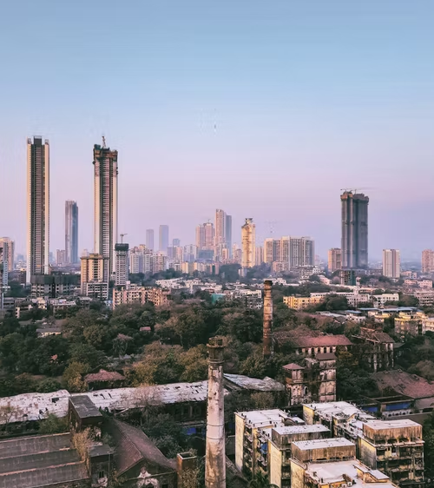
URBAN
CHURCH
PLANTING
TRAINING

Slide 9

The Learning Journey
Cycle 1
Conceptualization
Cycle 2
Integration
Cycle 3
Multiplication
Pre-Immersion
Immersion
Ministry Roadmap
Coaching
City Learning Cohorts
Advanced Trainings
Personal Reflection
Coaching
City Impact
City Coalition
Movement Catalysts
Church Multiplication

Slide 10




Topics we explore
Gospel Theology & Renewal
Culture, Contextualisation & Ministry Design
Church Planting Strategies
Gospel shaped Ministry & Movement

Slide 11
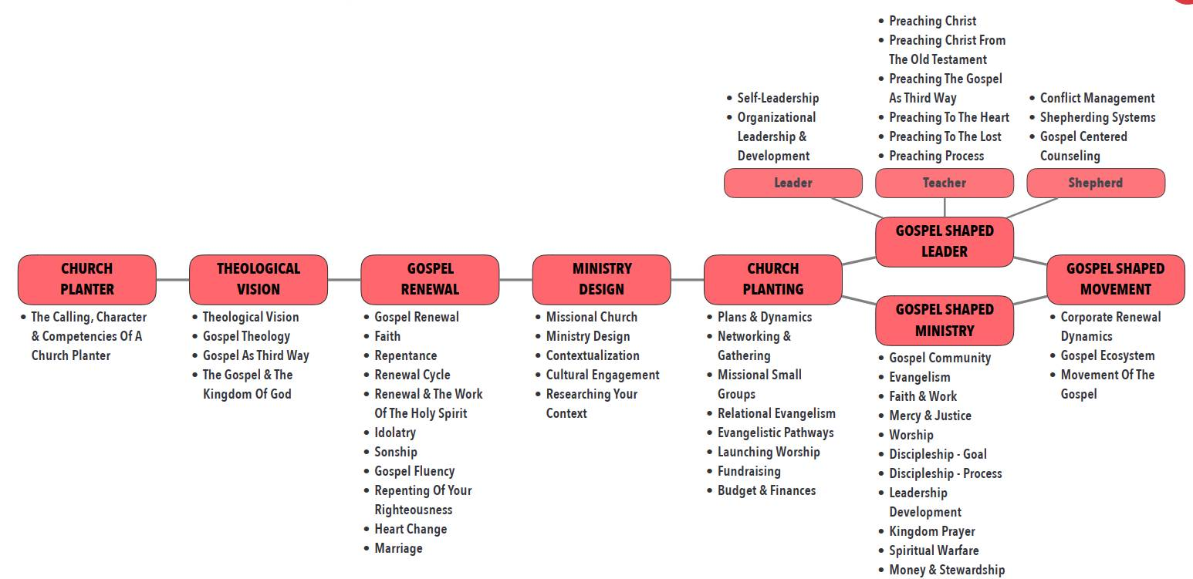

Slide 12
2023
Church Planters'
English
Immersion

Slide 13
CITY IMPACT
Faith & Work

Slide 14


Slide 15
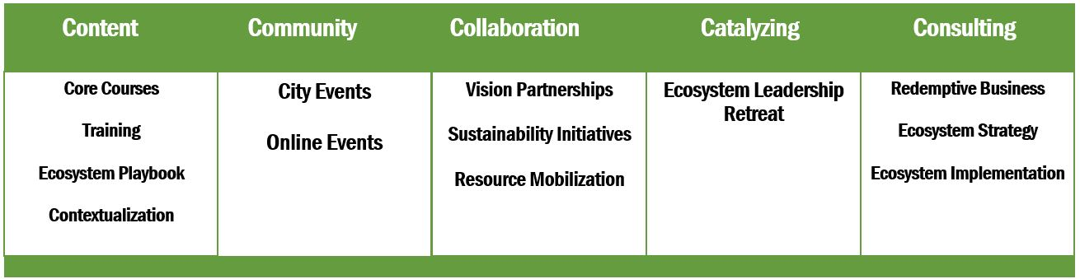

Slide 16
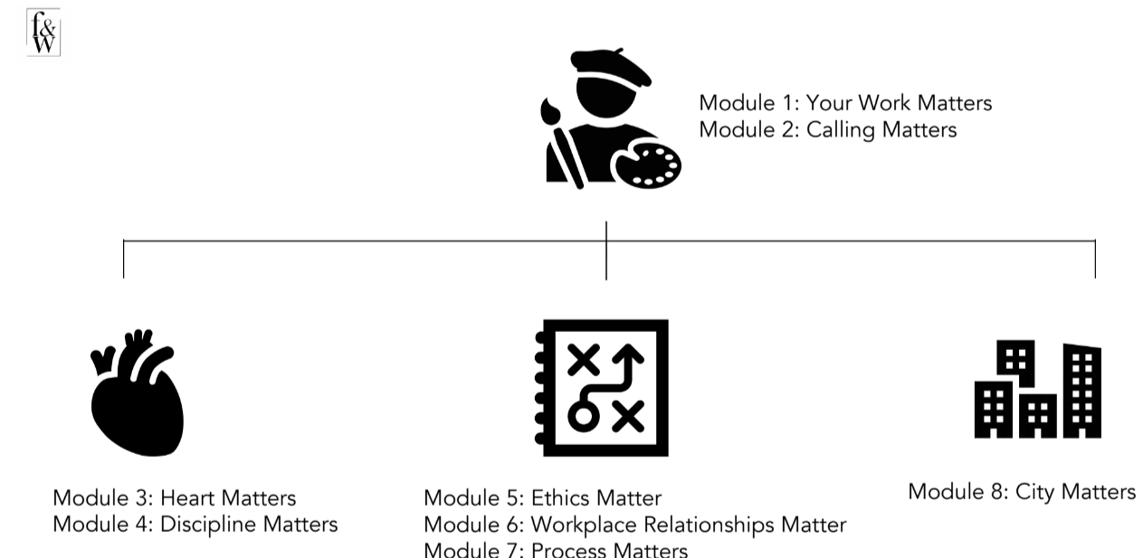
Small group course

Slide 18

For more information,
please connect with
Jeyakaran Emmanuel
National Catalyst
City Initiatives
Tel: +91 9841037882

