Slide 1
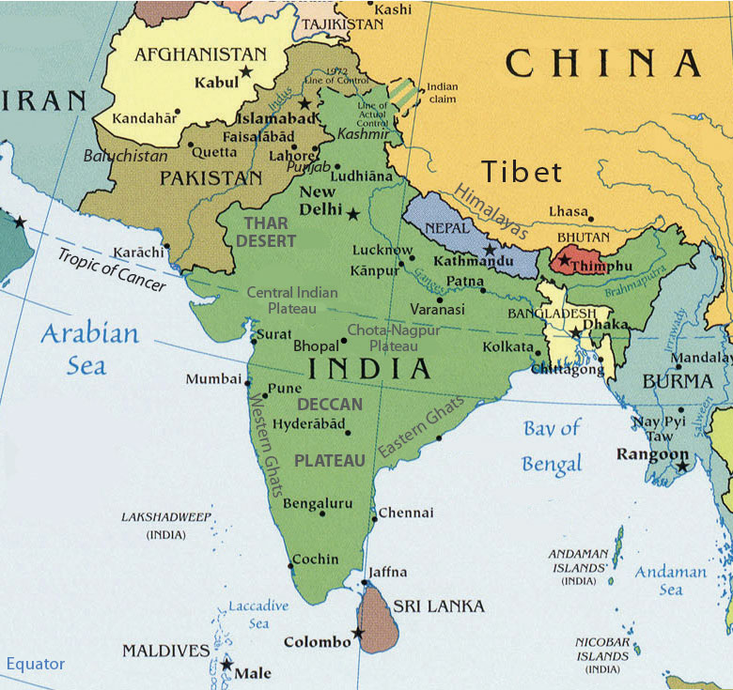
All Major
Religions:
Hindus:
Moslems:
Buddhists:
Sikh:
Jain:
Greatest
number
Of Lost Souls:
1.5 Billion.
Largest
Unreached
People
Groups:
3,600
28 Million
220 Million
If the GREAT COMMISSION is to be completed,
It must finish in Southern Asia!
1 Million
170 Million
1,383 Million
400,000
22 Million

Slide 2
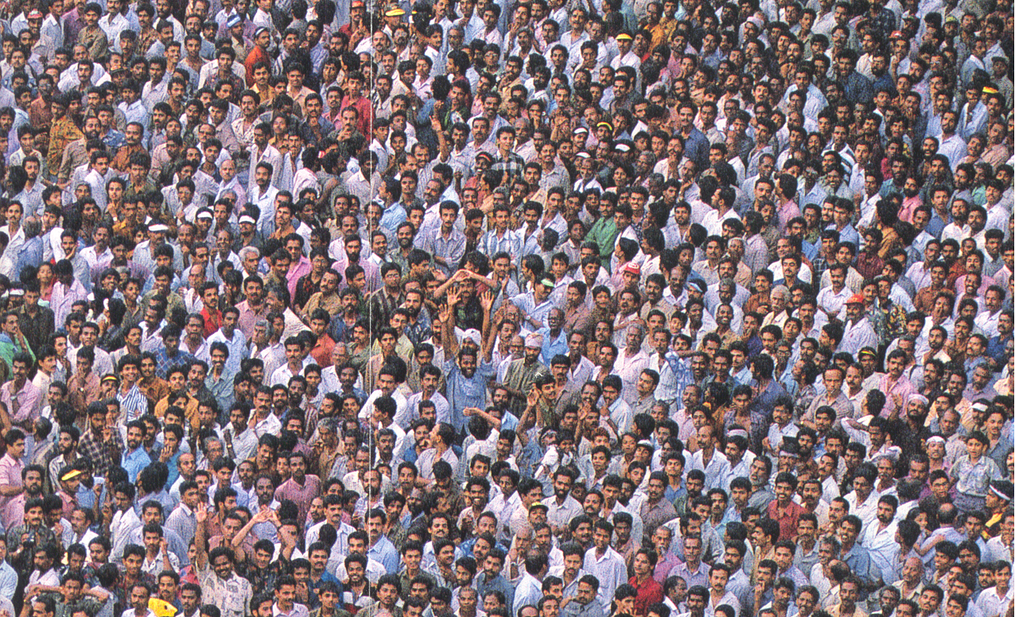
Paul’s Passion for the Lost
Key Phrases:
“By All Means Save some”.
2 Cor 9: 22. To the weak became I as weak, that I might gain the weak: I am made all things to all men, that I might by all means save some.
Where “Christ is not Named” – “They that have not heard.”
Romans 15: 20. Yea, so have I strived to preach the gospel, not where Christ was named, lest I should build upon another man's foundation:
21. But as it is written, To whom he was not spoken of, they shall see: and they that have not heard shall understand.

Slide 3
3. “ Whosoever”. – “How Can they hear?”
Romans 10:
13. For whosoever shall call upon the name of the Lord shall be saved.
14. How then shall they call on him in whom they have not believed? and how shall they believe in him of whom they have not heard? and how shall they hear without a preacher?
15. And how shall they preach, except they be sent?
4. “Regions Beyond.”
2 Corinthians 10:16
16 To preach the gospel in the regions beyond you, and not to boast in another man's line of things made ready to our hand.
5. “No Room in these Areas” -
Romans 15:22-23. In fact, my visit to you has been delayed so long because I have been preaching in these places.
23. But now I have finished my work in these regions, and after all these long years of waiting, I am eager to visit you.

Slide 4
The Greatest prayer is the prayer that has the Greater Listening capacity.

Slide 5
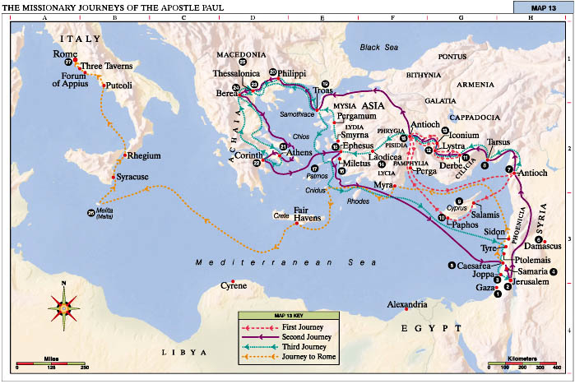
Key turning points of Acts: Each of them has a key Prayer intervention. 1. Pentecost. Prayer – Acts 2. 2. Persecution. – Acts 3-4. Prayer in Acts 4. 3. Prayer Priority – Acts 6. Devoted to prayer. 4. Persecution after Stephen. Acts 8. Samarian revival – Ethiopian. 5. Conversion of Saul – Acts 9 - Damascus Church – Ananias vision and prayer. 6. Peter and Cornelius. – Acts 10 - Peter’s prayer in Joppa. 7. Antioch Missions Prayer. Acts 13 8. Turn from Asia to Europe – the Macedonian Call – Acts 16.

Slide 6
The Great Commission and The GREAT PROPHECY
Matthew 24:14.
“And this gospel of the kingdom shall be preached in all the world for a witness unto all nations; and then shall the end come.

Slide 7
Missions Time-Line in Acts AD 30 – Pentecost - Acts 2. 31 - Jerusalem - Stephens’ Death – Acts 7 31 – Samaria – Philip – Ethiopian – Acts 8 34 – Saul’s Conversion. - Acts 9. 37 – Caesarea -Peter to Gentiles. - Acts 10. 42 – Antioch - Barnabas sent – Acts 11. 48 - First Missionary Journey - Paul - Acts 13. 60 – Paul Arrested in Jerusalem – Acts 22. 62 – Paul in Rome. Acts 28

Slide 8
The Timeline of the Church in Missions
Acts 1:8
Uttermost Parts
of the Earth
2000 yrs.
Other Nations
‘Ethne’
12 yrs
Jerusalem
1 yr.
Samaria
2 yrs
Judea
7 yrs

Slide 9
Antioch Church Missions Influence.

Slide 10
Focus on People Groups.

Slide 11
The Unreached of Southern Asia – 7 Nations.
SUMMARY
Total Population | 1,900,400,000
Total Peoples | 4,104
Total UPGs | 3,682
Total Unreached | 1,724,727,000
Workers 1:50,000 | 36,372

Slide 12
Church Planting in UPGs.
 | Churches | Workers
1 Church per UPG | 3,682 | 3,682
5 House Ch/UPG | 18,410 | 18,410
By Population:
1 Church per 100,000 | 17,245 | 17,245
1 Church per 50,000 | 34,494 | 34,494
1 Church per 10,000 | 172,472 | 172,472

Slide 13
Southern Asia Unreached People Groups
Country | Population | People Groups | UPGs | Pop of UPGs | 1 Church /UPG | 1Church per 100,000 | 1 Ch/per 50,000 | Workers Needed
Bangladesh | 163,942,000 | 331 | 299 | 162,024,000 | 299 | 1,620 | 3240 | 3,442
Bhutan | 769,000 | 76 | 73 | 766,000 | 73 | 7 | 14 | 78
India | 1,373,934,000 | 2717 | 2445 | 1,313,875,000 | 2445 | 13,138 | 26276 | 27,414
Maldives | 512,000 | 7 | 7 | 512,000 | 7 | 5 | 10 | 16
Nepal | 29,017,000 | 285 | 275 | 26,213,000 | 275 | 262 | 524 | 718
Pakistan | 219,932,000 | 512 | 504 | 217,910,000 | 504 | 2,179 | 4358 | 4,578
Sri Lanka | 21,297,000 | 174 | 79 | 3,434,000 | 79 | 34 | 68 | 126
Total | 1,809,400,000 | 4,104 | 3,682 | 1,724,727,000 | 3,682 | 17,245 | 34,494 | 36,372
Source (Joshua Project)

Slide 14
UPGs per Church 1st Century & Now
TODAY!
AD 100
12
UPGs
1
Church
1
UPG
600
Churches
1 : 600
12 : 1

Slide 15
FINISHING THE TASK
Matthew 24:14.
“And this gospel of the kingdom shall be preached in all the world for a witness unto all nations; and then shall the end come.
A Believer – Evangelism
A Body – A Church
A Bible – Translation
Breakthrough Prayer

Slide 17
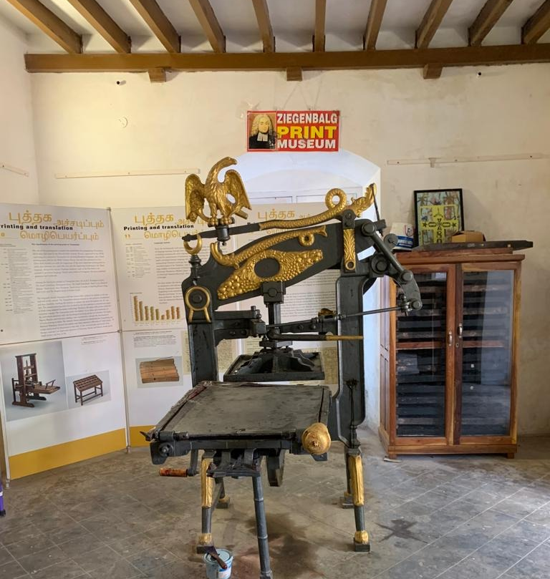
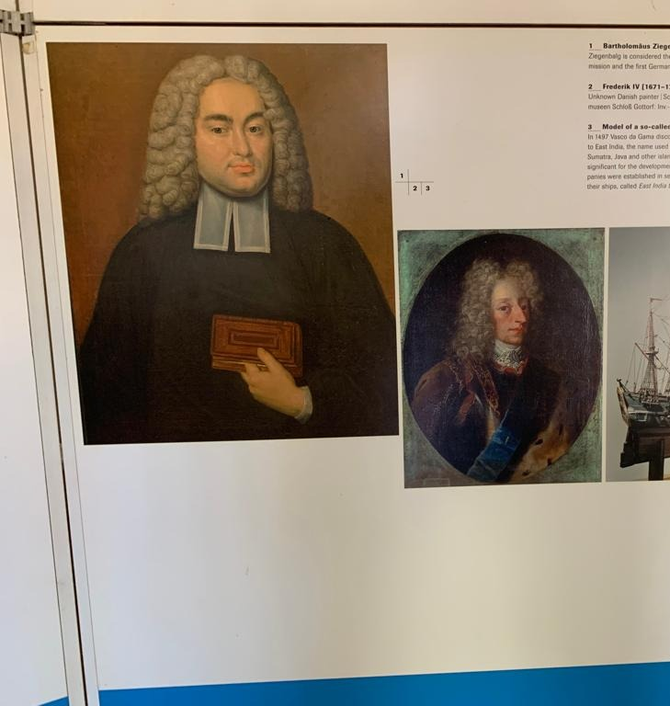

Slide 18
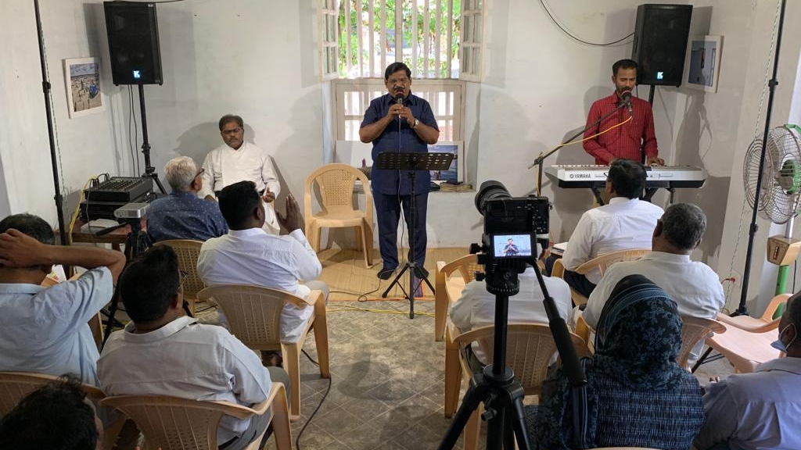

Slide 19
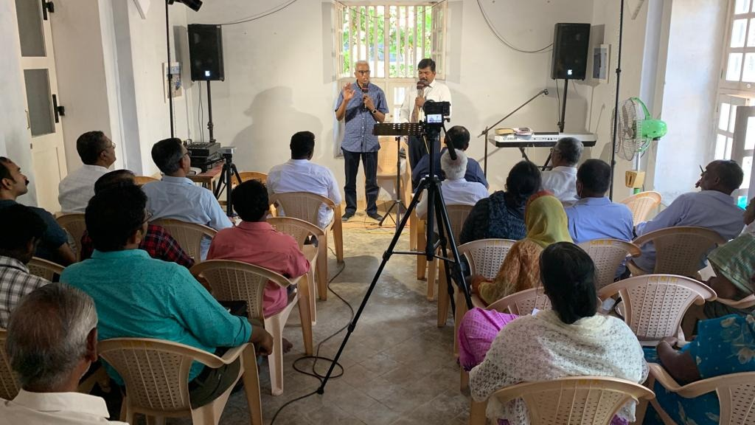

Slide 20
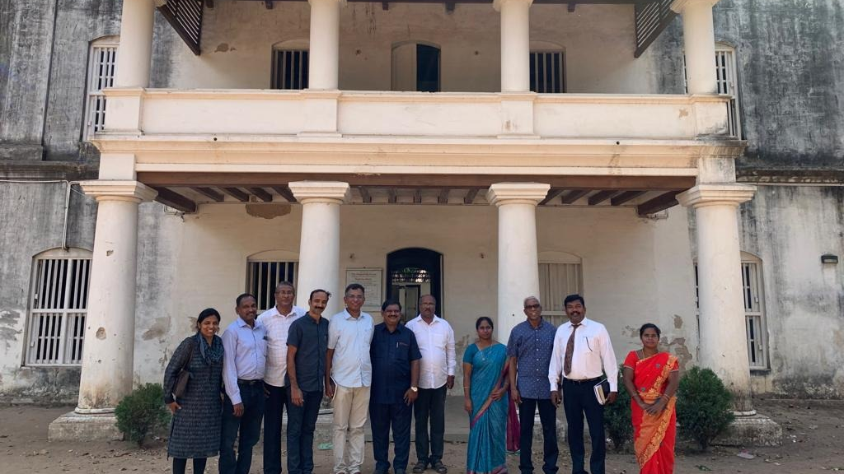

Slide 21
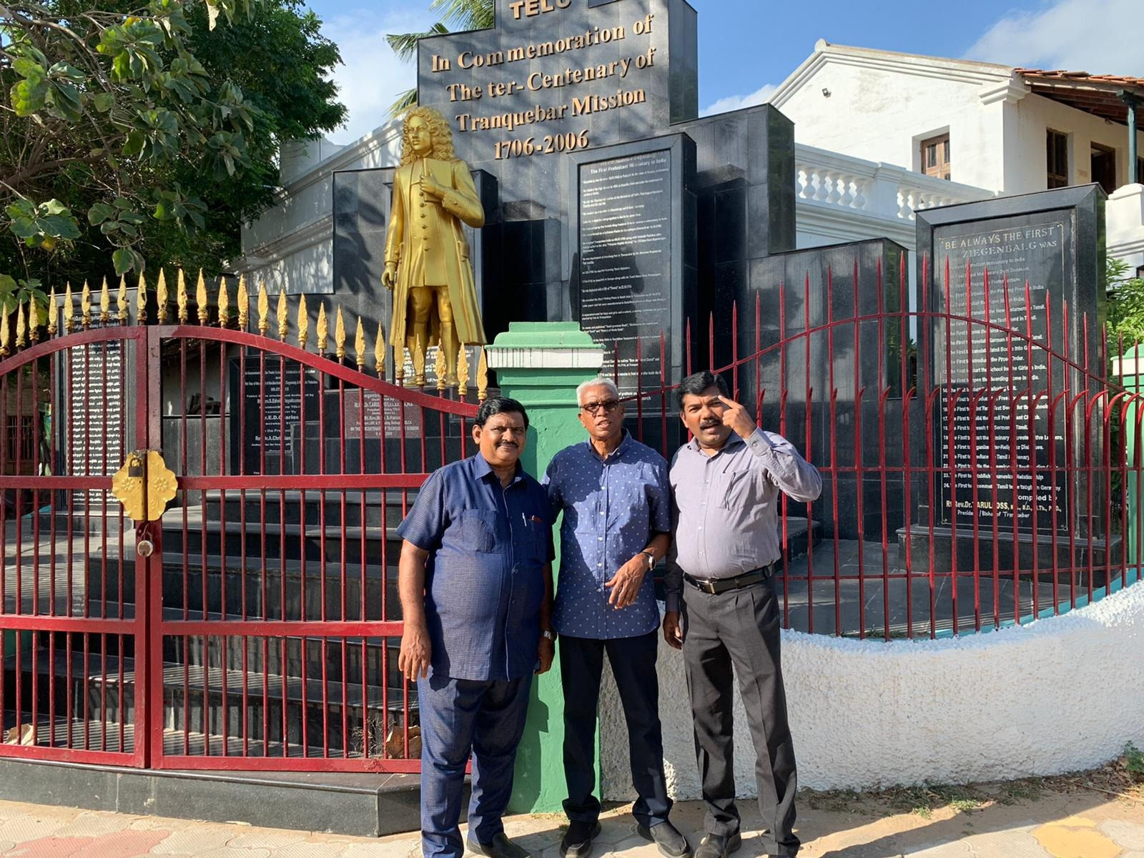

Slide 22
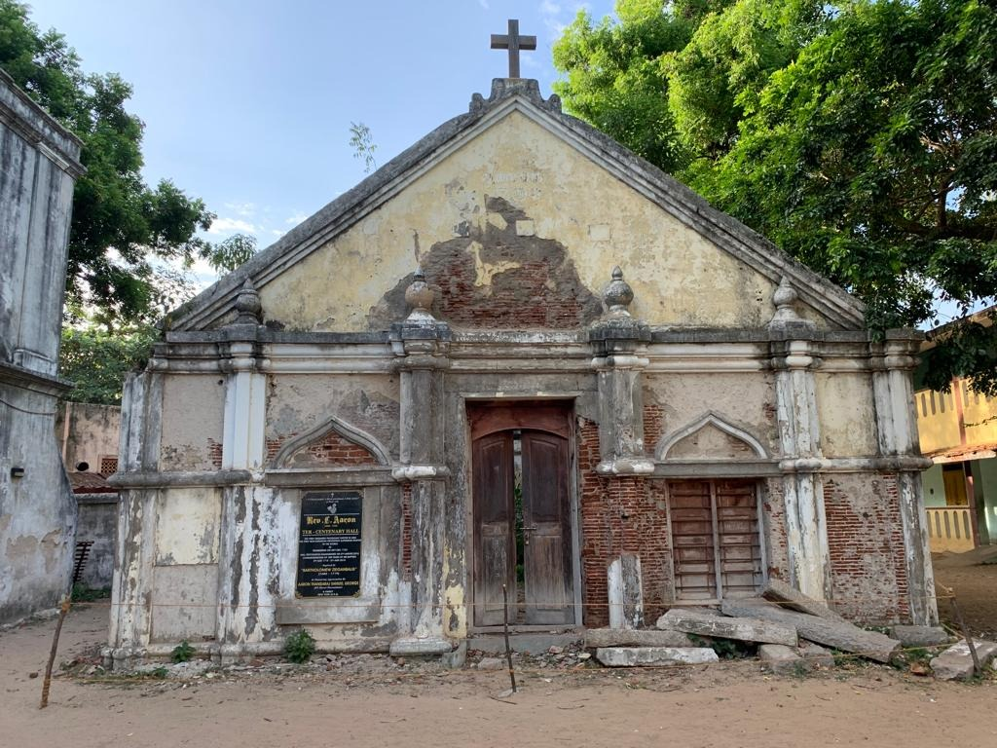

Slide 23
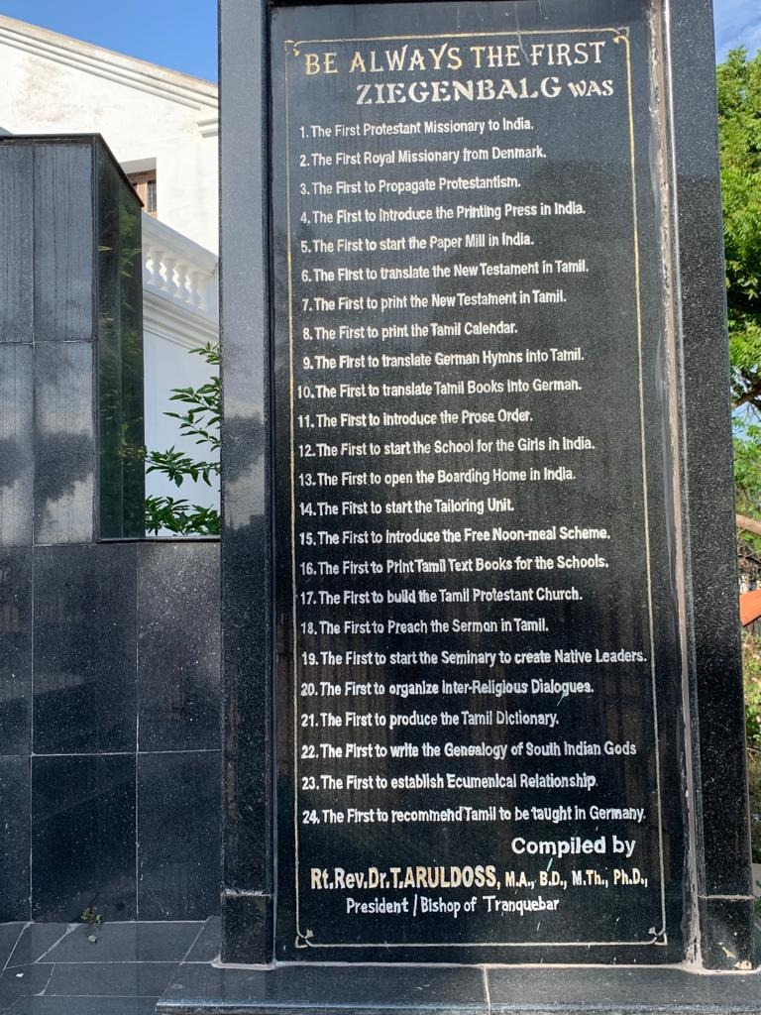

Slide 24
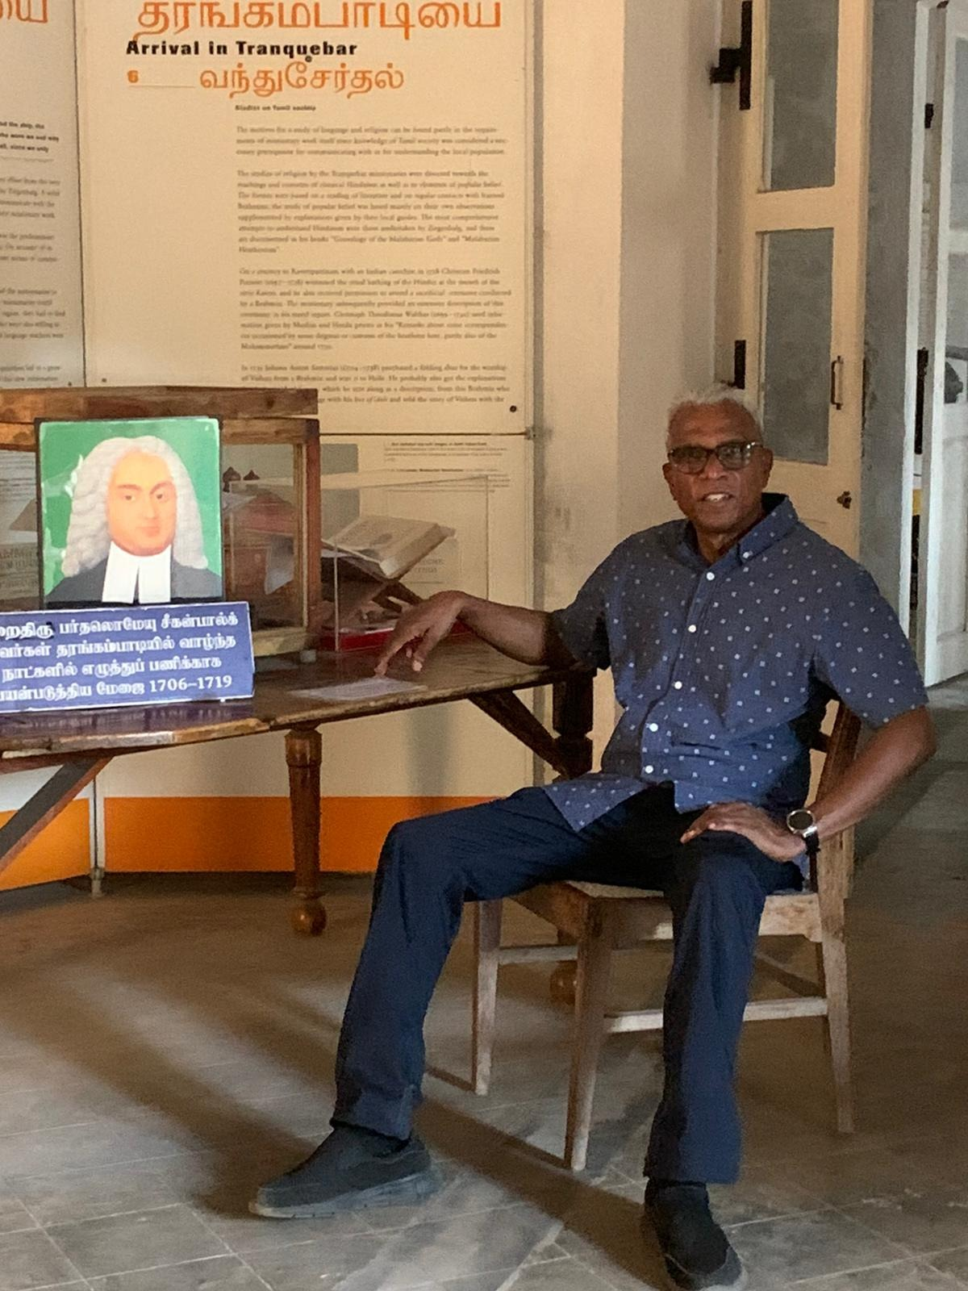

Slide 25
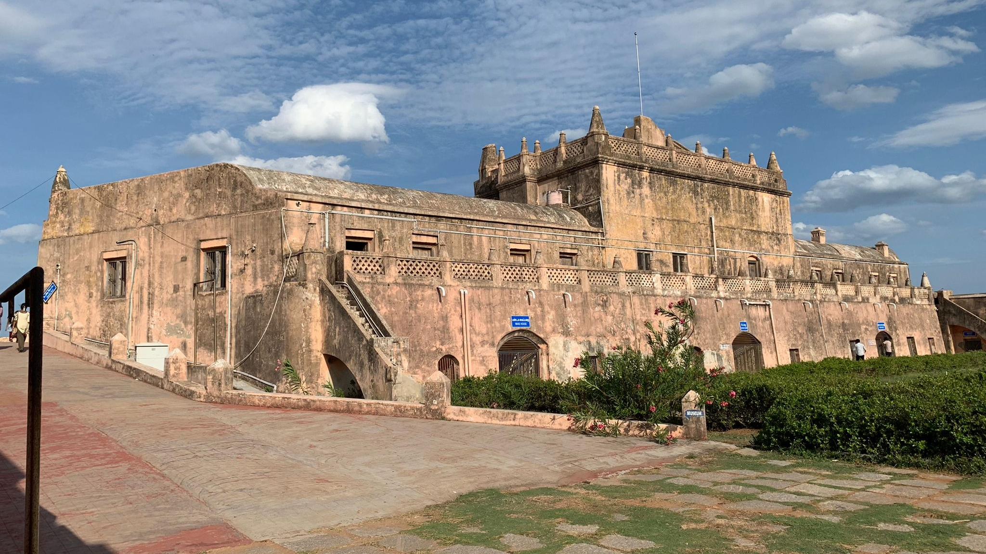

Slide 26
FINISHING THE TASK
Matthew 24:14.
“And this gospel of the kingdom shall be preached in all the world for a witness unto all nations; and then shall the end come.
A Believer – Evangelism
A Body – A Church
A Bible – Translation
Breakthrough Prayer

