Slide 1


A Heavenly and Prophetic Calling
You are the one
This is the place
And now is the time to be a HIS-tory Maker for Jesus.

Slide 2
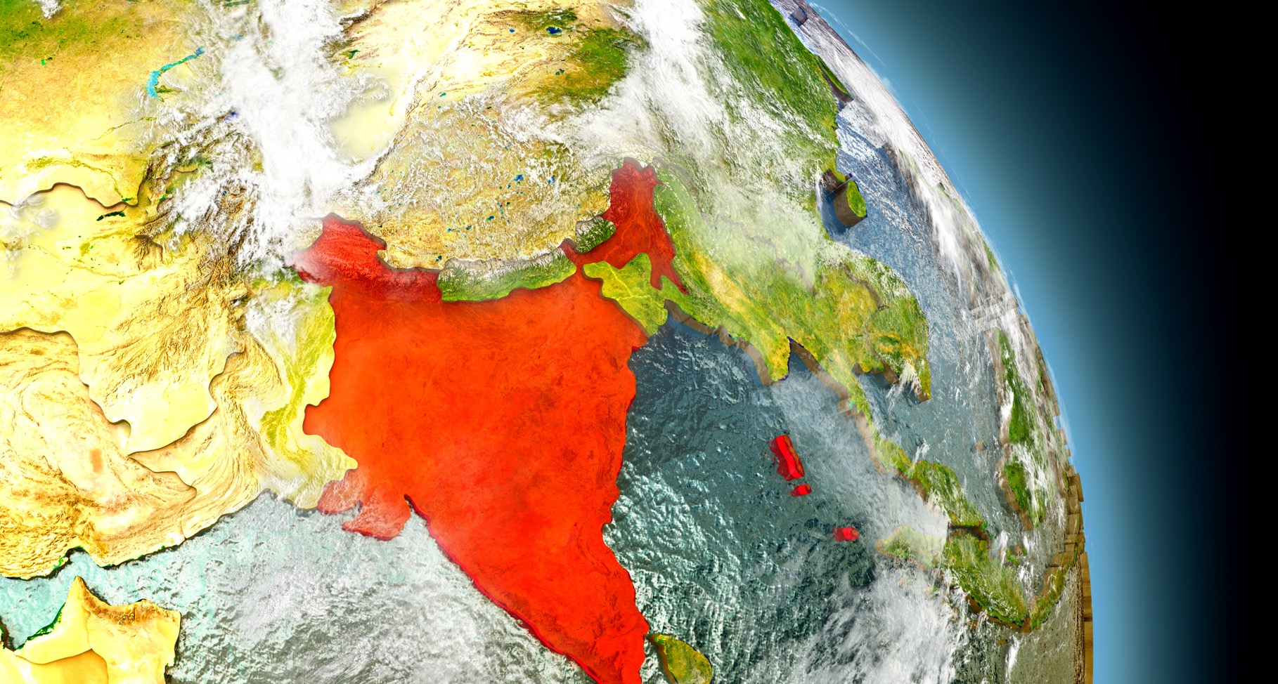
INDIA

Slide 3
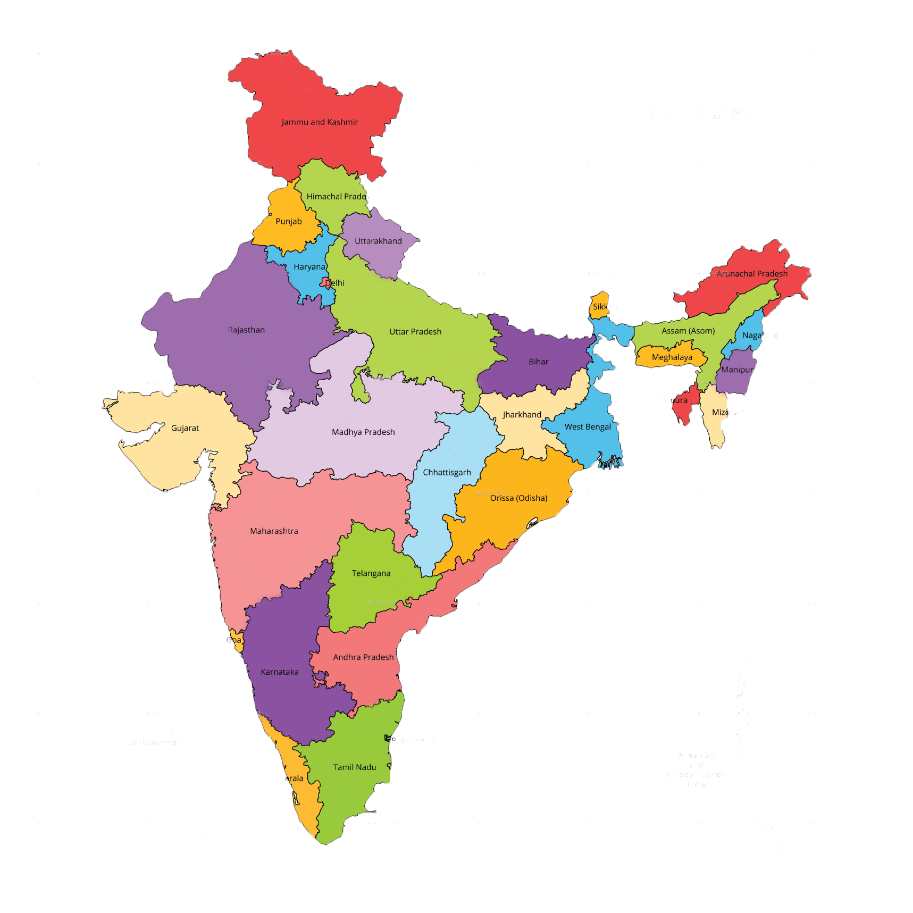
Population - 1,369,566,180
World’s Total Population – 17.1%
Median Age - 27.1 Years
It’s A Young Country
Life Expectancy - 69 Years
4635 PEOPLE GROUPS
1600 AND MORE LANGUAGES
620,000 VILLAGES
400 MAJOR CITIES
753 DISTRICTS
180M Muslims – 99.9% yet to hear the good news
Notes:
India and China are home to 39 per cent of the 830 million young people worldwide who use the Internet, according to a UN report.
https://www.thehindubusinessline.com/info-tech/india-china-home-to-39-of-young-internet-users-un-report/article9796579.ece
35 percent growth in internet users in rural India.
https://economictimes.indiatimes.com/tech/internet/internet-users-in-india-to-reach-627-million-in-2019-report/articleshow/68288868.cms?from=mdr
Internet users in India to rise by 40%, smartphones to double by 2023: McKinsey
Read more at:
//economictimes.indiatimes.com/articleshow/69040395.cms?from=mdr&utm_source=contentofinterest&utm_medium=text&utm_campaign=cppst

Slide 4
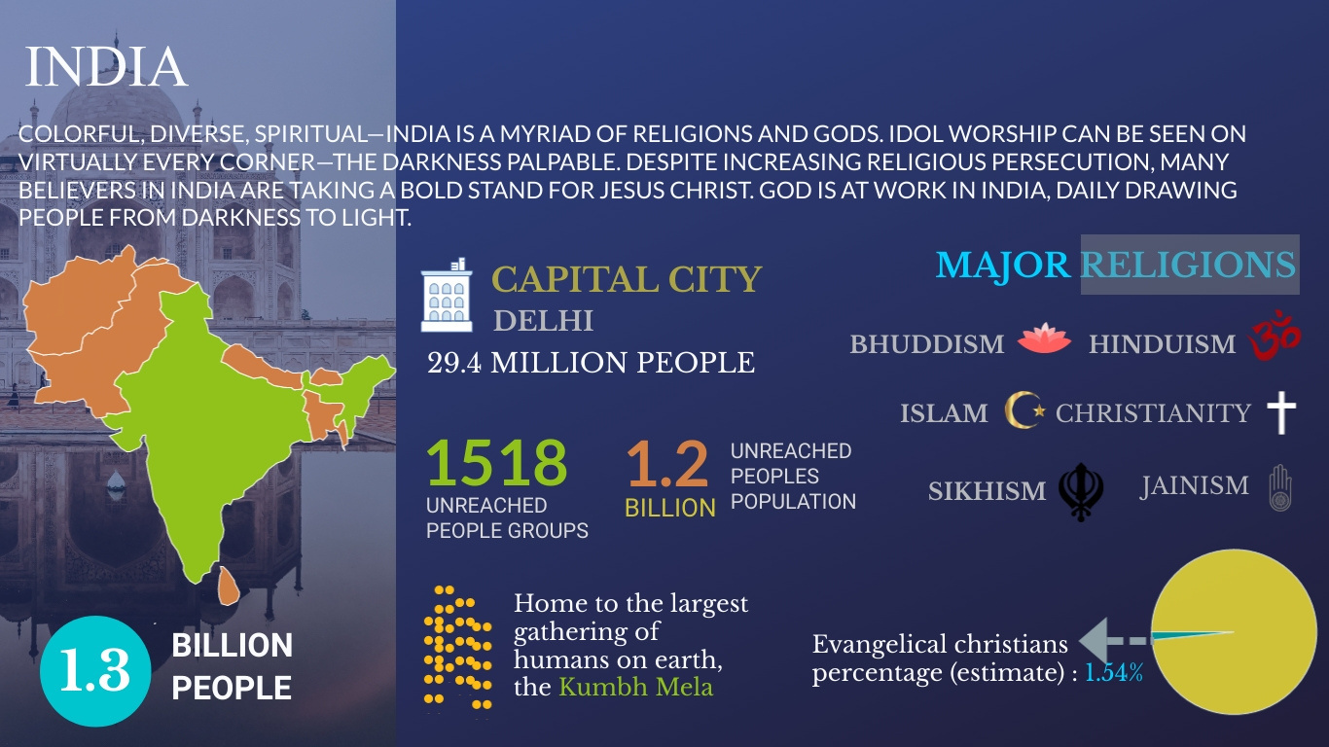
OVERVIEW AND UPG'S

Slide 5
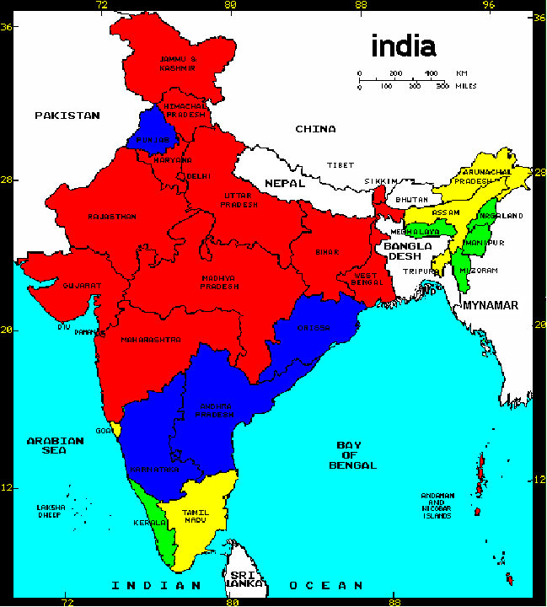
RED Christian
Presence is less than 1%
BLUE Christian
Presence is between 1 % -2%
YELLOW Medium
Christian Presence i.e. 3% - 12%
GREEN indicate
Good Christian Presence i.e. 25% - 90%
6.5% unofficially
Notes:
5

Slide 6

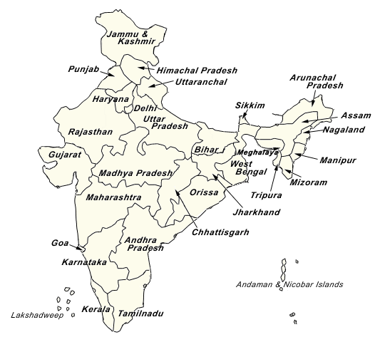
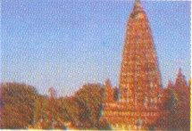
BADRINATH
AMARNATH
HARIDWAR
RISHIKESH
ALLAHABAD
MATHURA
BODH GAYA
MATA VAISHNO
VISHNU
SHIVA
VISHNU & BRAHMA
VISHNU
BRAHMA
KRISHNA
BUDDHA
KHEDARNATH
DEVI
VARANASI
SHIVA
KASI-VISHWANATH
BIRLA MANDIR
KOLKATTA
KALI
AMRITSAR
PURI
GOLDEN TEMPLE
AYODYA
PUTTAPARATHI
RAMA
SAIBABA
AKSHARDAM
TIRUPATHI
PERUMAL
PUSHKAR
NASHIK
SABARI MALA
KANYAKUMARI
RAMESHWARAM
CHIDAMBARAM
MELMARUVATHUR
MADURAI MEENAKSHI
BRAHMA
RAMA, LAXMAN, SITA
AYYAPPAN
KANYAKUMARI AMMAN
SHIVA
SHIVA
ADHIPARASAKTHI
MEENAKSHI
Notes:
6

Slide 7
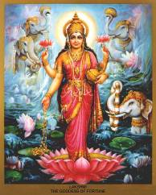
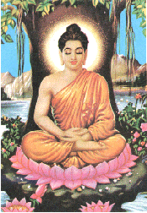
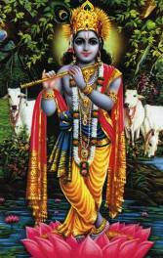
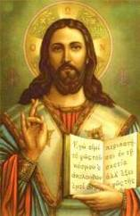
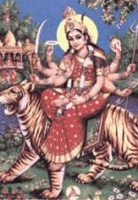
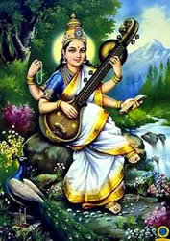
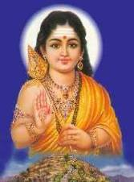
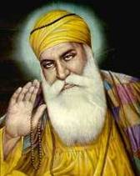
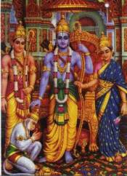
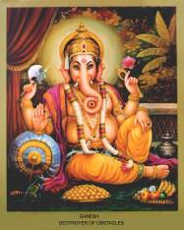
1.4 Billion people, 3 Billion Gods
Lakshmi
Buddha
Krishna
Lord Jesus Christ –
Hindus also believe in Him
Devi
Saraswati
Murugan
Nanak
Rama
Ganesha

Slide 8
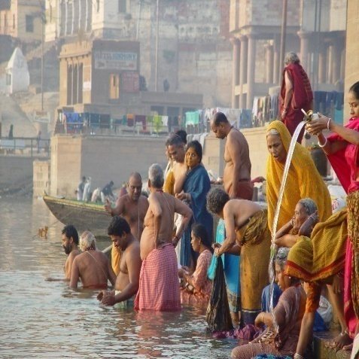
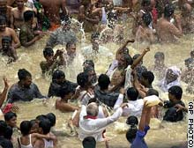
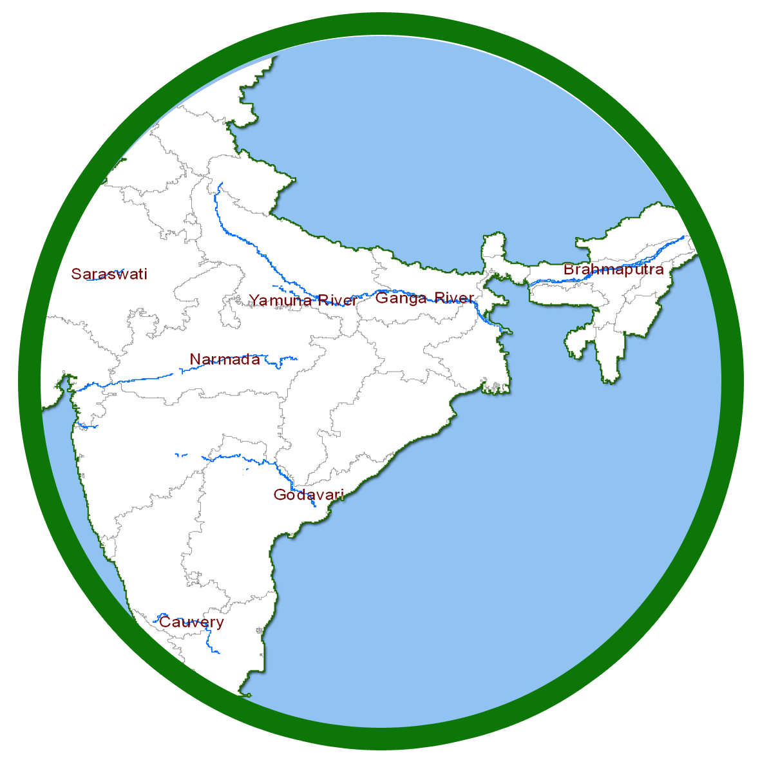
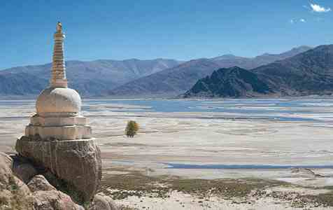
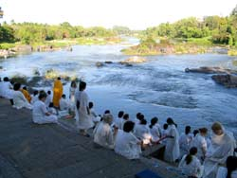
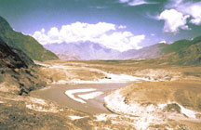
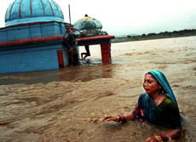
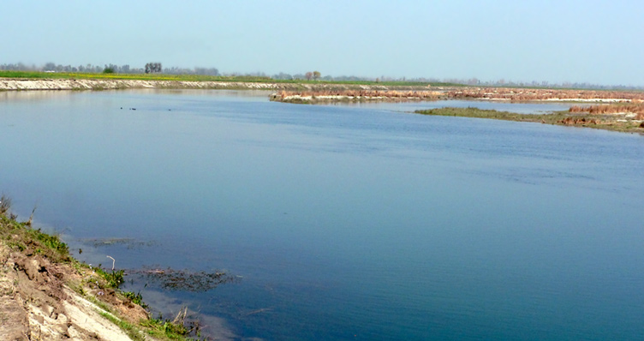
7 SACRED
RIVERS

Slide 9

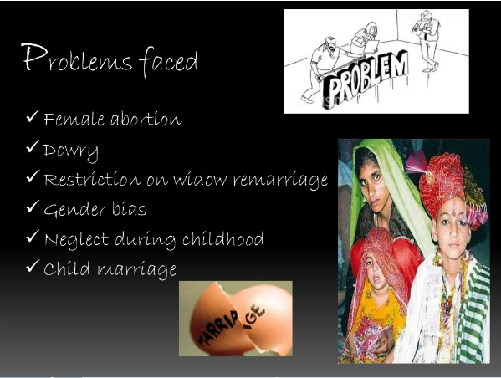
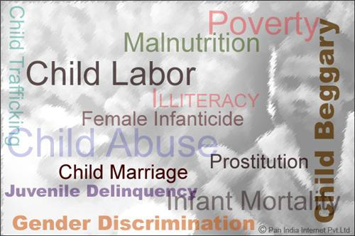
INDIA -KEY CHALLENGES
SOCIAL PROBLEM FACED BY WOMEN & CHILDREN

Slide 10
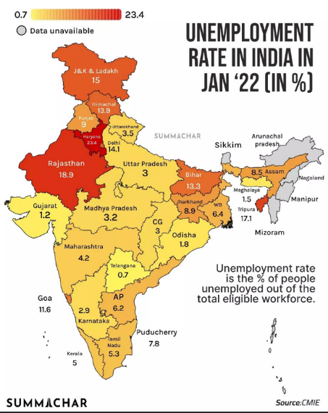
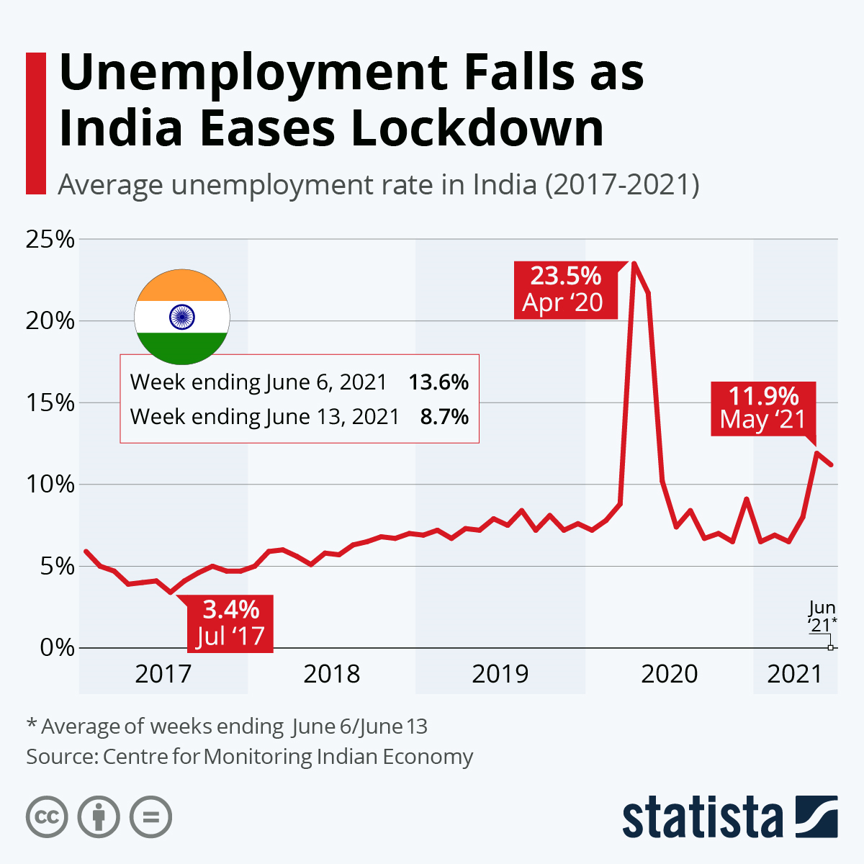
INDIA -KEY CHALLENGES
UNEMPLOYMENT IN INDIA

Slide 11
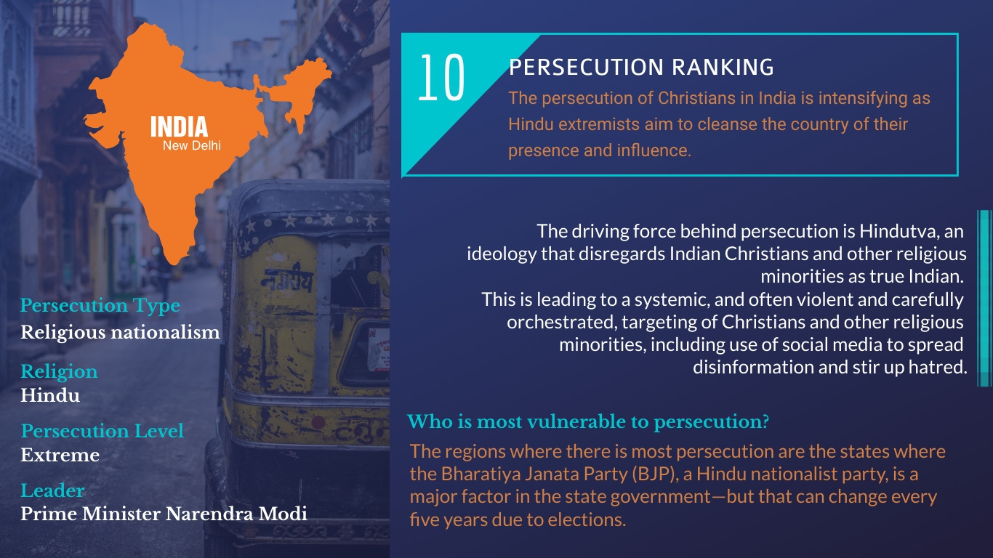

Slide 12
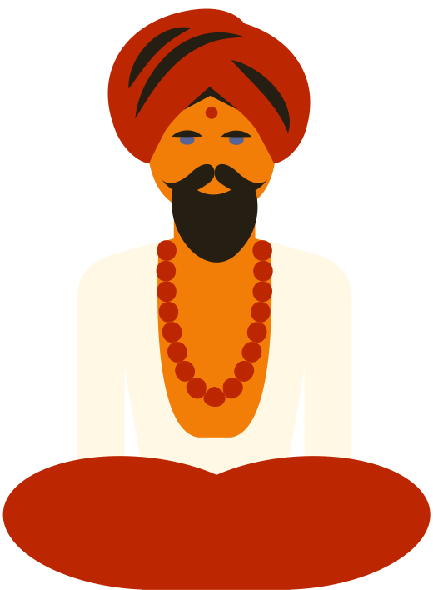
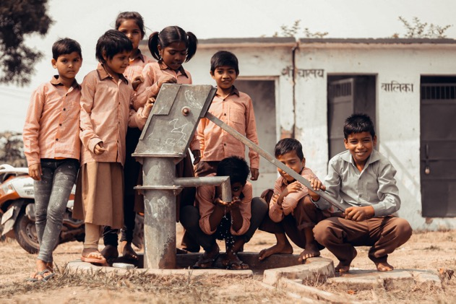

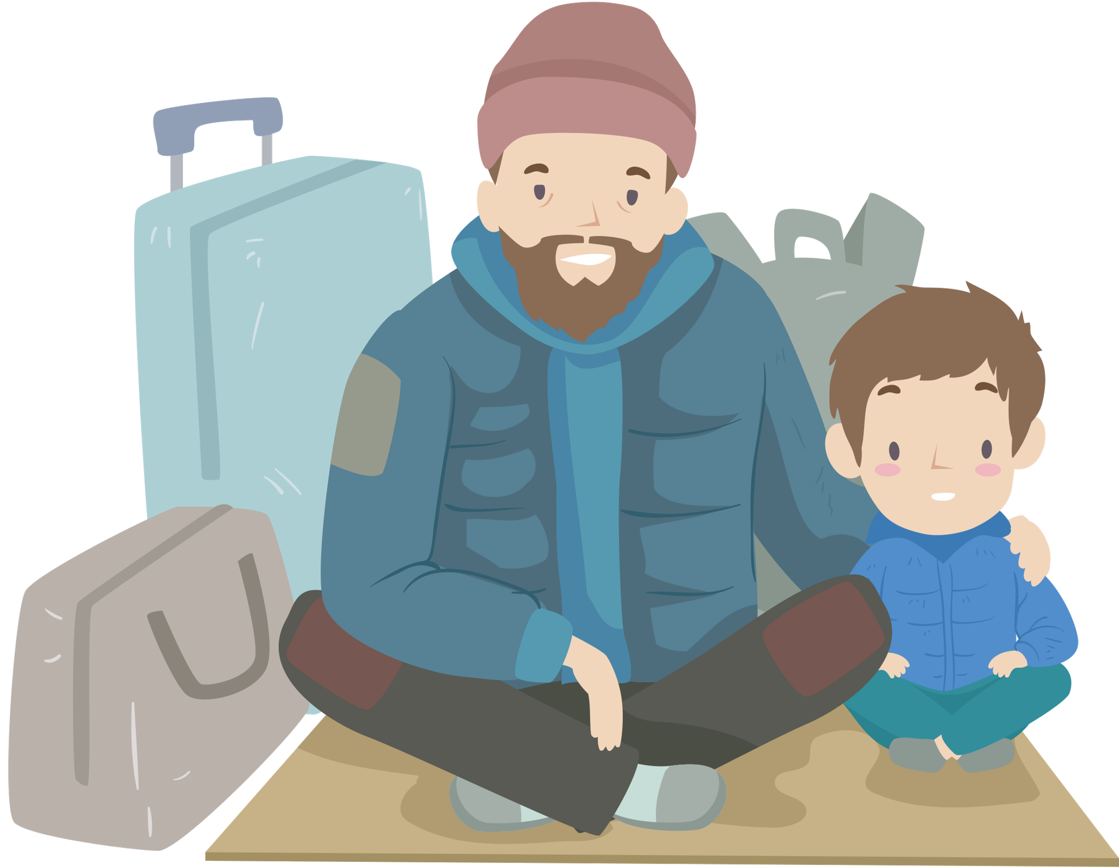

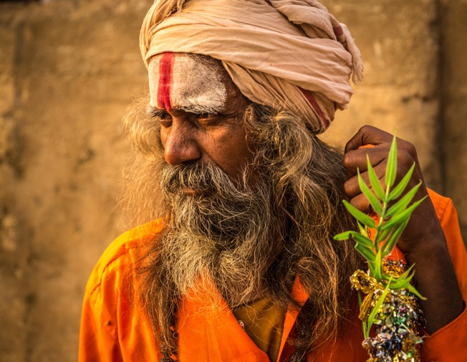


Pray for the cultural barriers of the caste system and Hinduism to be overcome by the Gospel. Pray for Christians to remove all caste discrimination from the Church, where it sadly does exist.
Pray for the Good News of Jesus Christ to reach every village and town.
Pray for justice and hope in a nation plagued by oppression, poverty, and disease.
Pray for our brothers and sisters in India to endure in the midst of this increasing persecution. Pray that churches might grow in unity, and in their ability to withstand persecution.
Pray for labourers to the unreached. Pray for the protection of new believers and Christian workers.
Pray that the government will choose to build on the progress of recent decades, especially to preserve and protect human dignity, rights, and freedoms.
PRAY FOR INDIA

Slide 13
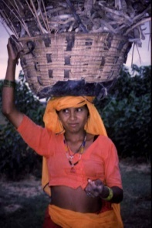
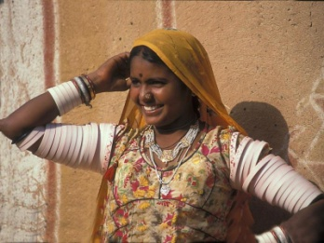
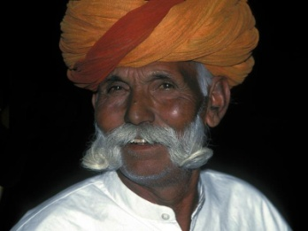
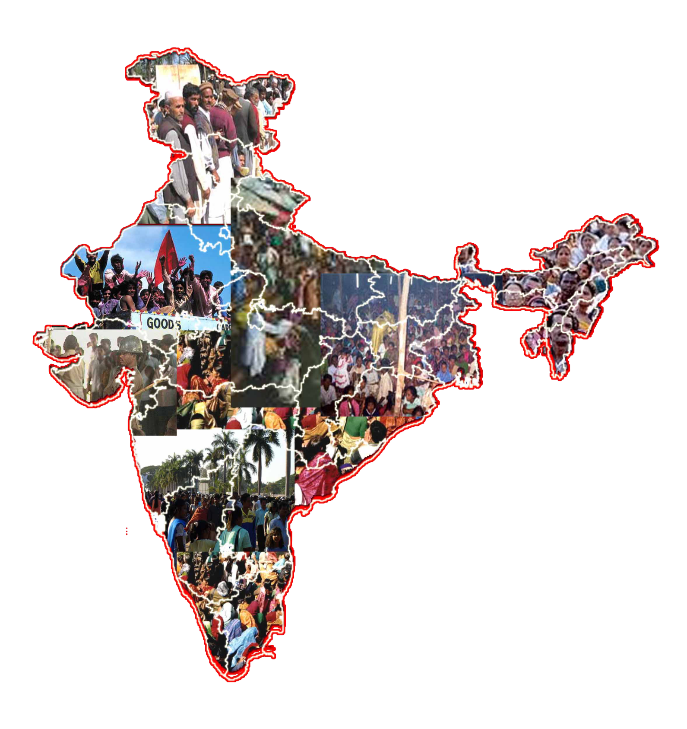
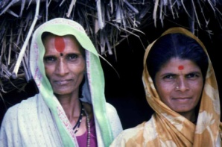
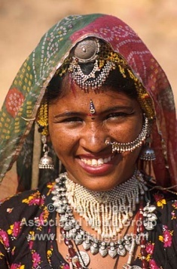
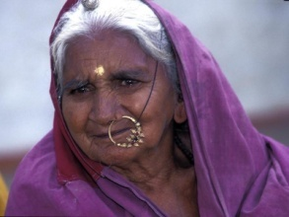
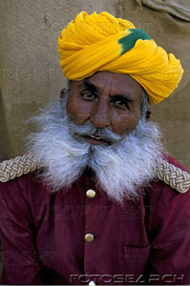
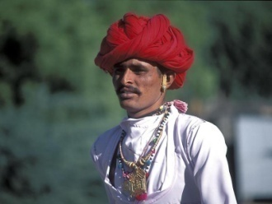
People Group
Out of
4635 / 3000 -unreached
Notes:
13

Slide 14
Villages
Out of
3.4/7 Lakhs-unreached
Notes:
14

Slide 15
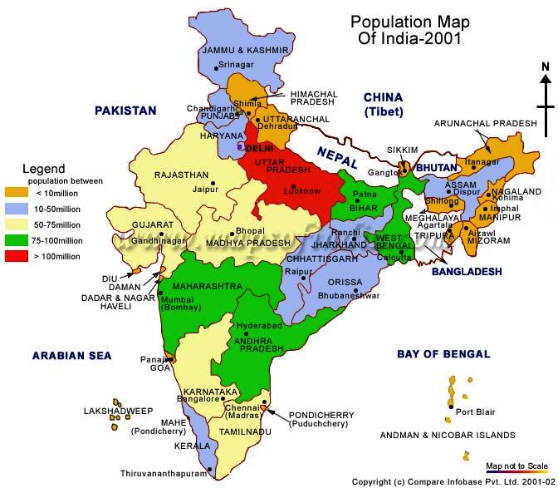
Not a single church in 2600 people groups.
13 crores of people have no access to hear the good news by radio or TV.
No Christian worker in 18000 pincodes out of 28000 pincodes in India.

Slide 16
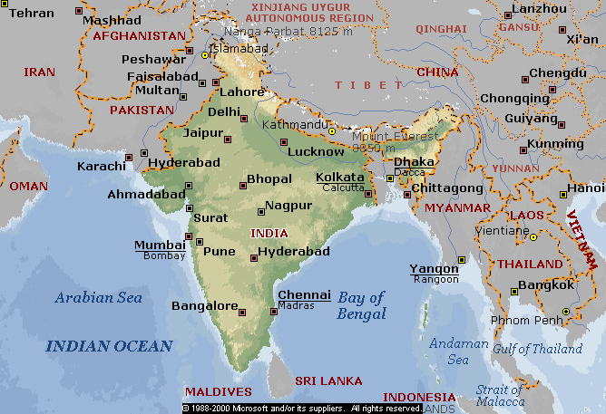
19 CRORE
Muslims
Notes:
16

Slide 17
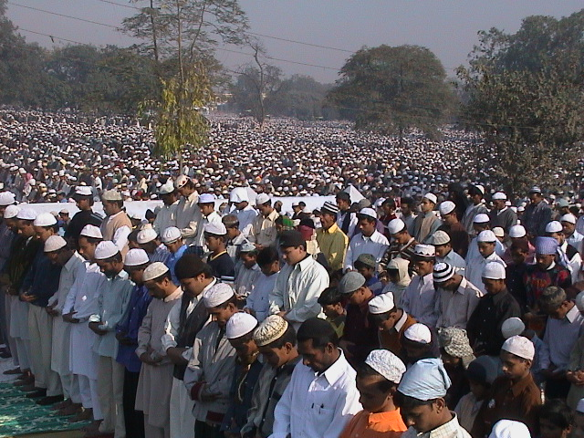

Slide 18
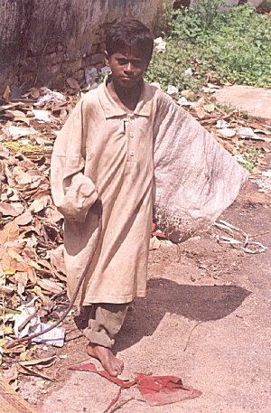



1 Crore Child Labour
Under 14 Years
Notes:
18

Slide 19
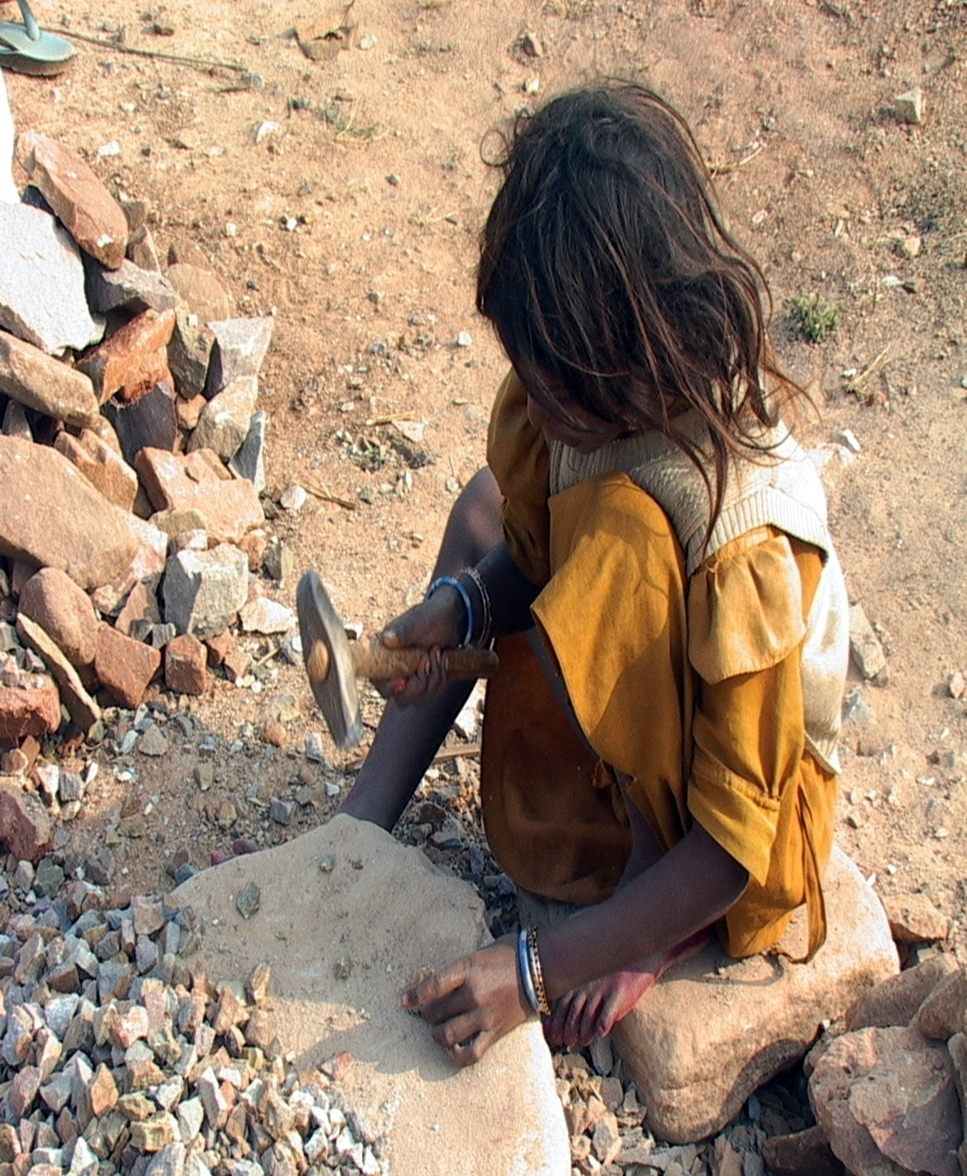
Notes:
19

Slide 20
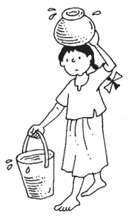
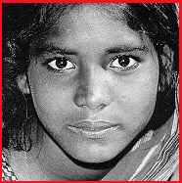
Domestic servant

Slide 21
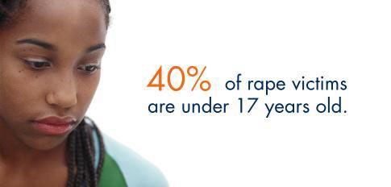
Harm to his children
Notes:
21

Slide 22

Children in Poverty
Notes:
22

Slide 23








INDIA -KEY CHALLENGES
Caste system continues to hold great influence over the culture and remains a major bar to social mobility. To this day, it is difficult for people of lower castes to find jobs, no matter what their education or background
Out of 1.5 billion people, 15% are malnourished
Of the 400 million children, possibly up to 35 million are orphans. 11 million are abandoned (90% are girls). 3 million live on the streets. Two-thirds of all children suffer physical abuse, and half suffer some kind of sexual harassment or abuse.
Overpopulation also makes pollution and sanitation unmanageable. These contribute to deadly realities such as contaminated water and widespread diseases such as cholera, typhoid, hepatitis, and more.
Society prefers male children, so some families abort, abandon, or even kill girl babies. the female population today lacks 35 million girls when compared with the male population. Women have lower rates of literacy and education, and domestic abuse is a widespread problem. Some young girls get dedicated to the ancient service of temple prostitution.
India’s infrastructure is unreliable, and political corruption is rampant.

Slide 24
Child Marriages
As many as 8.9% young girls in India still get married before attaining the age of 13 years while another 23.5 per cent tie the nuptials by the age of 15 and 50% before 18 years. The report says up to 30 per cent of young males have premarital sexual encounters with casual partners, multiple partners and even sex workers whereas the same is 10 per cent in case of young girls

Slide 25

Child Marriages
Notes:
25

Slide 26
Child Marriages
One-third of world's child brides in India: UNICEF: Nearly 25 million women in India were married in the year 2007 by the age of 18, according to a UNICEF report. The report added that children in India, may be engaged or even married before they turned 10.

Slide 27

Child prostitution
Notes:
27

Slide 28

Child Sacrifice
Child Sacrifice is increasing in India.
More than 1000 people groups in INDIA still practice the custom of offering the blood of their child to their God and Goddesses.
Notes:
28

Slide 29
Missing Children
One lakh children go missing in India every year: Home ministry. http://timesofindia.indiatimes.com/india/One-lakh-children-go-missing-in-India-every-year-Home-ministry/articleshow/39779841.cms
More worryingly, 55% per cent of those missing are girls and 45% of all missing children have remained untraceable as yet raising fears of them having been either killed or pushed into begging or prostitution rackets.
84% rise in missing children in 3 years

Slide 30






Slide 31



Slide 32


INDIA -KEY CHALLENGES
BLIND PEOPLE IN INDIA

Slide 33

Disabled Children
71% of disabled kids in rural India
India has 20.42 lakh disabled children aged between 0 and 6 years.
Children with hearing and eyesight disabilities form the lion's share among them

Slide 34
SPECIFIC STRONGHOLDS WHICH NEED TO BE TORN DOWN
SOCIAL STRONGHOLDS - Is the oppression over a city in high social injustice, racism and poverty, with their related problems, cause people to believe God does not care about their needs.
STRONGHOLDS BETWEEN CITY AND CHURCH - These are wedges driven by Satan between the church and the city which create an "us against them".
SEATS OF SATAN - A geographic location which is highly oppressed and demonically controlled by a dark principality. From this seat the enemy conducts warfare on the city, nation etc. Rev. 2:13.
SECTARIAN STRONGHOLDS - Cause division among churches, pride in doctrine and beliefs and idolatry of denominations etc.,
STRONGHOLDS OF INIQUITIES - These come from the sins of the fathers that produce iniquities or weakness toward certain types of sin in the succeeding generations. Neh.1:6 onwards

Slide 35


Vision of Coca-Cola Company
“A can of Coke in the hand
of every person on the planet.”

Slide 36






How much more Jesus Christ?

Slide 37

… Seeking the face of God for INDIA

Slide 38
5 points for Instant Prayer
People
Christians/ Believers
Workers / Pastors/ Missionaries
Rulers / Administrators/ PM/ President/MPs/ MLAs/Counselors
Against the Plan of the Evil One.

Slide 39
Conclusion
Teach me How to Pray
01
Give me Grace to Pray
02
Give me Strength to Pray
03
Pour unto me the Spirit of Intercession – Zac 12:10
04

