Slide 1
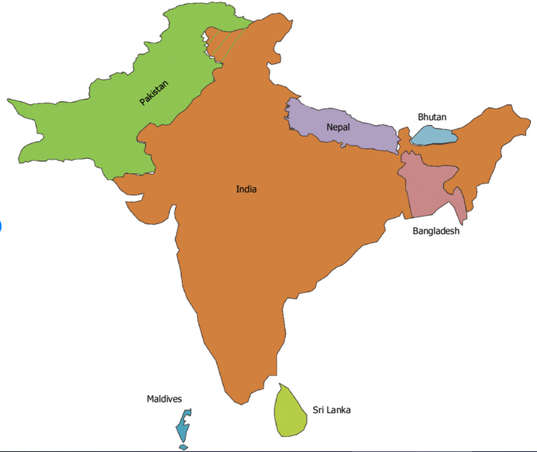
Afghanistan
Mission Challenge....
In a region like this in South Asia
Such a time like this

Slide 2
~2 Billion People
2000+ UPG,99%UUPG
4000 nations
Lost ,Last, Least Peoples
Coastal, Inland, PG, Missional
  Every believer a minister - From anywhere to every where
  Trends

Slide 3
1. VISION
Envisioned for mission
Great awakening on mission:
  2000years of StThomas
  500 years of mission initiative
  300 years of Protestants
  200 years of Renewal movements
  100 years of Charismatic AG mission
  50 years of emerging mission
Making Southern Hemisphere
  Tribals
  Dalits
  BC
  Others
  Children, Women
Challenge: Breakthrough

Slide 4
2. PASSION
Entrusting it to Men, Women and Children.
  Trusting vs. Tokenism.
Discipling as Leaders
2 Tim 2:2 - Commit to others:
Paul, Timothy, Faithful, Others
Pareto says 20% of what you do results in 80%of your outcome

Slide 5
3. MANDATE
Enabled mission as transformation
Engaging in costly visible bold terms of involvement as a mission movement
Simple Beginnings
  Not Surviving but thriving
Sustain the Strong Holds
  Creating momentum
Exponential growth
  Massive Church Growth Movements

Slide 6
In next 5 years like Moravians
24X7 in 1000 prayer centers
7 nations around India
  To think of networking facilitating reciprocating
Grassroot movements to give birth, Float and keep going
Be a GO Getter

Slide 7
I. PRAYER
No commercial
No name, fame, game
No wealth multiplication
No crazy success syndrome

Slide 8
II. MISSION
Kingdom of God
Nothing else

Slide 9
III. GLORY OF GOD
The supreme owner of our lives
Mission and any initiative

Slide 10
IV. CONFESSIONS
Forgive
Forgotten
Setting right
Humility

Slide 11
V. UNITY
Love
Respect
Equality
Transparent
Radical love for one another
Real genuine broken people's prayer

Slide 12
One idea could transform million if not billion
One strategy could make the difference
Innovative practical movements to happen
Rev 5:13 – Blessing and honor and glory and power be to him who sits on the throne and to the lamb, forever and ever
Worthy is the Lamb

