Slide 1
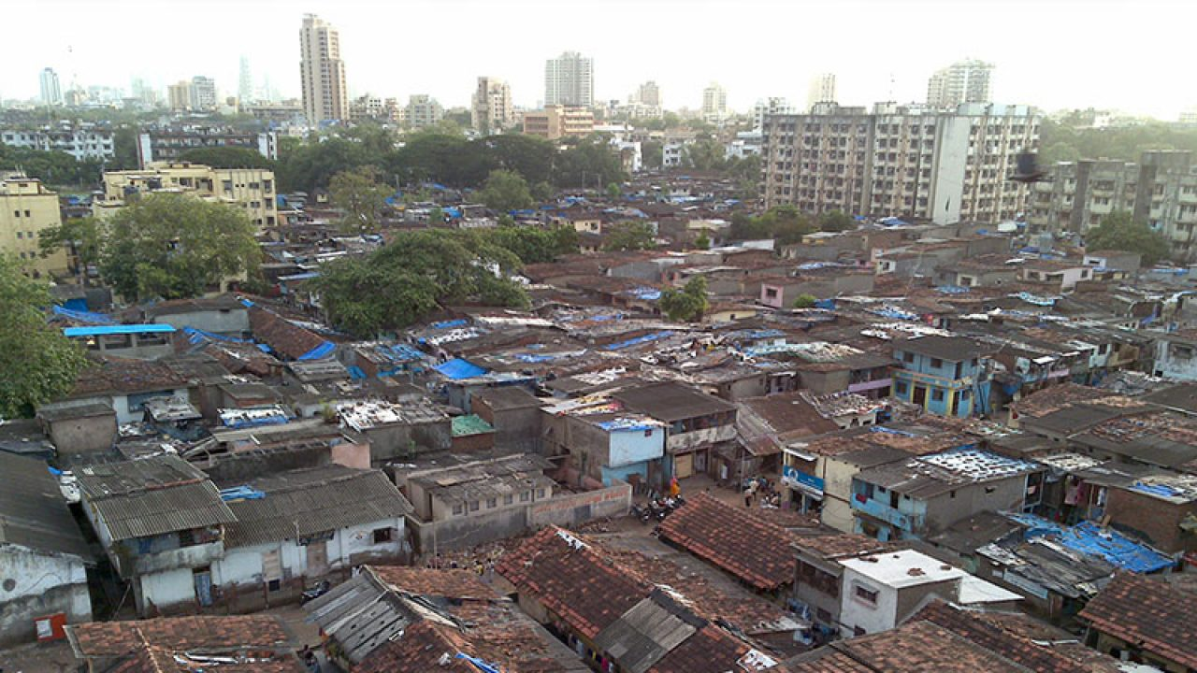
The Whole Church
Taking The Whole Gospel
To The Whole City
MOVEMENT SOUTH ASIA

Slide 2
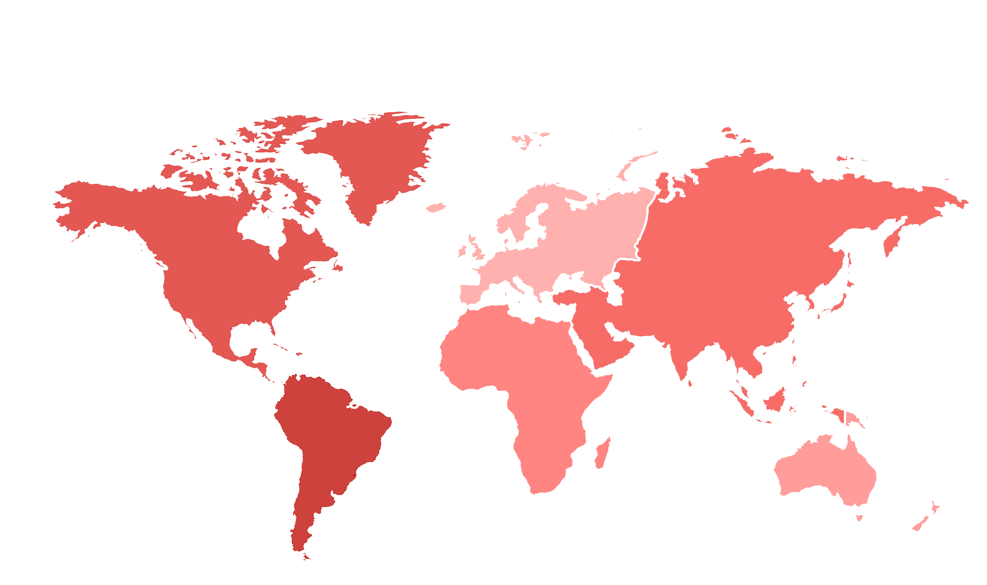

The Need
2.5 Billion Total, 33% of Global Population
Europe
571 Million | 77% Christian
Asia
388 Million | 9% Christian
Northern America
277 Million | 76% Christian
Oceania
29 Million | 71% Christian
Latin America
601 Million | 92% Christian
Africa
631 Million | 45% Christian

Slide 3
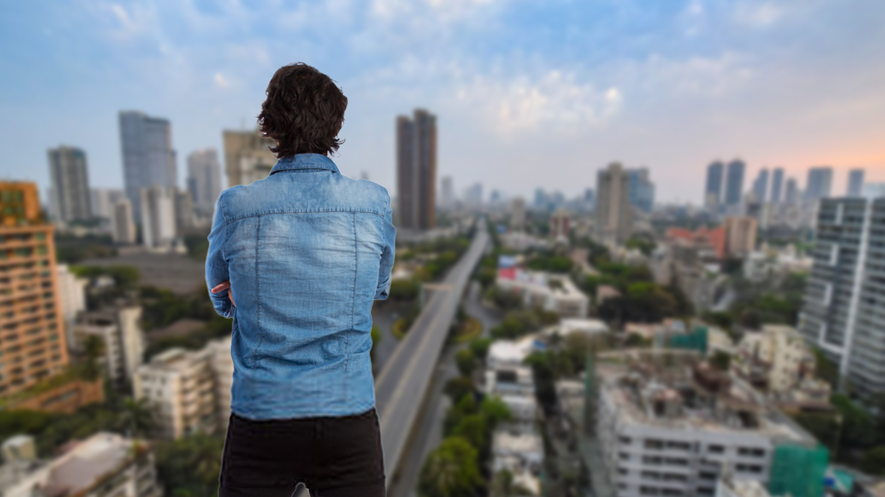

City Gospel Movement
City Gospel Movement is a new paradigm where the Church Leaders, Ministry Leaders, Social Workers and Marketplace Christians come together in unison for kingdom work in the Urban agglomerations.

Slide 4

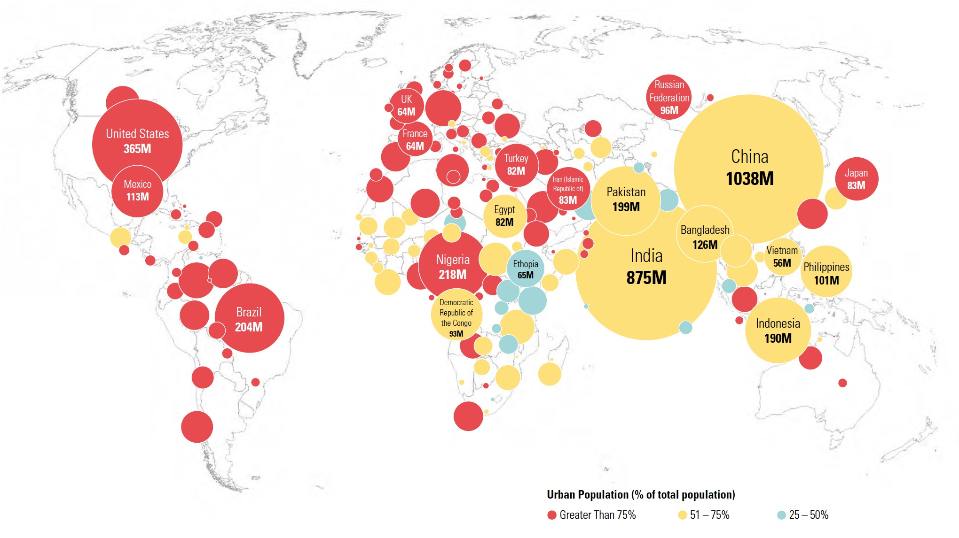
In the journey from garden to a heavenly city
More than half of the global population currently lives in urban areas, with that proportion projected to reach two-thirds by 2050, according to the UN World Urbanization Prospects report.

Slide 5
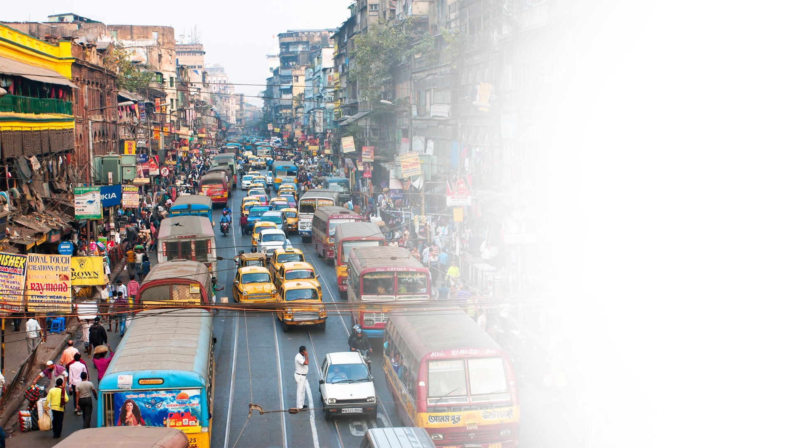
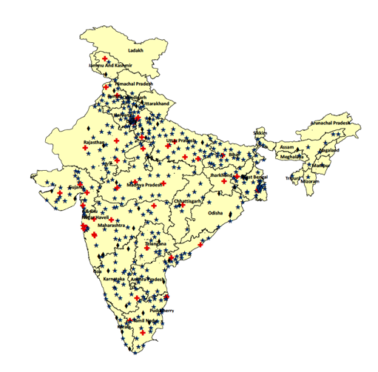
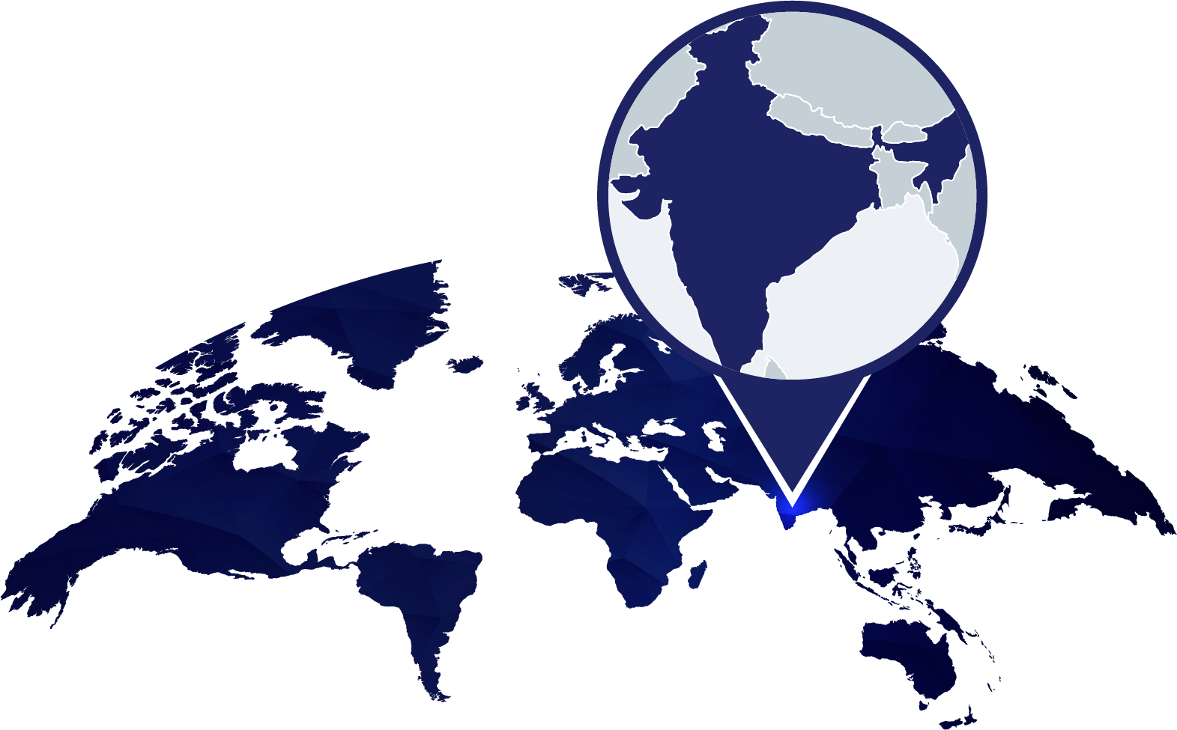
Total Cities in India
7,764

Slide 6
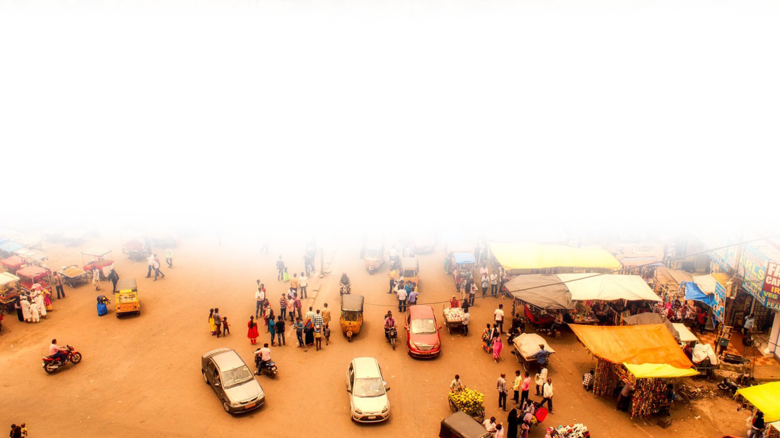
“And should I not pity Nineveh, that great city,”
- Jonah 4:11 (NKJV)
500 Cities in India have population over
1,00,000

Slide 7
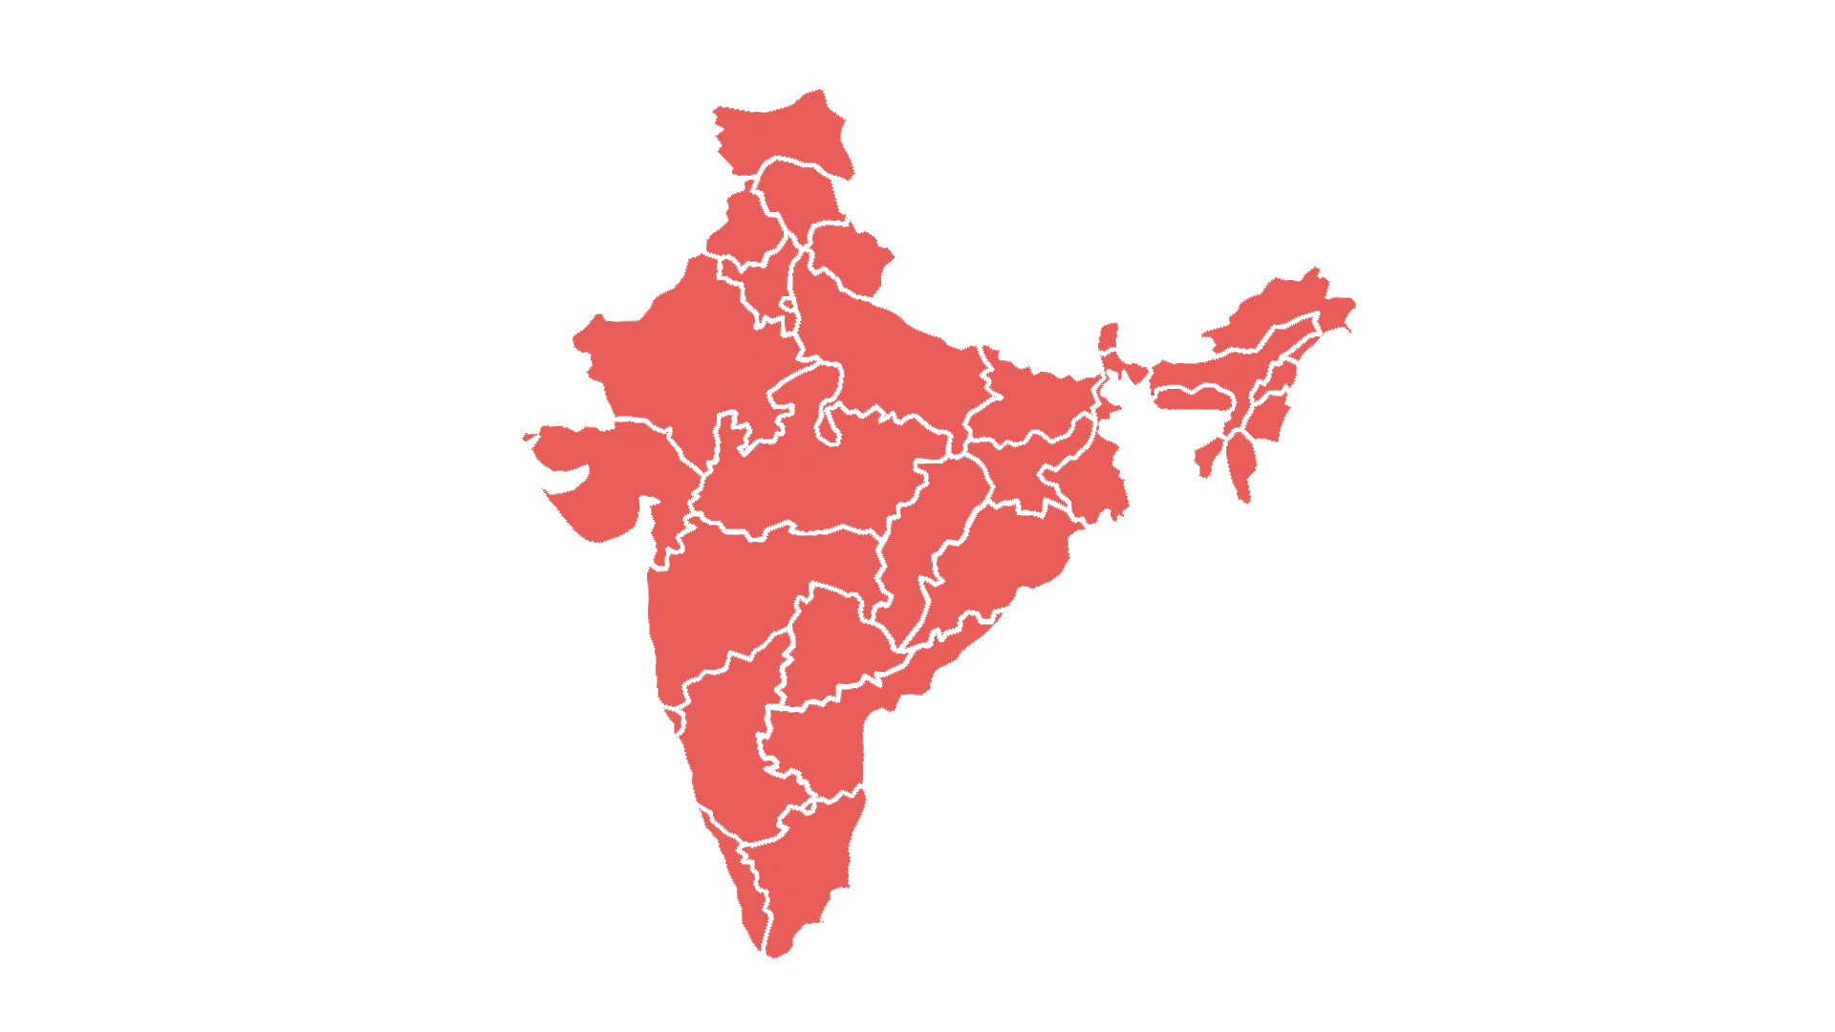
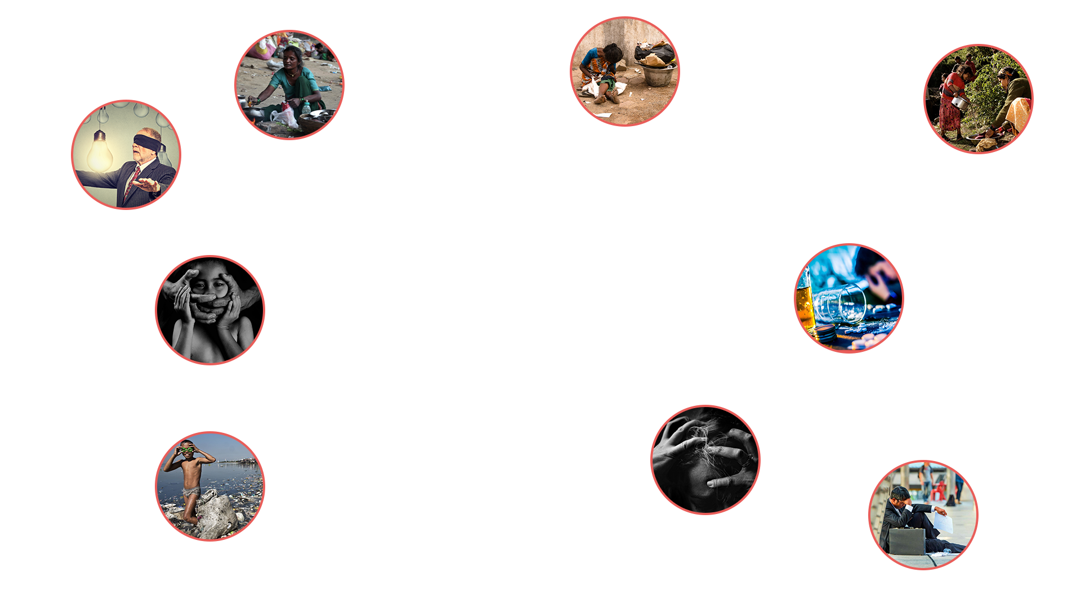
HOMELESSNESS
VIOLENT CRIMES
ENVIRONMENTAL
ISSUES
IGNORANCE
POVERTY
DRUGS & ALCOHOL
MENTAL HEALTH
ISSUES
UNEMPLOYMENT
DISCRIMINATION

Slide 8
Movement Day Gatherings are
Inclusive of demographic diversity
Inspiring leaders to action
Bringing in expert voices to address the spiritual & social realities of urban centers
Offering case studies highlighting best practices in city movements
Convening emerging leaders in shaping solutions — especially young leaders to address the unique issues of urban youth
Creating inter-generational community for shared learning & mentorship
Providing networking & partnership opportunities built around areas of passion for that city

Slide 9
The Gospel Matters
Church Unity Matters
Cities Matter
Emerging Leaders Matter
Gospel Movement Matters
Movement Day’s Belief Structure

Slide 10


THE WHOLE CHURCH
Church Leaders
Pastors/ Youth Leaders
Marketplace Leaders
Business/ Professionals
Non-Profit Leaders
Para Church/ NGOs
CHURCH

Slide 11




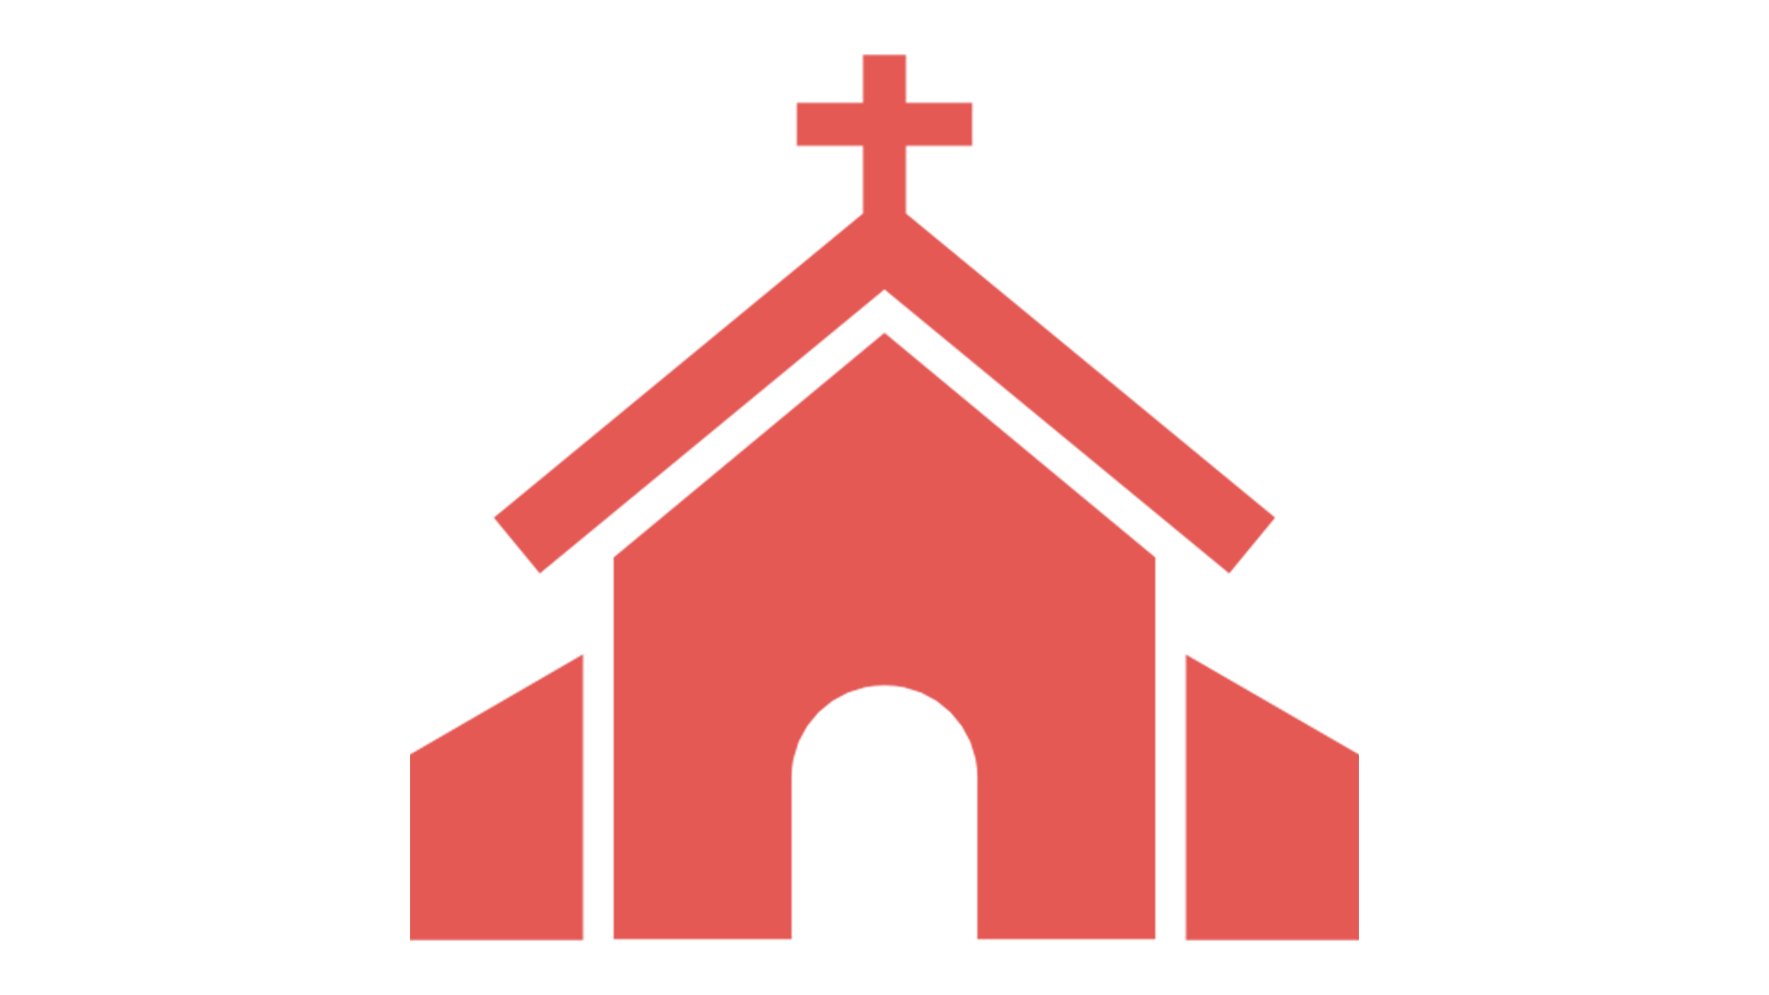
THE WHOLE
GOSPEL
Transformed
Community
Transformed
Individual
Transformed
Church

Slide 12


THE WHOLE CITY
SEGMENTS
STAGES
STREETS
SPHERES
Whole Church
Taking the Whole Gospel
to the Whole City

Slide 13
Prayer Initiatives
Research
Youth Mentoring
Movement of Churches
Social Transformation
Movement Day Expression
Learning Opportunities

Slide 14
Movement Day to City Gospel Movement
Prayer Initiatives
Research
Youth Mentoring
Movement of Churches
Social Transformation
Movement Day Expression
Learning Opportunities

Slide 15
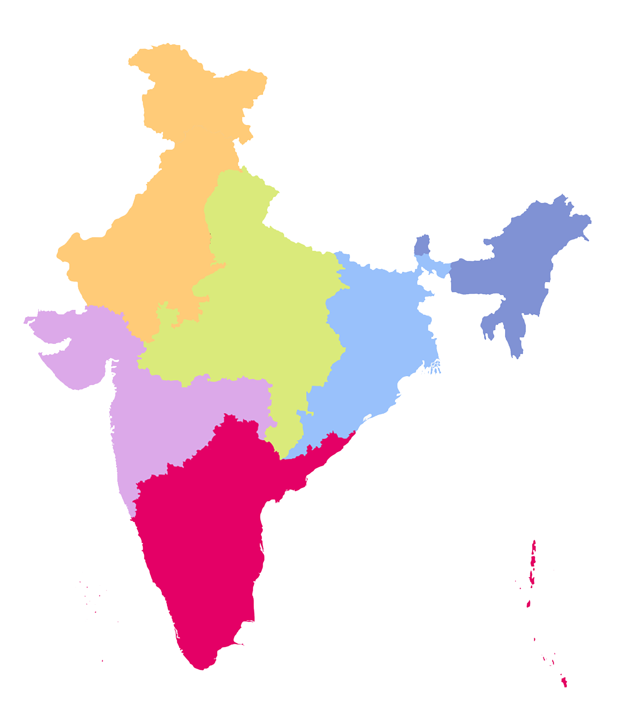



Movement in South Asia
Kathmandu
Darjeeling
Kohima/ Nagaland
Delhi
Gangtok
Kalimpong
Agra
Dimapur
Jaipur
Siliguri
Kolkata
Itanagar
Aizawal
Shillong
Mumbai
Jaigaon/ Phuntshuling (Part of Bhutan)
Pune
Goa
Our goal is to see 200 cities in South Asia to have a Gospel Movement of its own, by 2030
Bengaluru
Chennai
Tuticorin
Kochi
Colombo
Trinelveli

Slide 16
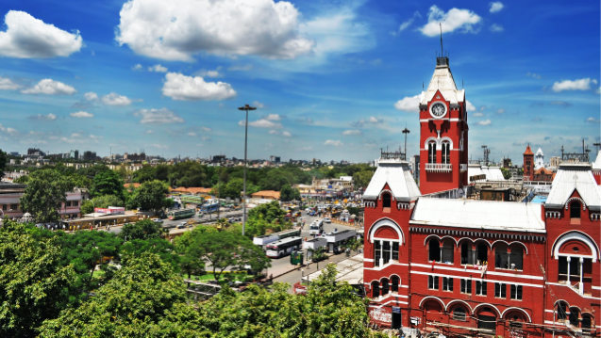
Chennai City Story

Slide 17
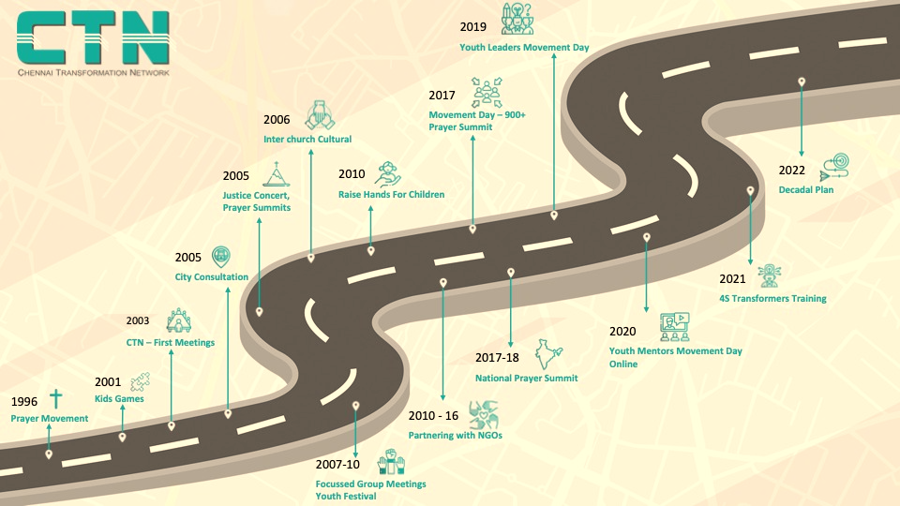

Slide 18
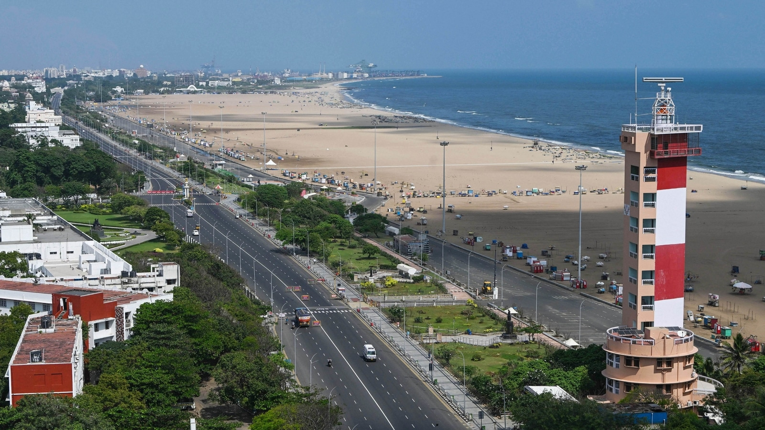
Our Mission – 10 “M”s of Chennai
Mission
Map the city
Focus (4S)
Main Street (Streets)
Outcomes
Mobilise Prayer
Movement of Churches
Millennials (Stages)
Marginalised(Segments)
Marketplace (Spheres)
Multiplying Evangelizing and Disciple making Churches
Impact
10% Christians
10000 Churches
Empowering Kingdom Businesses
Uplifting the Poor
Unleash the now generation

Slide 19
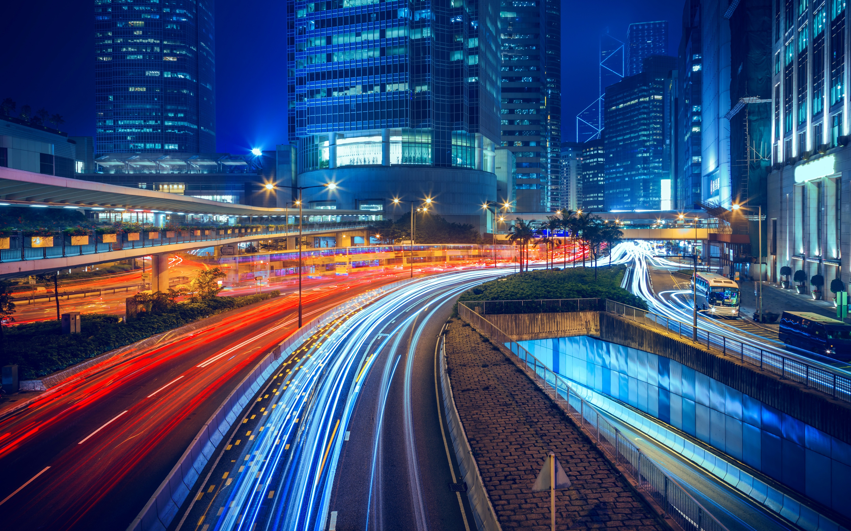
Let Us Take
The Whole Gospel to the
Whole City

Slide 20

Visit us:
www.movementday.in
Contact us:
city@movementday.in

