Slide 1
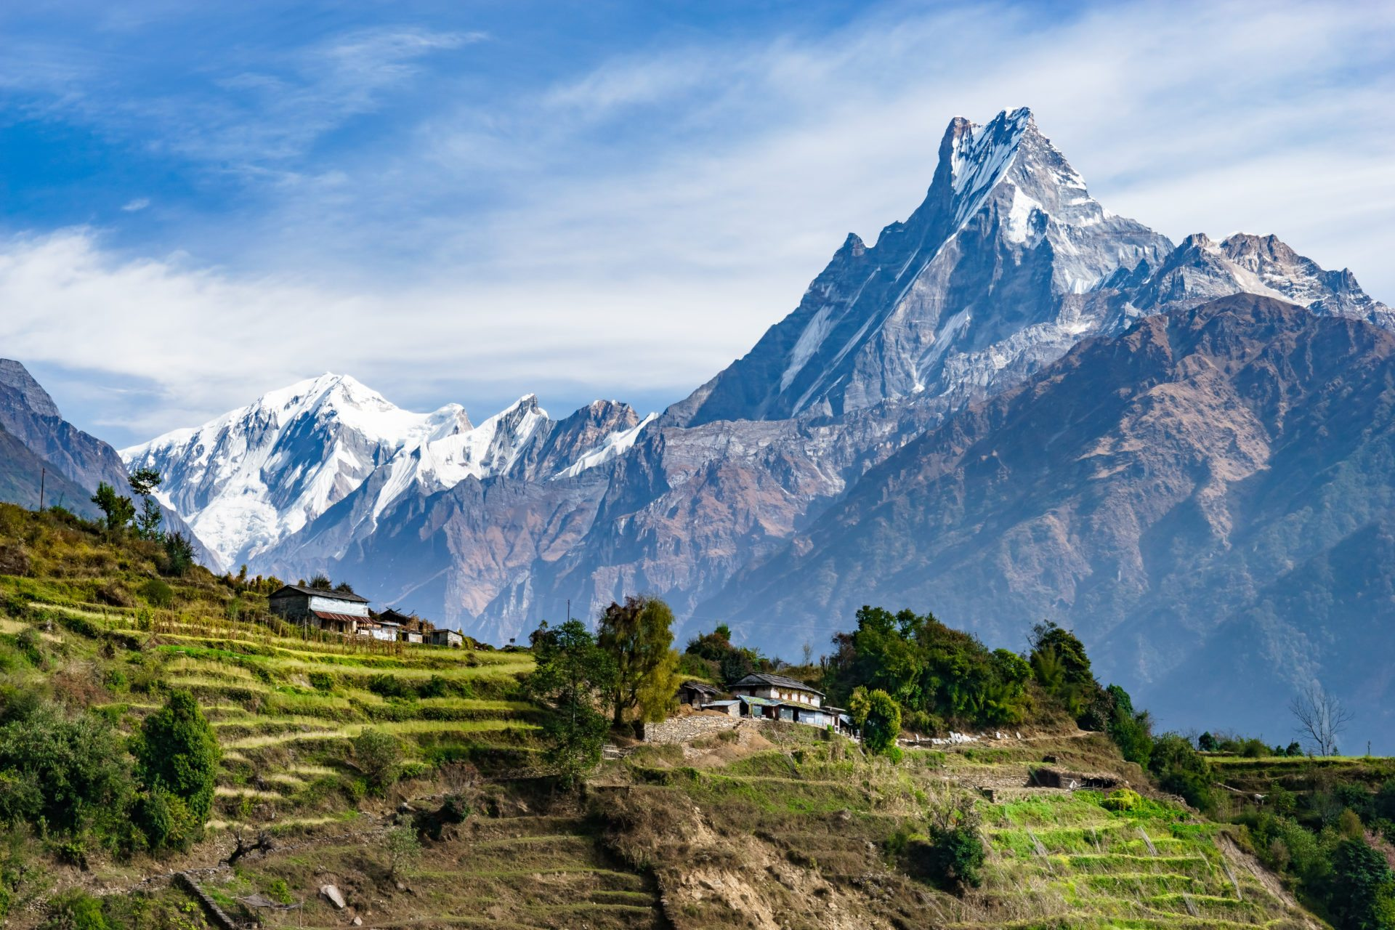
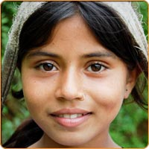
A HIMALAYAN NATION NEPAL

Slide 2
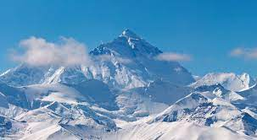
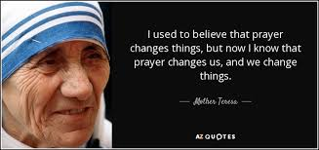
PRAYER FOR NEPAL

Slide 3
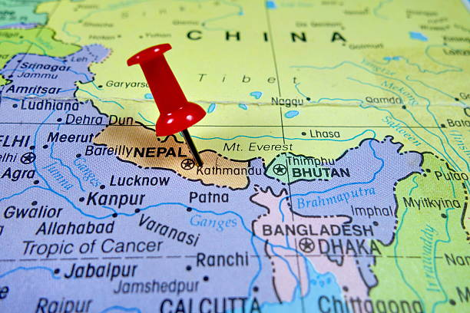
NEPAL
OPENED DOORS FOR THE CHRISTIANS IN 1950

Slide 4
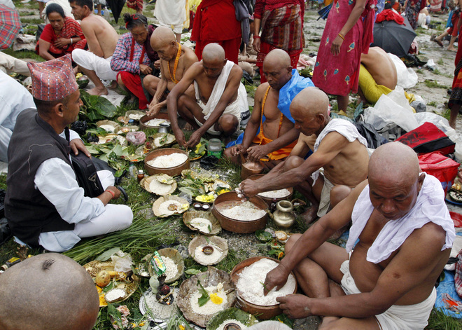
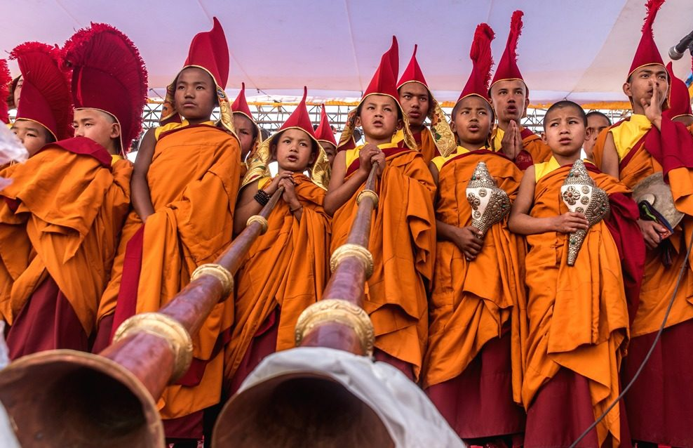
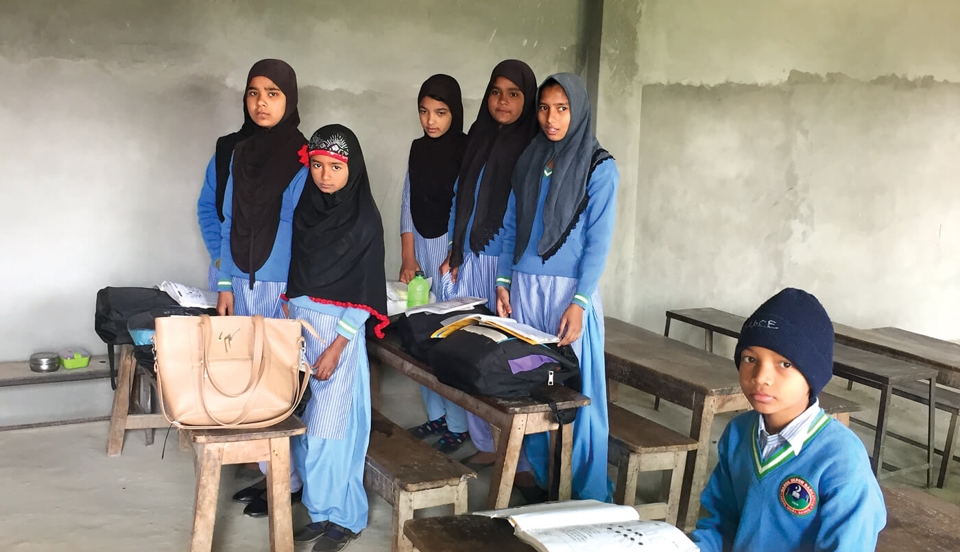
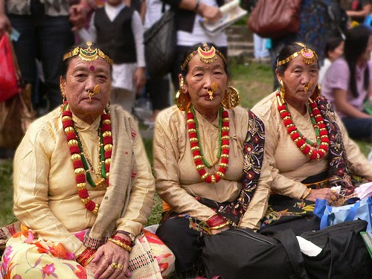
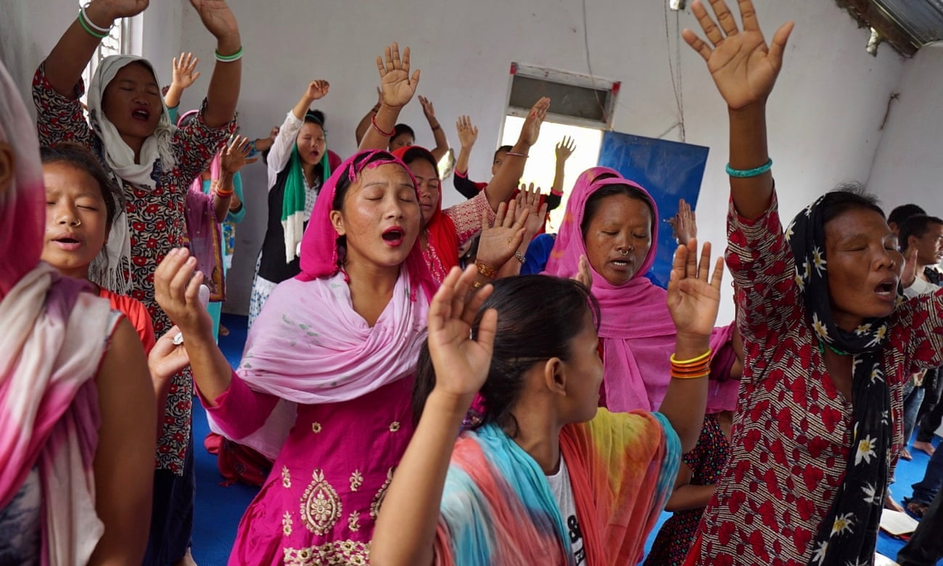
MAJOR RELIGIONS IN NEPAL
HINDUS: 81.3%
BUDDHISTS: 9%
ISLAM 4.4%
TOTAL POPULATION
ABOUT 30 MILLION
KIRATS 3.1 %
CHRISTIANS 1.4%
SOURCE: National Census 2011

Slide 5
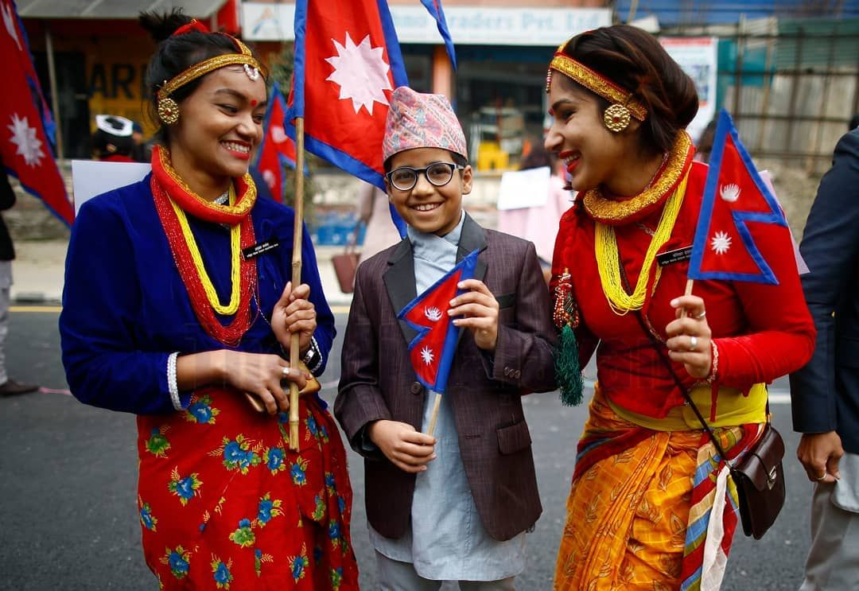
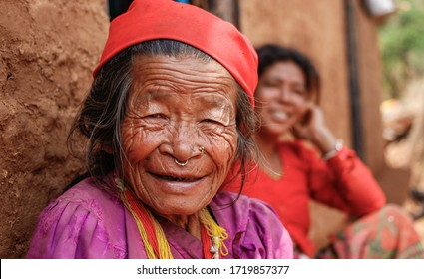
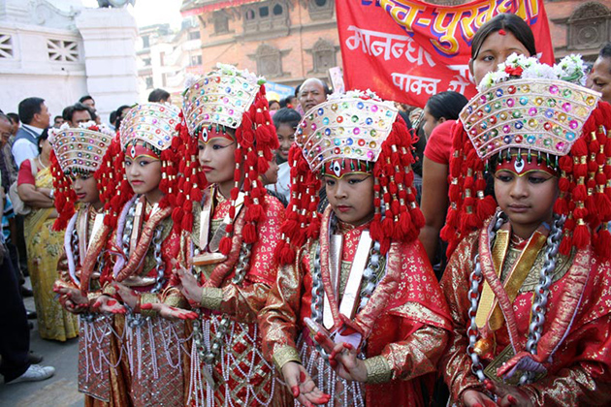
NEPAL
26 ETHNIC GROUPS IN NEPAL
LARGEST GROUP CHETTRI: 16.6%
BRAHAMINS (HILLS): 12.2%
MAGARS: 7.1%
NEWARS: 5%
YADAVS: 4%
Source: National Census 2011

Slide 6
NEPAL

Slide 7
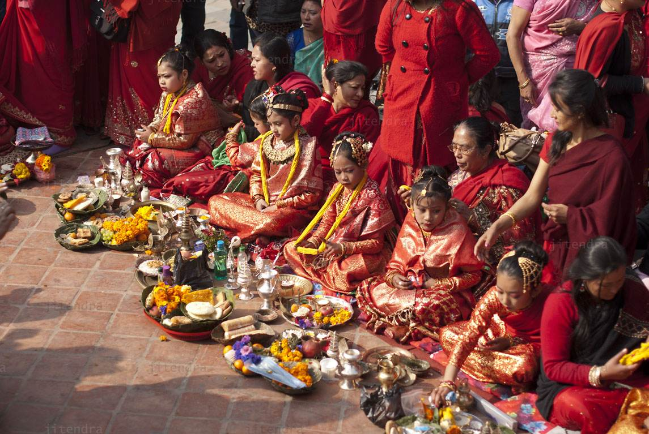
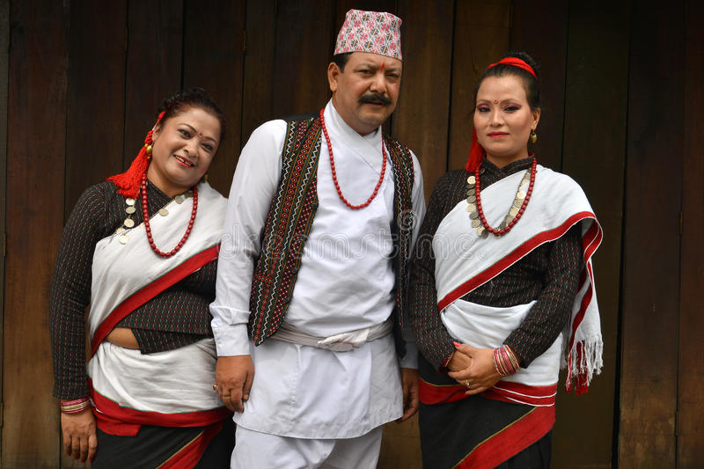
NEPAL
NEWARS
NEWARS IN THE CAPITAL CITY & REGIONS
POPULATION: (5%)
MAIN RELIGION: HINDUS, BUDDHISTS
LANGUAGE: NEWARI
MISSIONS: NEWAR MISSIONS ARE ON THE WAY
CHALLENGES: STRONG COMMUNITY

Slide 8
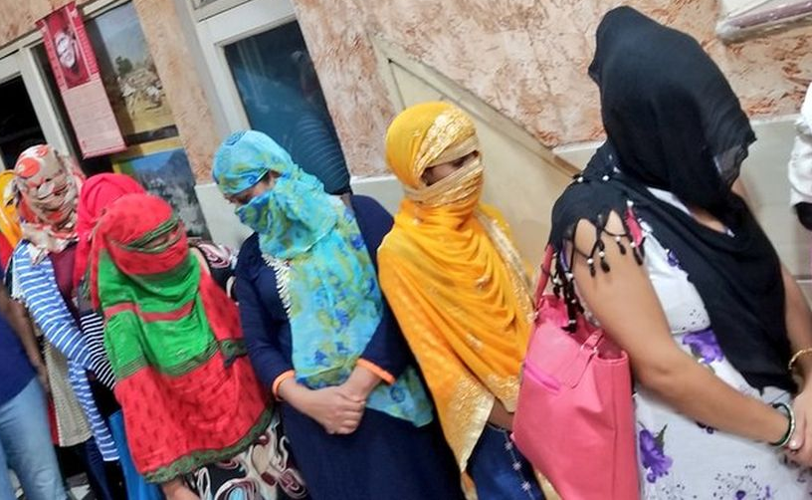
CHALLENGES IN NEPAL
POVERTY: 17.4 PERCENT PEOPLE LIVES IN MULTIDINENTIONAL POVERTY (UNICEF POVERTY INDEX 2021)
HUMAN TRAFFICKING
SEXUAL ABUSE
CHILD MARRIAGE
CHILD LABOR
CORRUPTION
UNSTABLE GOVERNMENT
UNEMPLOYMENT
MIGRATION

Slide 9
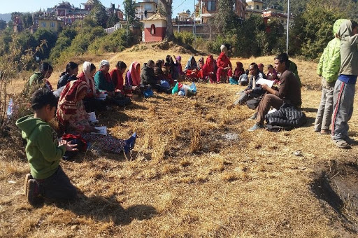
PRAISE GOD
MOVEMENTS AND MISSIONS
DINNOMINATIONAL MISSIONS
INDEPENDENT CHURCHES
PRAYER MOVEMENTS
KARNALI MISSIONS
HIMALAYAN MISSIONS

Slide 10
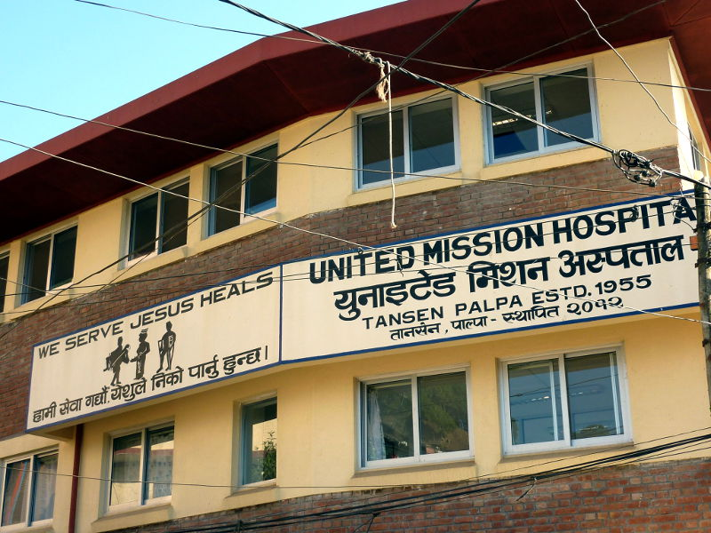
POVERTY ALLEVIATION
EDUCATION
HEALTH
COMMUNITY DEVELOPMENT
LIVELIHOOD
CHILDREN'S PROGRAM

Slide 11
PRAYER REQUESTS
Constituently Nepal is a secular state but proselytizing is considered as crime by the Criminal
Code 2017
1. Please pray that this law could be abolished so that there will be a complete freedom of religion and
belief.
2. Please pray for the unity among the churches in Nepal so that together we can achieve much more.
3. Please pray for the ongoing missions, movements and social works to be continued and more
people would be reached.
4. Please pray that the country could make progress and prosper, and also the issues like poverty,
human trafficking, abuses on children and women etc. would get rid off.
5. Please also pray for the stable government.
6. Please pray for the children that consists of 42% of the total population and among them about
50% are at risks.

Slide 12
If my people, who are called by my name, will humble themselves and pray and seek my face and turn from their wicked ways, then I will hear from heaven, and I will forgive their sin and will heal their land.
2 Chronicles 7:14

Slide 13
THANK YOU
PLEASE CONTINUE TO PRAY FOR NEPAL AND THE UNREACHED PEOPLE GROUPS

