Slide 1
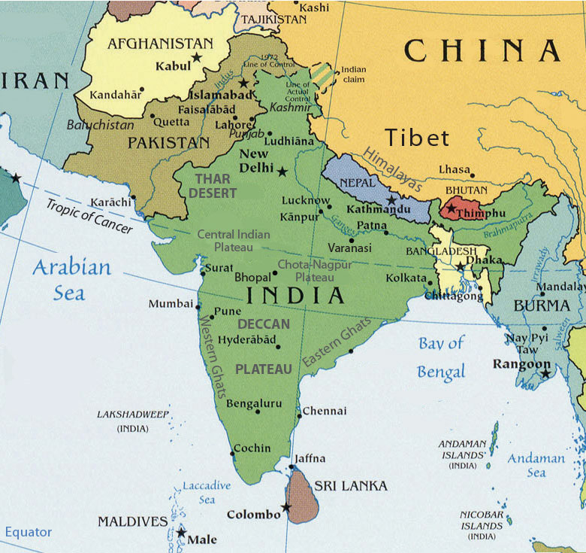
All Major
Religions:
Hindus:
Moslems:
Buddhists:
Sikh:
Jain:
Greatest
number
Of Lost Souls:
1.5 Billion.
Largest
Unreached
People
Groups:
3,600
28 Million
220 Million
If the GREAT COMMISSION is to be completed,
It must finish in Southern Asia!
1 Million
170 Million
1,383 Million
400,000
22 Million

Slide 2
7 Nations of Southern Asia & Population
All Major
Religions:
Hindus:
Moslems:
Buddhists:
Sikh:
Jain:
The Greatest
Number of
Lost Souls:
1.5 billion.
Largest
Unreached
People
Groups:
3,600
28 Million
220 Million
1 Million
170 Million
1,383 Million
400,000
22 Million

Slide 3
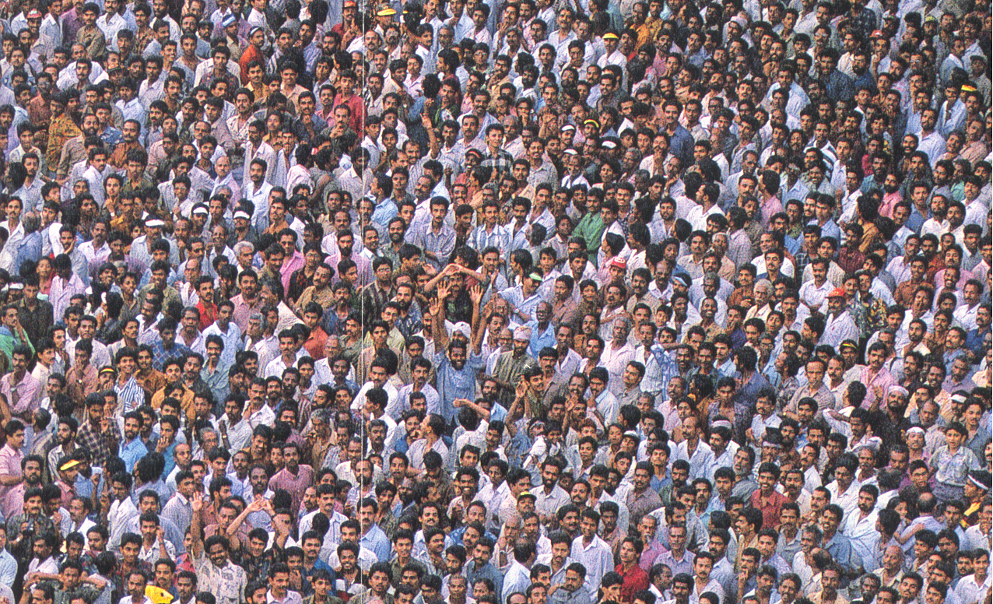
Paul’s Passion for the Lost
Key Phrases:
“By All Means Save some”.
2 Cor 9: 22. To the weak became I as weak, that I might gain the weak: I am made all things to all men, that I might by all means save some.
Where “Christ is not Named” – “They that have not heard.”
Romans 15: 20. Yea, so have I strived to preach the gospel, not where Christ was named, lest I should build upon another man's foundation:
21. But as it is written, To whom he was not spoken of, they shall see: and they that have not heard shall understand.

Slide 4
3. “ Whosoever”. – “How Can they hear?”
Romans 10:
13. For whosoever shall call upon the name of the Lord shall be saved.
14. How then shall they call on him in whom they have not believed? and how shall they believe in him of whom they have not heard? and how shall they hear without a preacher?
15. And how shall they preach, except they be sent?
4. “Regions Beyond.”
2 Corinthians 10:16
16 To preach the gospel in the regions beyond you, and not to boast in another man's line of things made ready to our hand.
5. “No Room in these Areas” -
Romans 15:22-23. In fact, my visit to you has been delayed so long because I have been preaching in these places.
23. But now I have finished my work in these regions, and after all these long years of waiting, I am eager to visit you.

Slide 5
The Greatest prayer is the prayer that has the Greater Listening capacity.

Slide 6
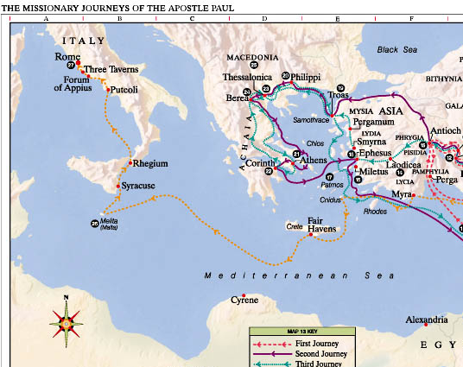
Key turning points of Acts:
Each of them has a key Prayer intervention.
1. Pentecost. Prayer – Acts 2.
2. Persecution. – Acts 3-4. Prayer in Acts 4.
3. Prayer Priority – Acts 6. Devoted to prayer.
4. Persecution after Stephen. Acts 8. Samarian revival – Ethiopian.
5. Conversion of Saul – Acts 9 - Damascus Church – Ananias vision and prayer.
6. Peter and Cornelius. – Acts 10 - Peter’s prayer in Joppa.
7. Antioch Missions Prayer. Acts 13
8. Turn from Asia to Europe – the Macedonian Call – Acts 16.

Slide 7
The Great Commission and The GREAT PROPHECY
Matthew 24:14.
“And this gospel of the kingdom shall be preached in all the world for a witness unto all nations; and then shall the end come.

