Slide 1
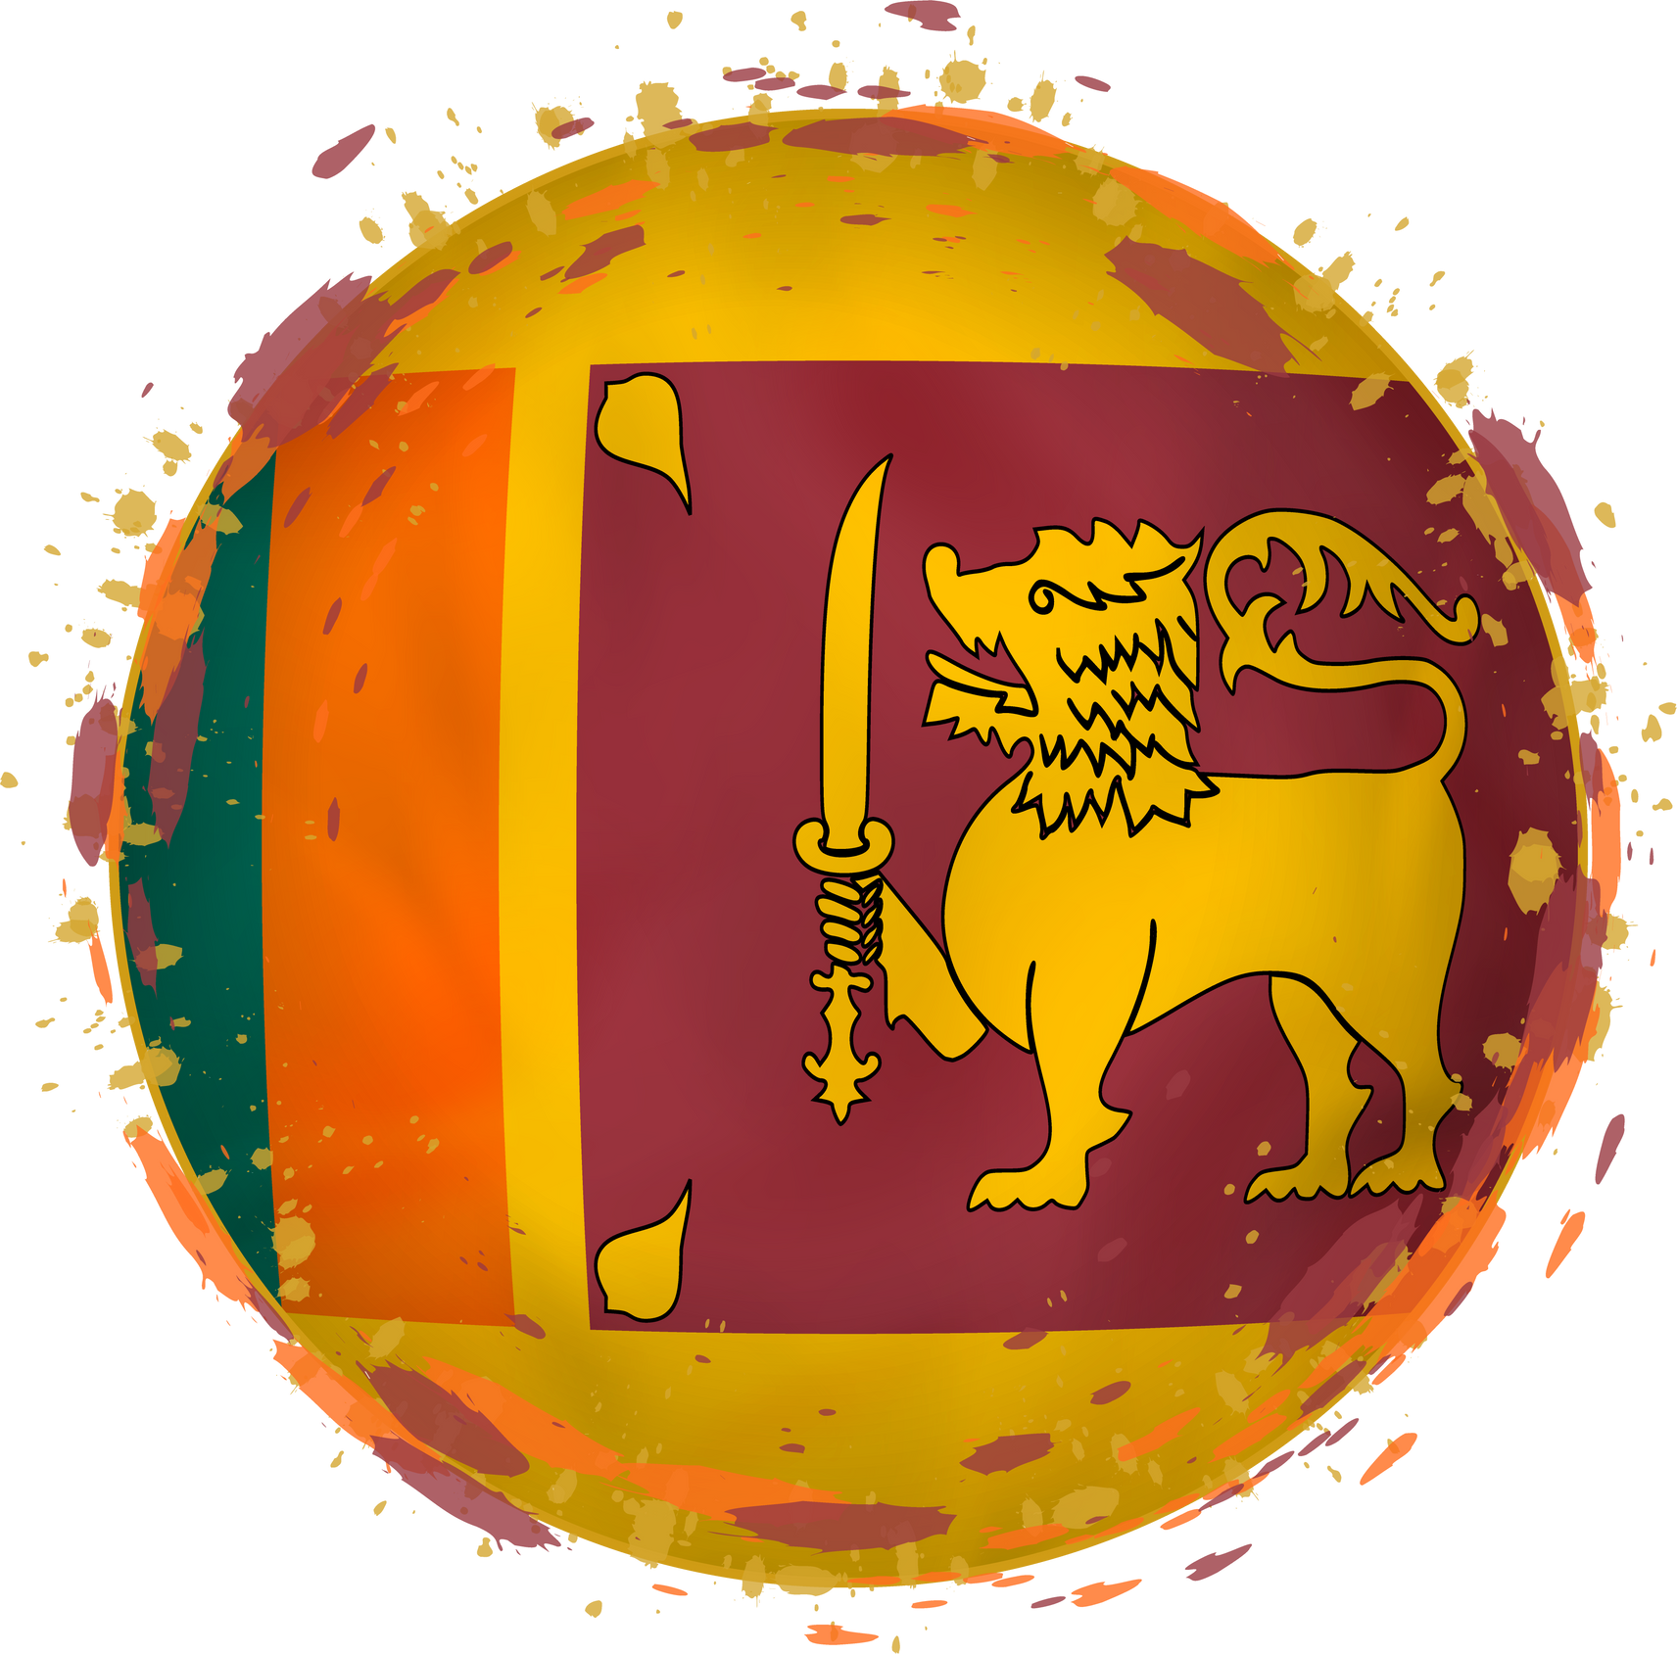
SRI LANKA
THE
UNFINISHED
TASK
IN OUR
NATION
Prayer Conference – India 2022

Slide 2
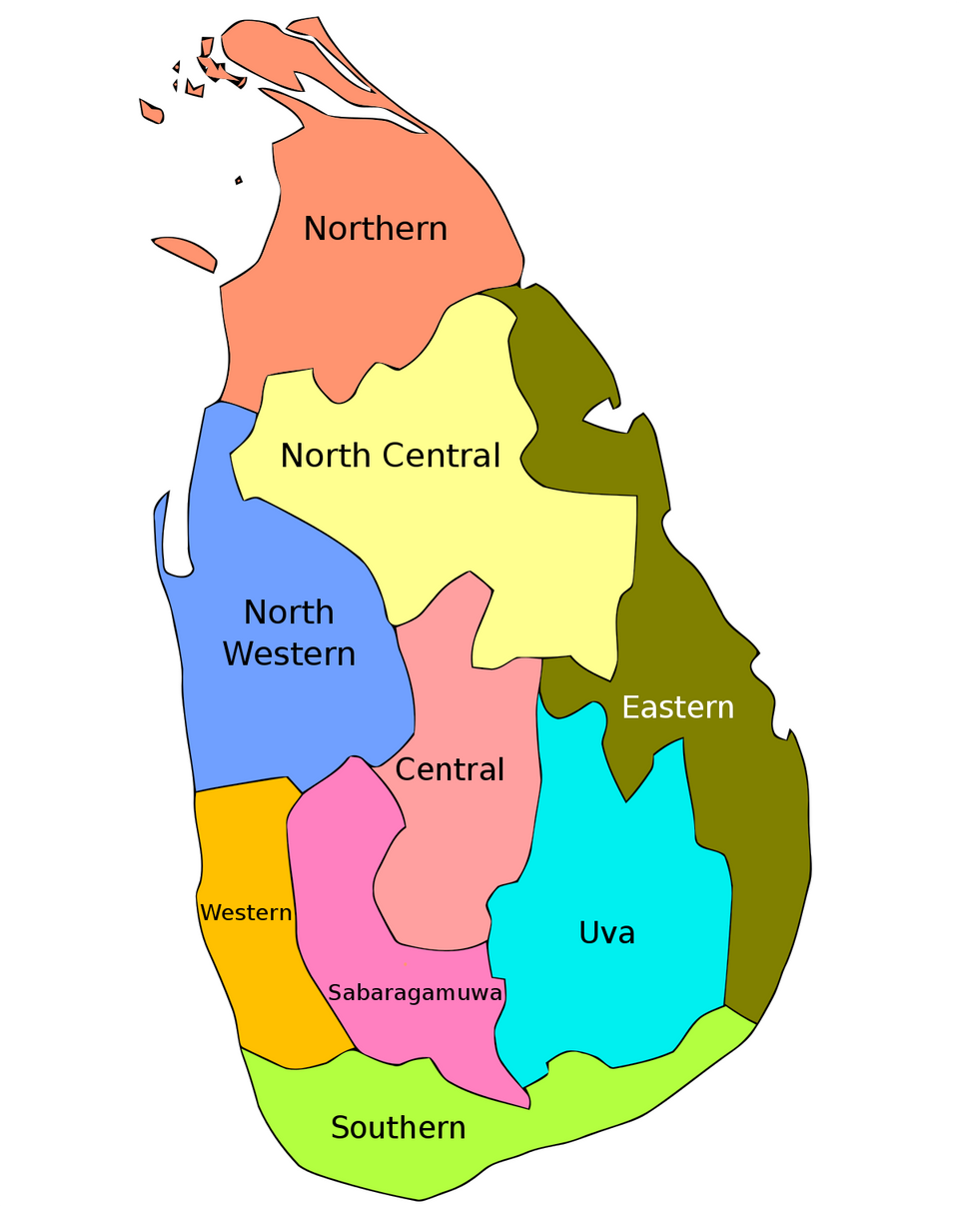
POPULATION
20,263,723 PEOPLE
LIVING ACROSS:
9 PROVINCES
25 DISTRICTS
331 DIVISIONAL SECRETARIATS
14,022 G/S DIVISIONS
IN 38,318 VILLAGES

Slide 3
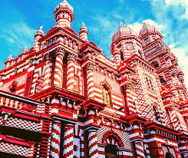
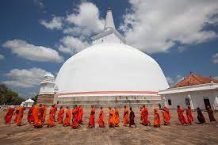


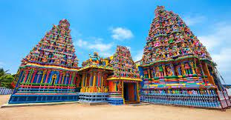
FAITHS
BUDDHIST 14,222,844 (70%)
HINDUS 2,554,606 (12.6%)
ISLAM 1,967,227 (9.7%)
CATHOLIC 1,237,038 (6.1%)
CHRISTIAN 272,568 (1.3%)
OTHERS 9,440 (0.3%)

Slide 4
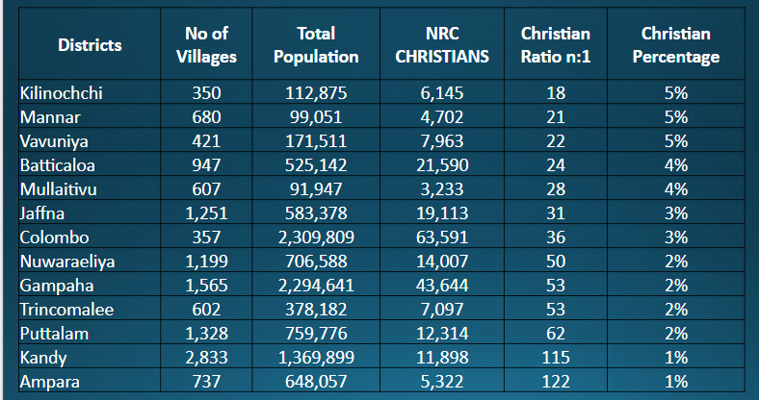
OUR REACH

Slide 5
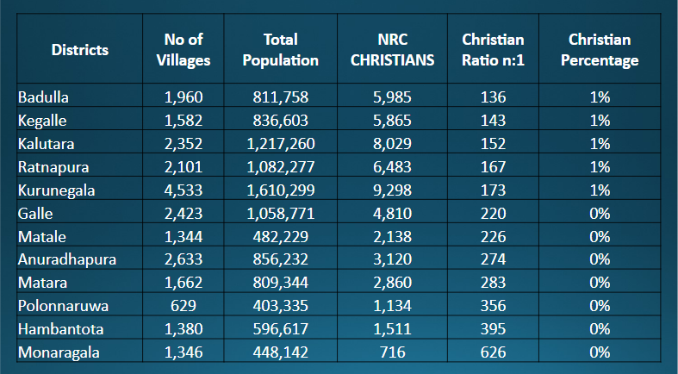
OUR REACH

Slide 6
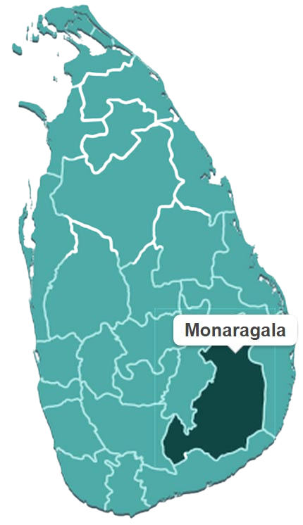
LEAST REACHED
MONARAGALA DISTRICT - 448,142
  BUDDHISTS 423,648 (94.5 %)
  HINDUS 12,522 (2.8 %)
  ISLAM 9,702 (2.1 %)
  ROMAN CATHOLICS 1,508 (0.3 %)
  OTHER CHRISTIANS 716 (0.1 %)
  OTHERS 46 (0.01%)
POPULATION BELIEVERS
448,142 716
CHRISTIAN : NON CHRISTIAN RATIO 1: 625

Slide 7
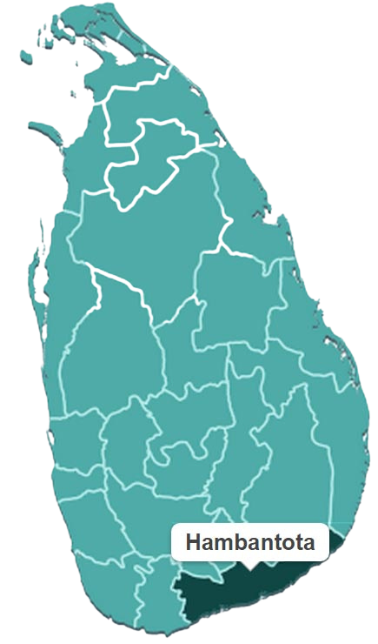
LEAST REACHED
HAMBANTOTA DISTRICT - 596,617
  BUDDHISTS 577,284 (96.7 %)
  HINDUS 1,243 (0.2 %)
  ISLAM 15,163 (2.5 %)
  ROMAN CATHOLICS 1,098 (0.1 %)
  OTHER CHRISTIANS 1,511 (0.2 %)
  OTHERS 318 (0.05%)
POPULATION BELIEVERS
596,617 1,511
CHRISTIAN : NON CHRISTIAN RATIO 1: 394

Slide 8
HOSTILITY TO THE GOSPEL
BACKGROUND AND CONTEXT
  A rise in Sinhala-Buddhist nationalism in the post-war period leading to the formation of Buddhist extremist groups, the politicisation of religion and vice versa, the proliferation of anti-minority rhetoric and a culture of impunity for proponents of religious violence.
  Since 2010, around 1000 incidents of religious liberty violations against Christians; 4 mass-scale anti-Muslim riots and several anti-Hindu incidents have been reported
  54% increase of FoRB violations against Christians 2020-2021
  Minority communities being scapegoated and blamed for the spread of COVID-19
  A shift towards authoritarian governance through constitutional amendments undermining democratic processes, weakening the independence of the judiciary and impairing the rule of law.

Slide 9
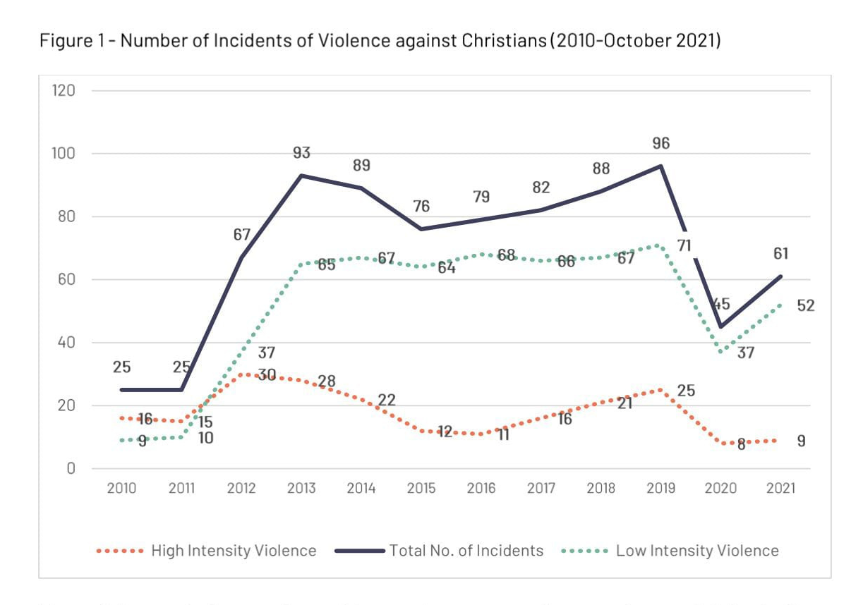
HOSTILITY TO THE GOSPEL

Slide 10
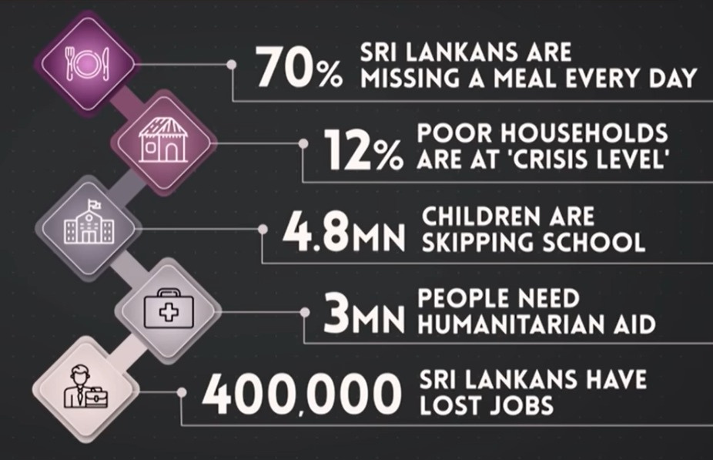
SRI LANKA IN CRISIS

Slide 11
SRI LANKA IN CRISIS
HOW SERIOUS IS THE CRISIS?
  Sri Lanka’s debt-laden economy has “collapsed” as it runs out of money to pay for food, fuel and medicine.
  The island is relying on help from neighboring India, China and from the International Monetary Fund (IMF).
  Sri Lankans are skipping meals as they line up for hours to buy scarce fuel and cooking gas.
  The government owes $51bn and is unable to make interest payments on its loans.
  Tourism, an important engine of economic growth, sputtered because of the pandemic.
  Country’s currency has collapsed by 80 percent, making imports more expensive and worsening inflation.
  The result is a country on the edge of bankruptcy, with hardly any money to import fuel, milk, medicine and even toilet paper.

Slide 12
SRI LANKA IN CRISIS
EXTERNAL DEBT
  Sri Lanka's foreign debt increased substantially, going from USD 11.3 billion in 2005 to USD 56.3 billion in 2020.[ While foreign debt was about 42% of the GDP in 2019,it rose to 119% of its GDP in 2021.
  On 12 April 2022, Sri Lanka announced that it will be defaulting on its external debt of $51 billion
  The country's tourism sector represented over one-tenth of the GDP of Sri Lanka.[83] The sector was negatively affected by the 2019 Easter bombings, and the COVID-19 pandemic prevented recovery.[35] Tourism earned Sri Lanka $4.4 billion and contributed 5.6% to GDP in 2018, but this dropped to just 0.8% in 2020.
  On 6 April 2022, the CBSL allegedly printed 119.08 billion rupees, making it the highest reported amount printed on a single day by the CBSL for the year 2022. The total money added to financial markets for the year 2022 increased to Rs. 432.76 billion.
TOURISM
MONEY PRINTING

Slide 13

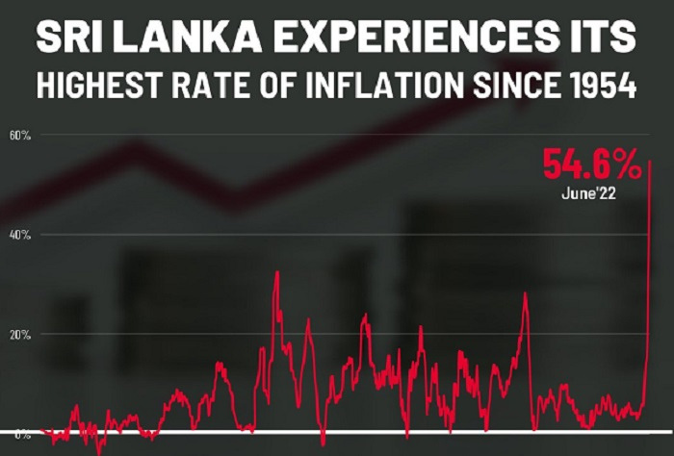

SRI LANKA IN CRISIS
Accordingly, Food inflation (Y-o-Y) increased to 80.1% in June 2022 from 57.4% in May 2022, while Non-Food inflation (Y-o-Y) increased to 42.4% in June 2022 from 30.6% in May 2022.

Slide 14
SRI LANKA IN CRISIS
WFP report on approx. 6 million faced with Hunger in the next 6 months
SME association states that 4 million are at the risk of losing their jobs in the next year.
Youth and children are undergoing serious mental stress due the prevailing situation
Massive brain Drain - Loss of Hope especially Youth and young adults
Segments of Youth are moving into violence as an option for course correction
Undermining of law and order, corruption and mismanagement of the countries resources
Increase of family breakdown. 400 divorces a day according to official stats
Desperately need credible leadership in our nation

Slide 15
THE CHURCH IN RESPONSE
1) Stronger national prayer emphasis
2) Unity of the church of Sri Lanka
3) The Gospel is penetrating into unreached areas and people groups as the ground is fertile
4) God is positioning the Church of Sri Lanka to be the Antioch of Asia

Slide 16
THE CHURCH IN RESPONSE
COMMON STRATEGIC OBJECTIVES TO REACH OUR NATION:
  Establishing a congregation for every village and neighborhood (Missional Families- House Churches)
  Lay Missionary Movements - To mobilize the whole body of Christ in Sri Lanka.
  To work strategically towards discipling People of all segments and groups in our country.

Slide 17
Prayer Needs
The political stability of the nation. Especially as there is a Parliamentary election to decide the next president tomorrow.
For the economic stability of the nation.
The church to rise up at this time of need.
For the protests to continue peacefully and there won’t be any act of violence during the process.
With the pandemic, political and economic stability we need that young Christian leaders step forward during this time.
God’s grace towards the Youth and Children of the our nation at this difficult time.

Slide 18
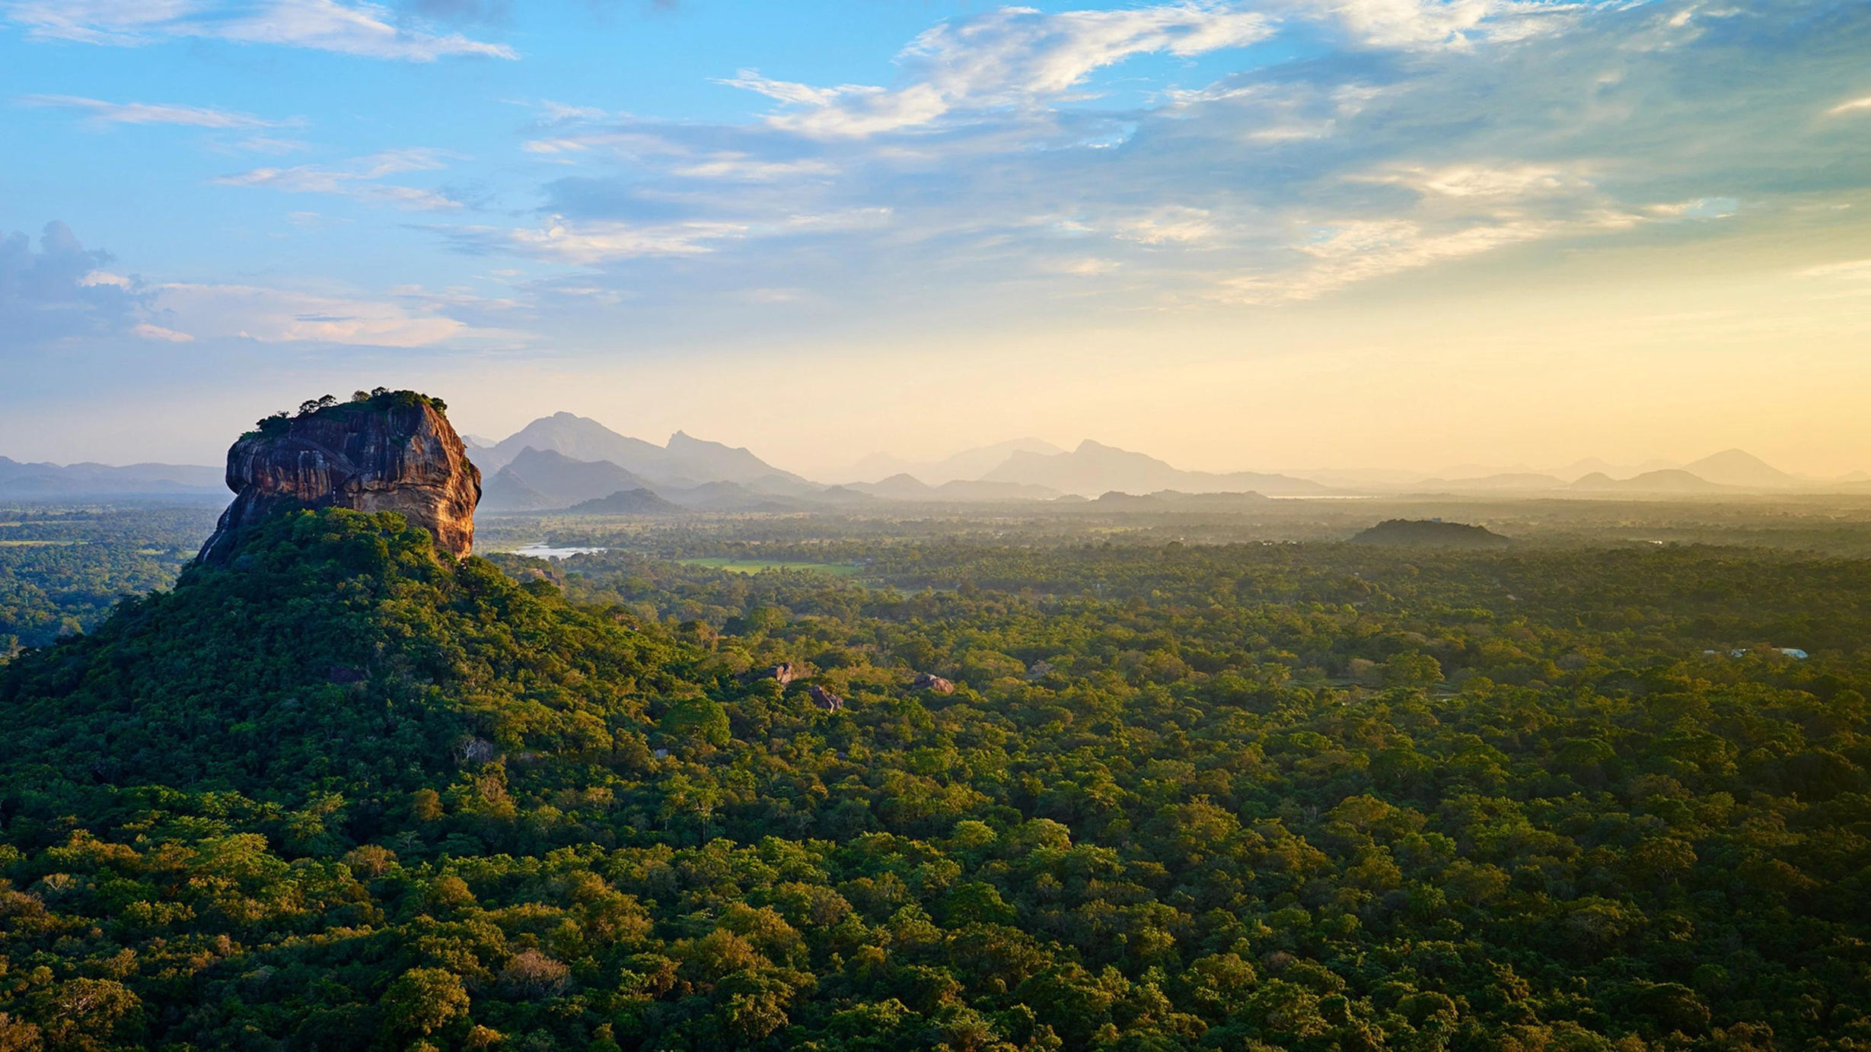
THANK YOU
FOR PRAYING FOR
SRI LANKA

