Slide 1
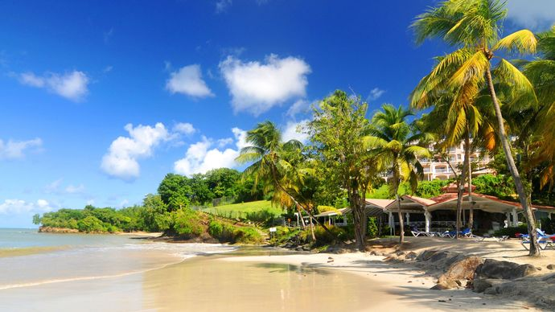

Maldives

Slide 2
Republic of Maldives, Maldive Islands,
Independent island country in the north-central Indian Ocean.
It consists of a chain of about 1,200 small coral islands and sandbanks (some 200 of which are inhabited),
Grouped in CLUSTERS, or ATOLLS. ( Atoll means States )

Slide 3
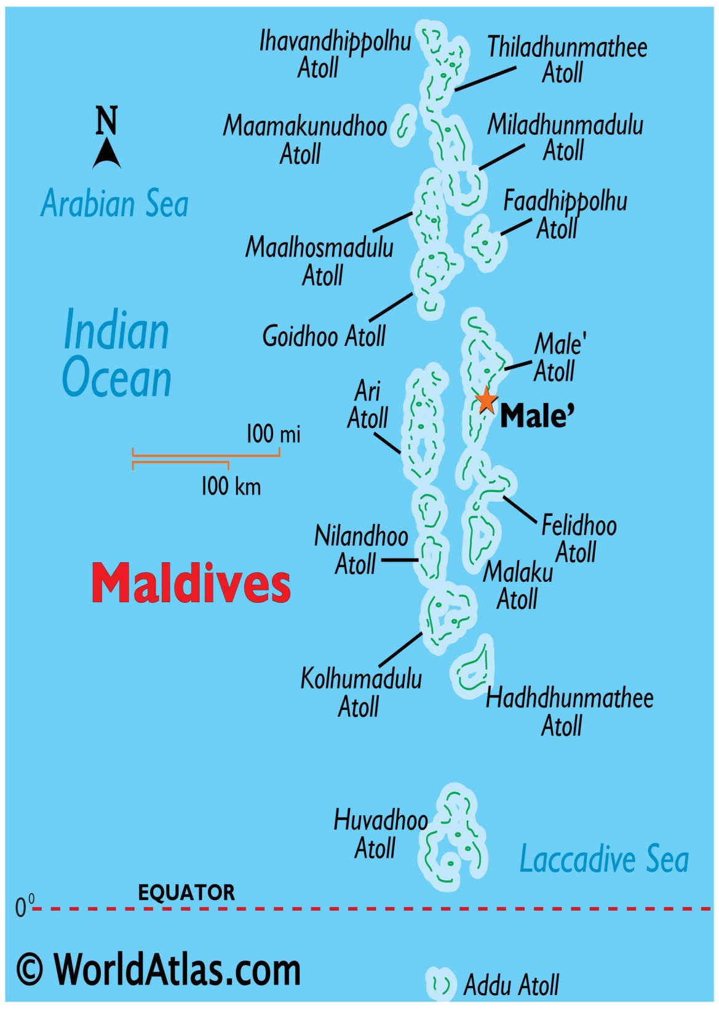

Slide 4
The islands extend more than 510 miles (820 km) from north to south and 80 miles (130 km) from east to west.
The northernmost atoll is about 370 miles (600 km) south-southwest of the Indian mainland, and the central area, including the capital island of Male’ , is about 400 miles (645 km) southwest of Sri Lanka

Slide 5
The Maldives Islands are submerged ancient volcanic mountain range.
low-lying, none rising to more than 6 feet (1.8 metres) above sea level.
The average annual temperature varies from 76 to 86 °F (24 to 30 °C).
Rainfall averages about 84 inches (2,130 mm) per year.

Slide 6
Physical features of Maldives
People
The population of Maldives belongs almost entirely to the Maldivian ethnic group.
The first settlers, it is generally believed, were Tamil and Sinhalese peoples from southern India and Sri Lanka.
The official language is an Indo-European language called Dhivehi (or Maldivian); Arabic, Hindi, and English are also spoken. Islam is the state religion.

Slide 7
Economy
. Annual growth of gross domestic product(GDP) has been high, averaging about 6 percent in the 2010s,
The economy is based on tourism, fishing, boatbuilding, and boat repairing, with the tourism sector driving the rapid growth.

Slide 8
Tsunami
In December 2004 the Maldives was damaged by a large tsunami caused by a massive earthquake in the Indian Ocean off Indonesia. Scores of people were killed, and much property was damaged.

Slide 9
The Portuguese forcibly established themselves in Male from 1558 until their expulsion in 1573.
In the 17th century the islands were a sultanate under the protection of the Dutch rulers of Ceylon (Sri Lanka),
after the British took possession of Ceylon in 1796, the islands became a British protectorate,
A republic was proclaimed in 1953, but later that year the country reverted to a sultanate.

Slide 10
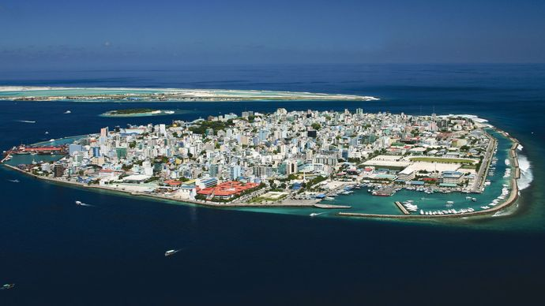
Male
Male, Maldives.

Slide 11
Persecution
The official stance of the Maldivian government is that no non-Muslim can be a citizen. Their constitution officially says: “Despite the provisions of article [9](a) [which explains the normal terms of citizenship] a non-Muslim may not become a citizen of the Maldives.”

Slide 12
PERSECUTION
Maldives removed church image from school textbook
Indian teacher arrested and deported for owning a Bible
Maldives activist investigated for ‘blasphemy’ over ‘religions other than Islam’ tweet.
Maldives elections unlikely to improve religious freedom

Slide 13
Expatriate workers
There are non-citizens who reside on the islands, mainly expatriate workers. These are not allowed to publicly practice their religion or evangelize, although they are technically allowed to practice in private. The law states, “Non-Muslims living in or visiting the country are prohibited from openly expressing their religious beliefs, holding public congregations to conduct religious activities, or involving Maldivians in such activities.”

Slide 14
Bible in Maldivian Language
Christian materials are difficult to come by in the Maldives. The official language is Dhivehi, and the Bible has not yet been completely translated into this language. Even if it was, the government closely monitors materials coming into the country and does not allow materials that are deemed contrary to Islam.

Slide 15
Jihadist in Maldives
Maldives has the highest number of jihadist fighters per capita in the world: approximately 200 individuals have left Maldives to fight for ISIS, and these terrorists are welcomed back home as heroes.

Slide 16
GOD CALLED ME ( ROM- 15 : 20,21)
God called us to reach the people of Mald!ves country where the b!ble is banned and chvrch is not allowed, gospel preacher is jailed.
God took me to Maldives in the year of 2006 with blessing of a job as Civil Engineer in an island which is close to the capital of the country.
We used to gather in the beach while I was in the country and God blessed me with the language also.
God called us to reach the people of Mald!ves country where the b!ble is banned
and chvrch is not allowed, gospel preacher is jailed. God took me to Maldives in the year of 2006 with blessing of a job as Civil Engineer in an island which is close to the capital of the country. We used to gather in the beach He blessed me with the language also. He gave me the burden to reach the people but I did not get any chance later. Last January He opened door to visit the country for short trip to share the good news .
It was a great experience to share the good news to some Maldivians and one believed in gospel .Moreover my old company but different MD asked me to join in his company as Engineer again. then I and my wife were praying for the will of God. Then God spoke to us to go. At first I came to this country and after 45 days my family came here. God blesses the ministry very well as I am trying to meet Locals as many as possible and sharing good news.
Some are positively reacted with the gospel.

Slide 17
GOD BROUGHT ME (Gen – 12 :1 , 2 )
He gave me the burden to reach the people but I did not get any chance later.
Last January He opened a door to visit the country for short trip to share the good news .

Slide 18
PRAYER MOVEMENT
God helped me to gather in Whatsapp group with 22 prayer warriors to pray for Maldives Revival
20 Prayer Warriors adopted 20 Atolls each and focusedly pray daily

Slide 19
PRAYER WALK
God gave me a plan to go to each Atoll and do prayer walk for each Atoll
I initiated Prayer walk in 4 islands for now. I planned to go all Atolls also

Slide 20
By God’s grace, ministry of five month gospel sharing and follow up one Maldivian baptized

Slide 21
THANK YOU

